Slide 1
LO: to reflect
C: Islam

Slide 2

What different ways can Muslims show their commitment to God?

Slide 3
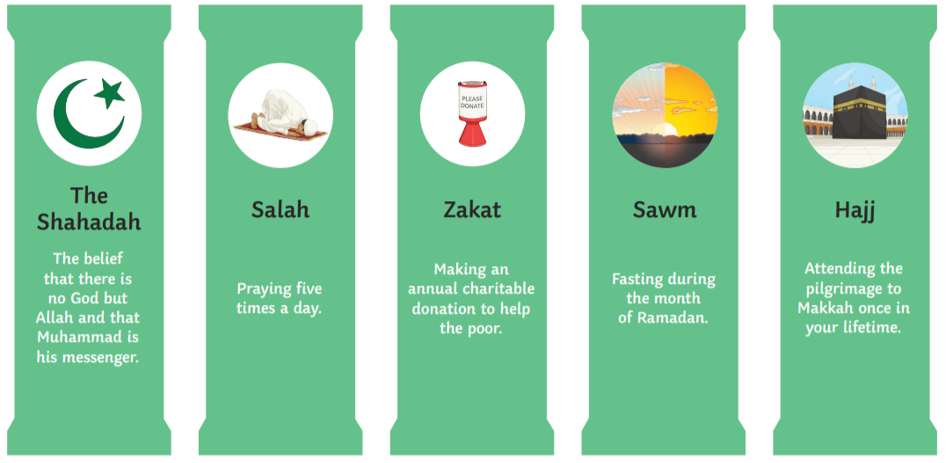
What are the 5 Pillars of Islam?
What have you learned about these pillars during our topic?
Create a bubble map.

Slide 4
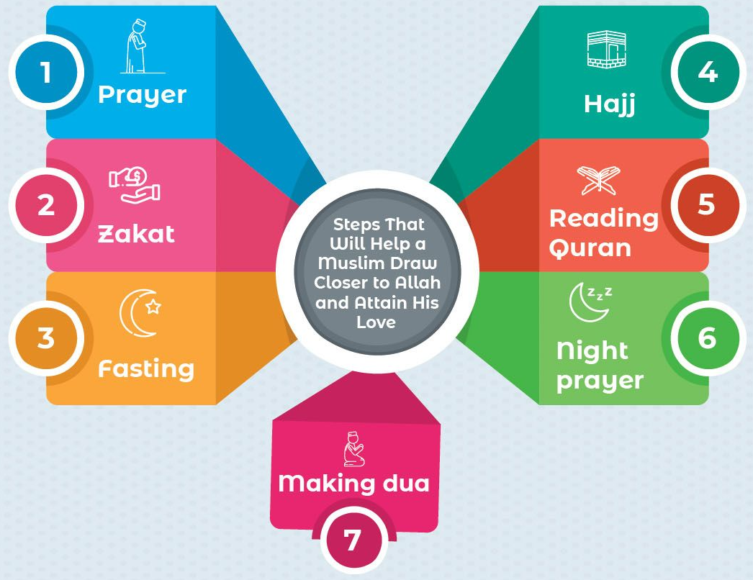
Which one shows the most commitment? Why?
Is there only one answer?
Consider your thoughts/ideas in response to the question:
What is the best way for a Muslims to show commitment to God?

Slide 5

Even if you do not think it is necessary to pray 5 times each day, give to charity, fast during Ramadan and visit Mecca, often being committed to someone or something means putting them before yourself and doing things that are difficult or you may not want to do.
Commitments are not always easy to stick to.

Slide 6
Activity
Paddling: put the 5 different commitments that Muslims show to Allah in order of importance. Write an explanation for why you have ordered them this way.
Snorkelling (in pairs) and Diving (independently):
If I could only choose one pillar that I think most helps a Muslims to be a better Muslim, I would choose…because…
Prepare a short speech that answers the following questions:
  How does the pillar help a Muslim show their commitment to God (Allah)?
  How does the pillar draw the person closer to Allah?
  How does the pillar help the person demonstrate their faith to others?

Slide 7
Red Pen
Paddling: Which pillar of duty do you think you would find most challenging to follow? Why?
Snorkelling and Diving: Why do you think Muslims choose different ways to show their commitment to God? Explain your answer.

