Slide 1
Owning our learning charter
PSHCE

Slide 2

Consider if you…
Have ever voted on something.
Have ever seen politicians on TV discussing and debating.
Have ever felt that you have not been listened to.
Feel that this school does listen to you.
Have ever lost an argument.
Have ever won an argument.
Have ever felt disappointed that something you voted on didn’t win the vote.

Slide 3
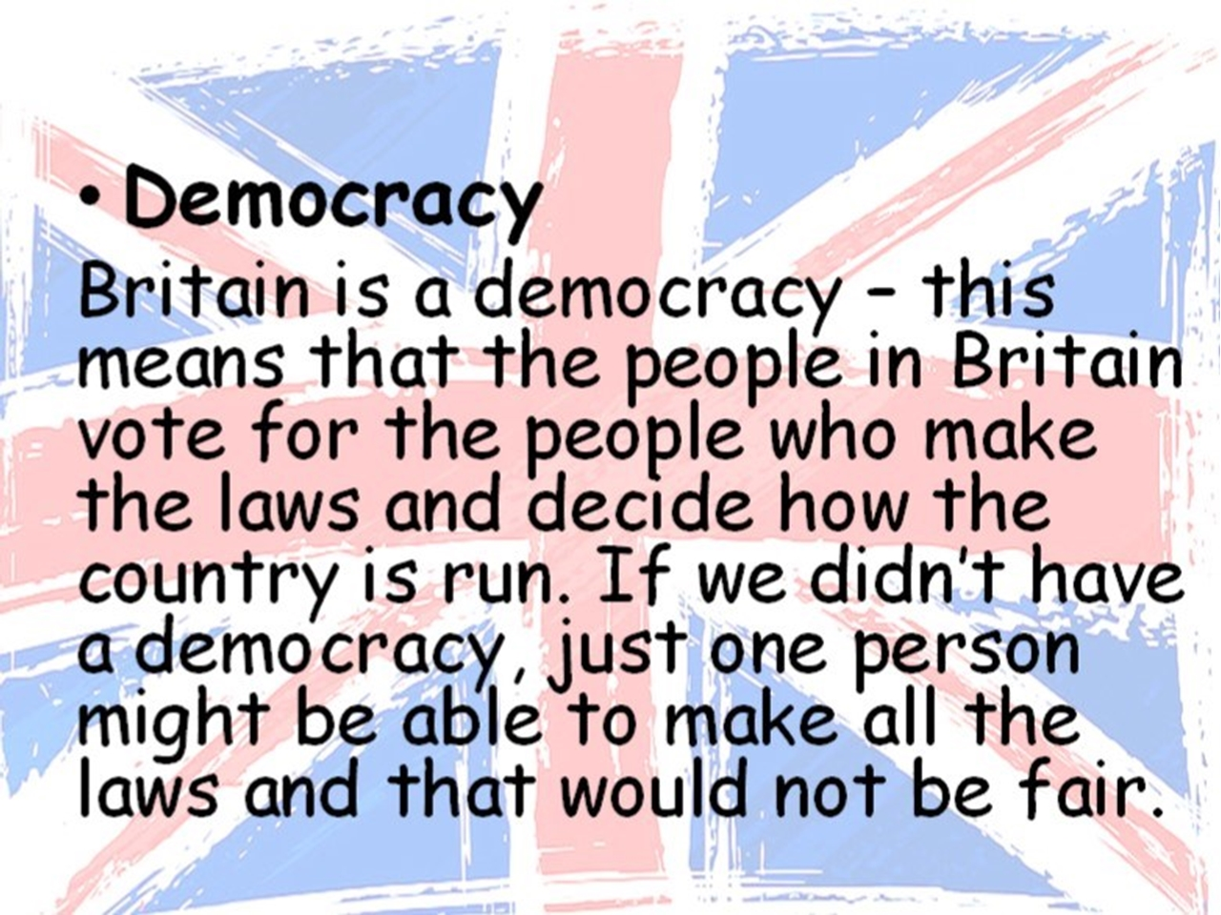
Democracy is important!
It is important for people to have their say and be listened to.
It is important to be able to vote and accept a democratic decision.
In most countries, this is how the Government works.
In Law Courts, there is a similar process.

Slide 4

What makes group work effective?

Slide 5
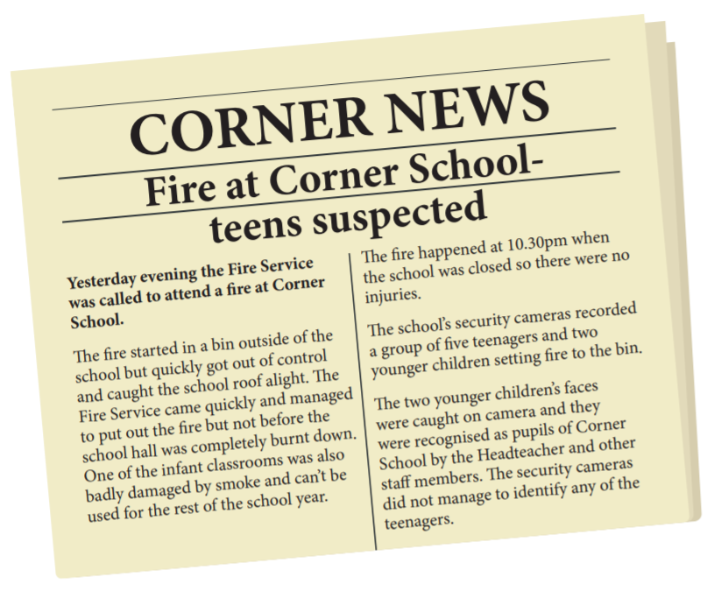
Look back at the role play cards from last week.
Remind yourself of the roles and the scenario being discussed.

Slide 6
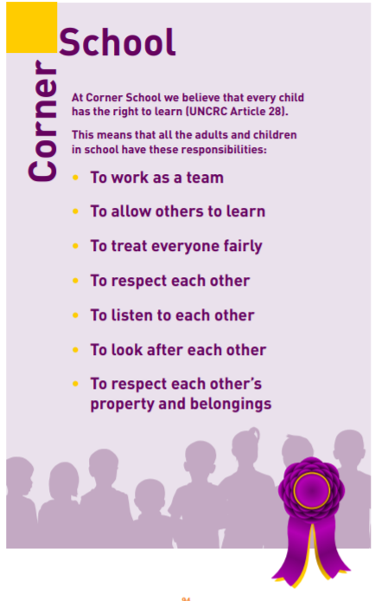
What parts of the Corner School’s Learning Charter have been broken by the children in the scenario?
Do you think Corner School’s Learning Charter applies to outside of school hours as well as when the children are in school?

Slide 7
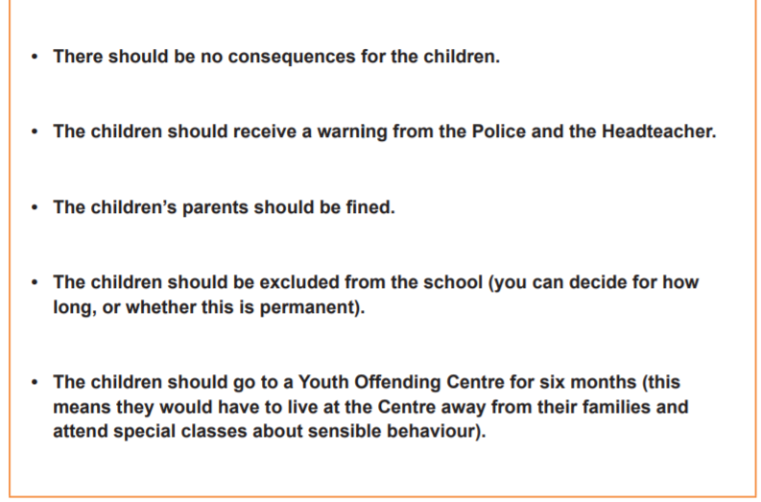
Decide on the appropriate consequence or consequences for the two children in the scenario, choosing from those listed.
Do you understand all of the consequences?
You will need to justify your choice.

