Slide 1

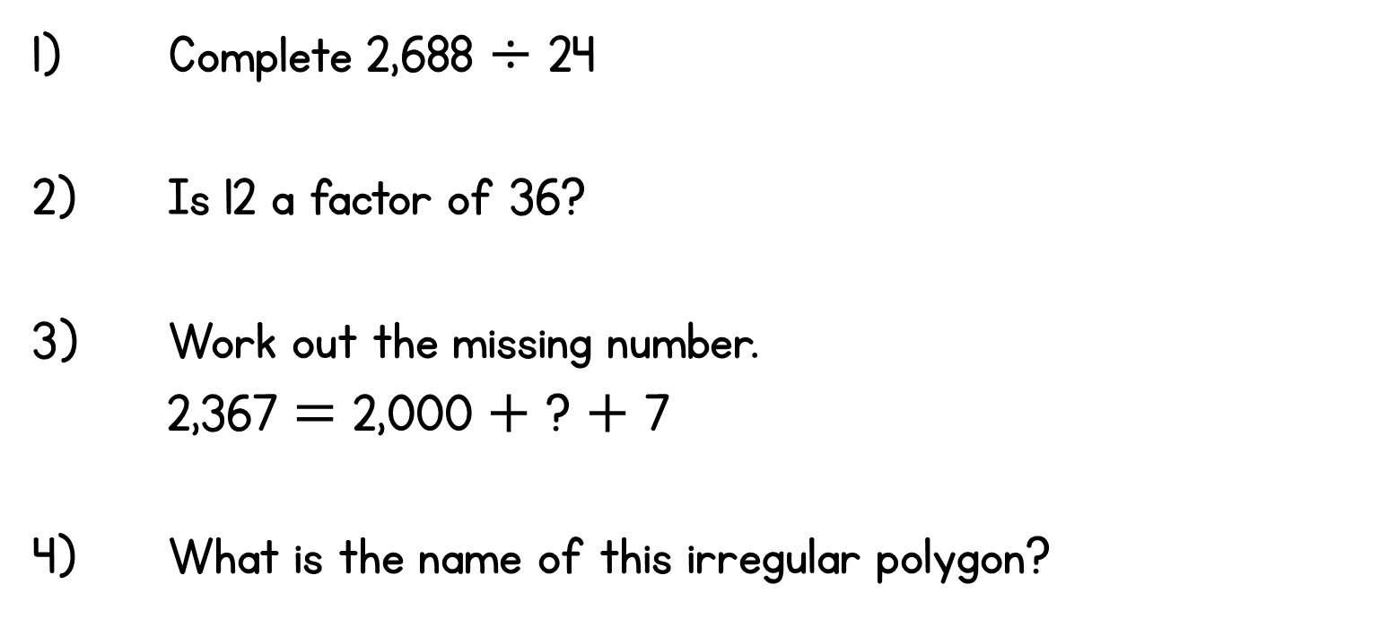

Year 6 | Week 5 | Day 3

Slide 2


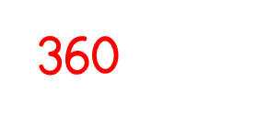

Year 6 | Week 5 | Day 3

Slide 3


Arithmetic Starter

Slide 4
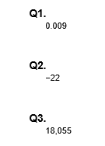
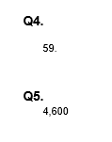
Arithmetic Starter - Answers

Slide 5


Slide 6
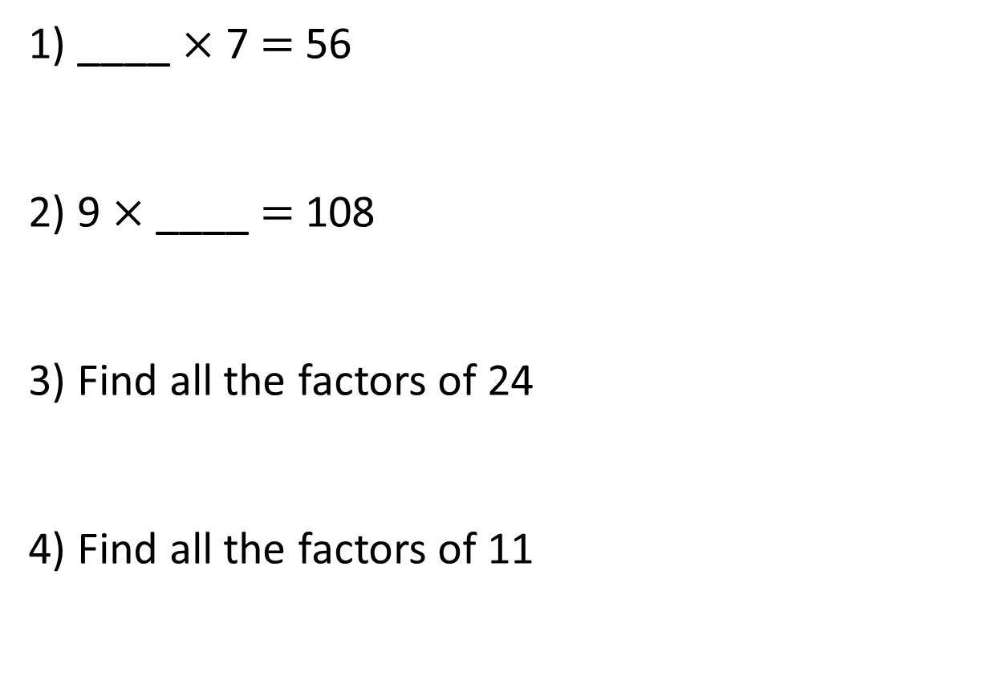
1) ____ $×$ 7 $=$ 56
2) 9 $×$ ____ $=$ 108
3) Find all the factors of 24
4) Find all the factors of 11

Slide 7
8
1) ____ $×$ 7 $=$ 56
2) 9 $×$ ____ $=$ 108
3) Find all the factors of 24
4) Find all the factors of 11
12
1, 2, 3, 4, 6, 8, 12, 24
1, 11

Slide 8
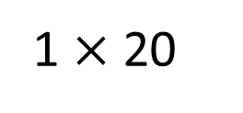
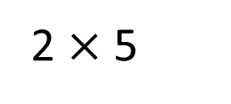
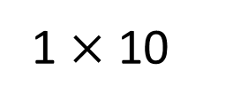
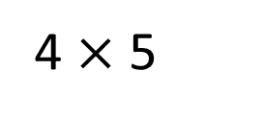
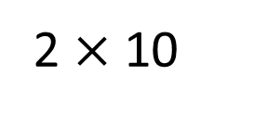
Find all the common factors of 10 and 20
1 $×$ 10
10
1 $×$ 20
20
4 $×$ 5
2 $×$ 5
2 $×$ 10
1, 2, 5, 10
1, 2, 4, 5, 10, 20
Common factors: 1, 2, 5, 10

Slide 9

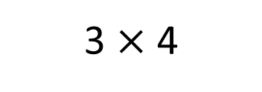
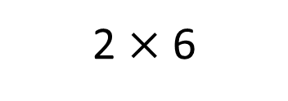
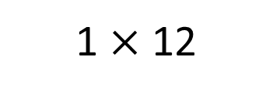
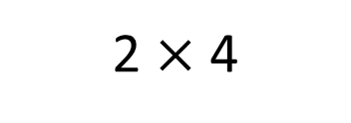
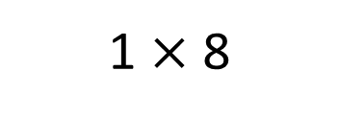
Complete the Venn diagram
Factors of 12
Factors of 8
1 $×$ 12
1 $×$ 8
2 $×$ 6
3
8
3 $×$ 4
1
2 $×$ 4
12
2
4
6
Have a think

Slide 10
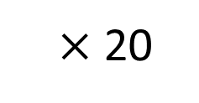
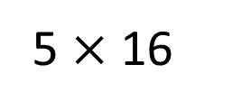
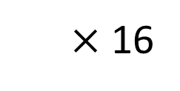
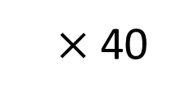
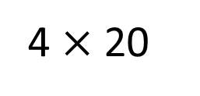
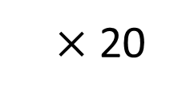
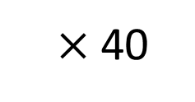
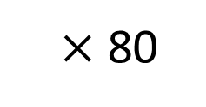
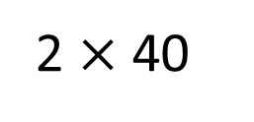
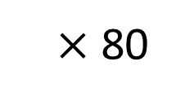
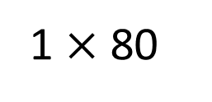
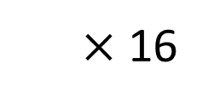
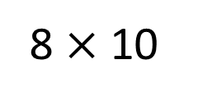
Find a common factor of 80, 160 and 300 that is greater than 15
20
80
160
300
$×$ 80
$×$ 80
1 $×$ 80
2
2 $×$ 40
$×$ 40
$×$ 40
4
15
4 $×$ 20
8
$×$ 20
$×$ 20
5 $×$ 16
$×$ 16
$×$ 16
10
8 $×$ 10
Have a think

Slide 11


I’m thinking of a 2-digit number between 20 and 50
Tommy
Whitney
My number is 30
The common factors of 30 and Tommy’s number are 1, 3, 5 and 15
Factors of 30
Tommy’s number
2
15
1
6
3
30
10
5
45
30
15
60
What is Tommy’s number?

Slide 12
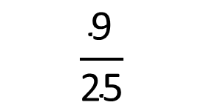
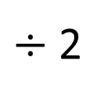
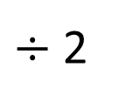
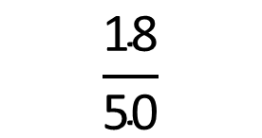
Can you use common factors to simplify this fraction?
$÷$ 2
$$\frac{\text{18}}{\text{50}}$$
$$\frac{\text{9}}{\text{25}}$$
$÷$ 2
Factors of 18: 1, 2, 3, 6, 9, 18
Factors of 50: 1, 2, 5, 10, 25, 50

Slide 13
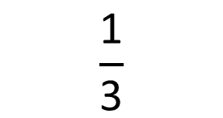
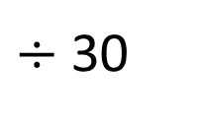
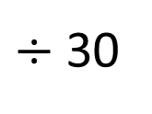
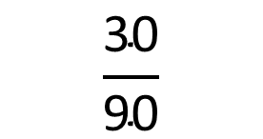
Can you use common factors to simplify this fraction?
$÷$ 30
$$\frac{\text{30}}{\text{90}}$$
$$\frac{\text{1}}{\text{3}}$$
$÷$ 30
Factors of 30: 1, 2, 3, 5, 6, 10, 15, 30
Factors of 90: 1, 2, 3, 5, 6, 9, 15, 30, 45, 90
Have a think

Slide 14
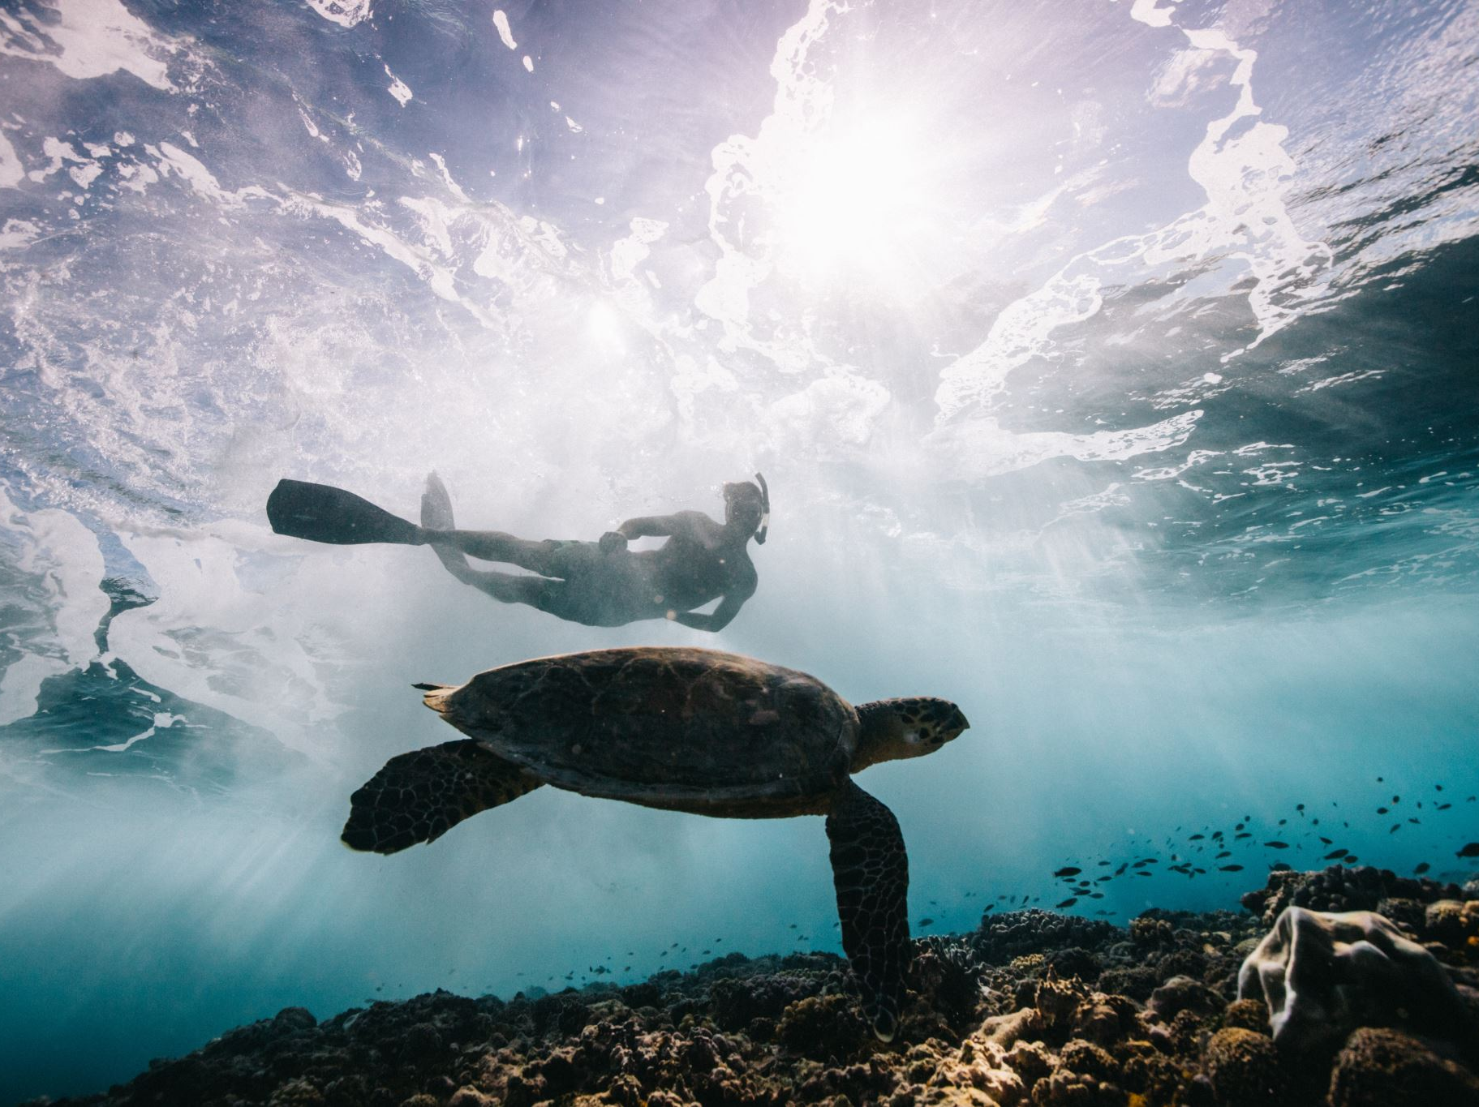
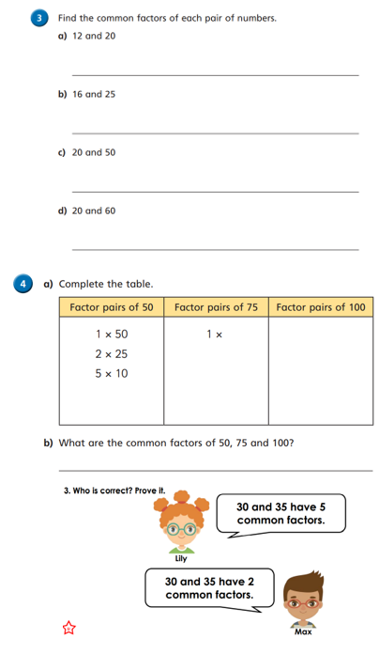
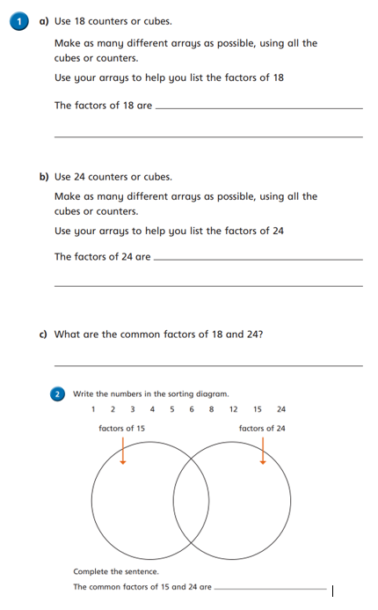
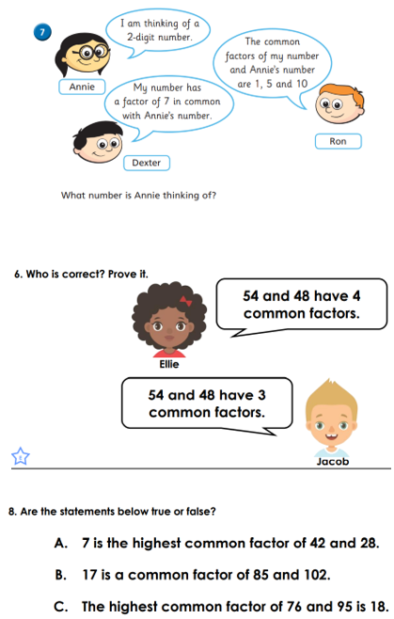
Independent Activity
Paddling Snorkelling Diving

Slide 15
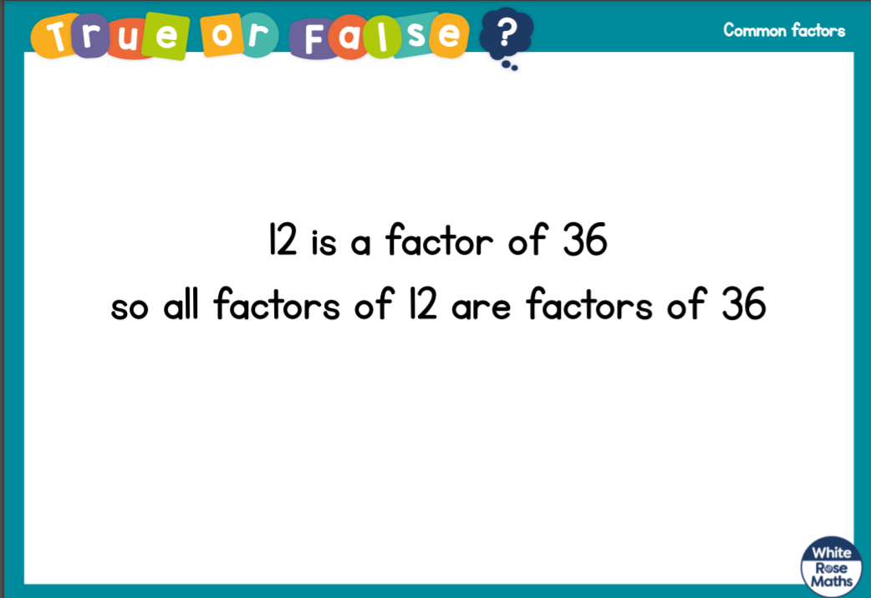



Slide 16



