Slide 1

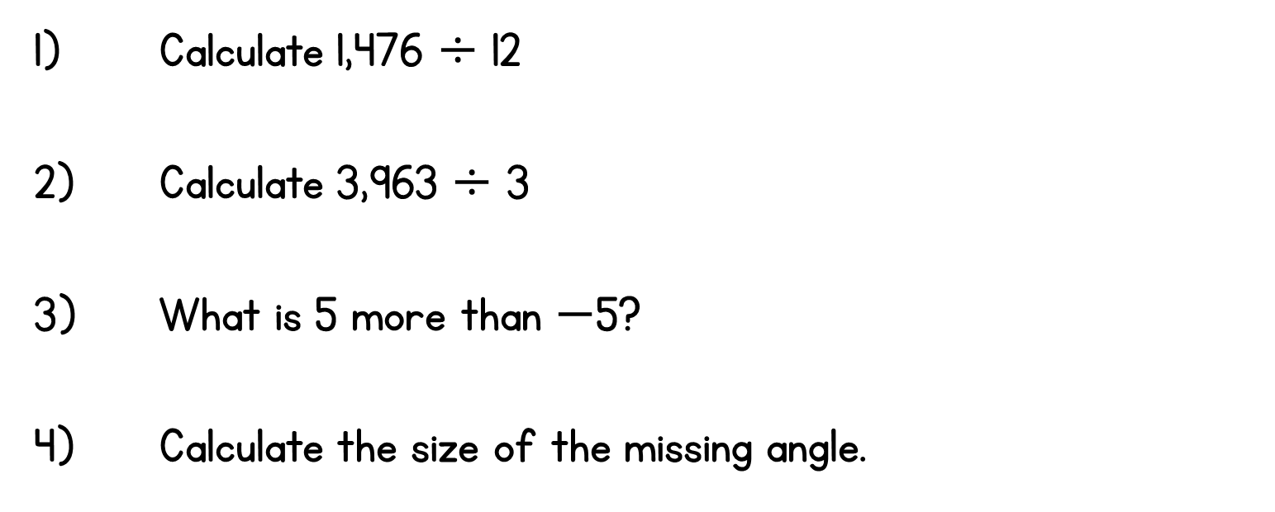
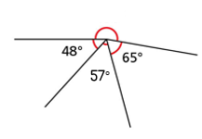
Year 6 | Week 5 | Day 1

Slide 2
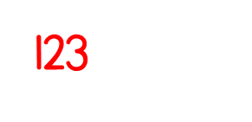
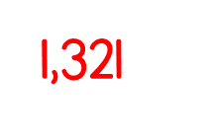
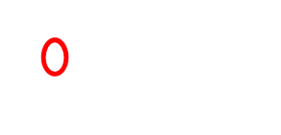
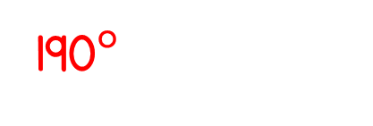
Year 6 | Week 5 | Day 1

Slide 3


Arithmetic Starter

Slide 4
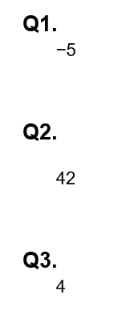
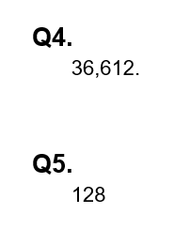
Arithmetic Starter - Answers

Slide 5


Slide 6
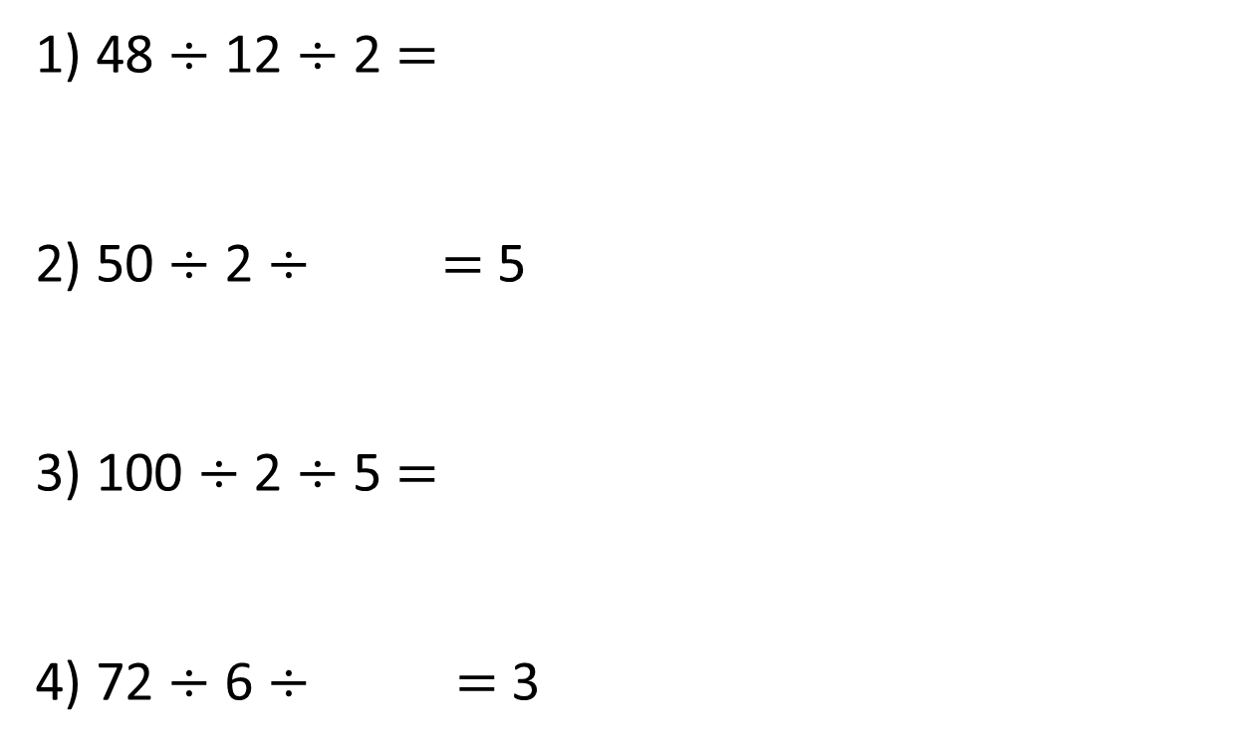
1) 48 $÷$ 12 $÷$ 2 $=$
2) 50 $÷$ 2 $÷$ $=$ 5
3) 100 $÷$ 2 $÷$ 5 $=$
4) 72 $÷$ 6 $÷$ $=$ 3

Slide 7
1) 48 $÷$ 12 $÷$ 2 $=$
2) 50 $÷$ 2 $÷$ $=$ 5
3) 100 $÷$ 2 $÷$ 5 $=$
4) 72 $÷$ 6 $÷$ $=$ 3
2
4
5
25
10
50
4
12

Slide 8
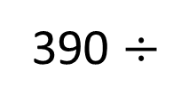
390 $÷$
30
1 and 30
30
2 and 15
3 and 10

Slide 9
390 $÷$
30
1 and 30
30
5 and 6
2 and 15
3 and 10

Slide 10
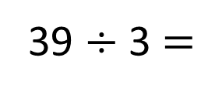
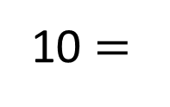
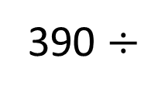
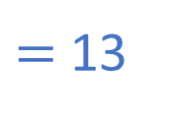
390 $÷$
$=$ 13
30
390 $÷$
10 $=$
39
39 $÷$ 3 $=$
13
1 and 30
30
5 and 6
2 and 15
3 and 10

Slide 11

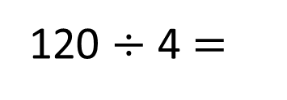
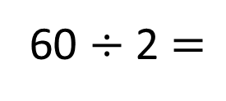
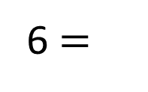
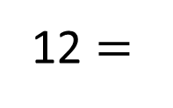
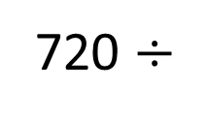
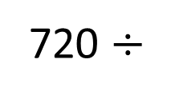
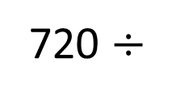
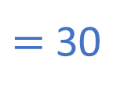
720 $÷$
$=$ 30
Have a think
24
720 $÷$
6 $=$
120
120 $÷$ 4 $=$
30
720 $÷$
12 $=$
60
60 $÷$ 2 $=$
30
1 and 24
24
4 and 6
2 and 12
3 and 8

Slide 12

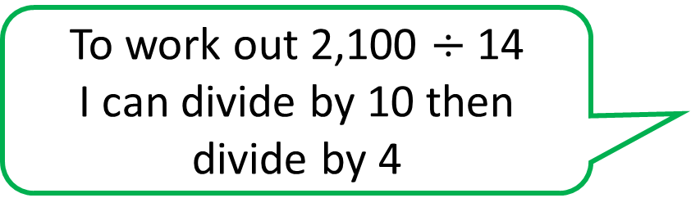
Have a think
To work out 2,100 $÷$ 14
I can divide by 10 then divide by 4

Slide 13

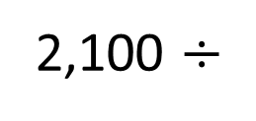

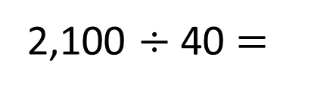
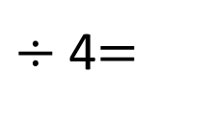
To work out 2,100 $÷$ 14
I can divide by 10 then divide by 4
2,100 $÷$
10
$÷$ 4$=$
2,100 $÷$ 40 $=$
14
1 and 14
14
10
4
2 and 7

Slide 14
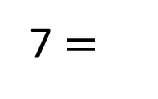
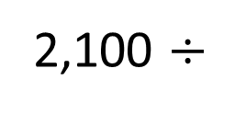
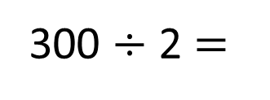
To work out 2,100 $÷$ 14
I can divide by 10 then divide by 4
2,100 $÷$
7 $=$
300
300 $÷$ 2 $=$
150
1 and 14
14
2 and 7

Slide 15

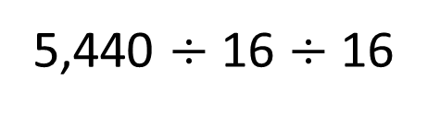
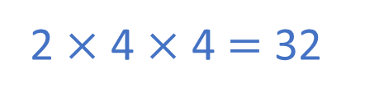
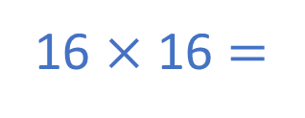
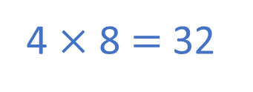
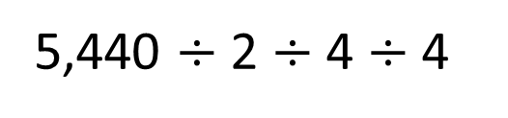
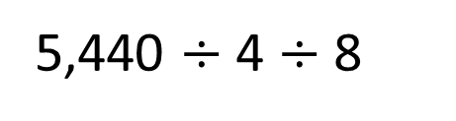
Dora is calculating 5,440 $÷$ 32
Which method would give the correct answer?
5,440 $÷$ 4 $÷$ 8
5,440 $÷$ 16 $÷$ 16
4 $×$ 8 $=$ 32
16 $×$ 16 $=$
5,440 $÷$ 2 $÷$ 4 $÷$ 4
2 $×$ 4 $×$ 4 $=$ 32
Have a think

Slide 16
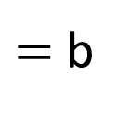
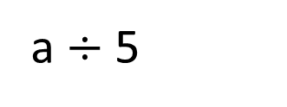
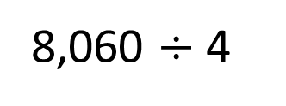
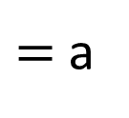
Calculate the value of b
8,060
a
a
a
a
b
b
b
b
b
8,060 $÷$ 4
$=$ a
a $÷$ 5
$=$ b
20

Slide 17
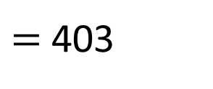
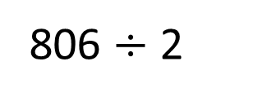
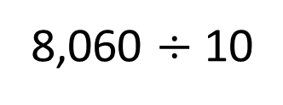
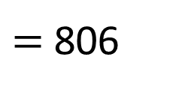
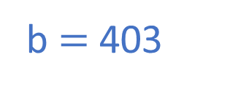
Calculate the value of b
b $=$ 403
8,060
a
a
a
a
b
b
b
b
b
8,060 $÷$ 10
$=$ 806
806 $÷$ 2
$=$ 403
1 and 20
20
4 and 5
2 and 10

Slide 18
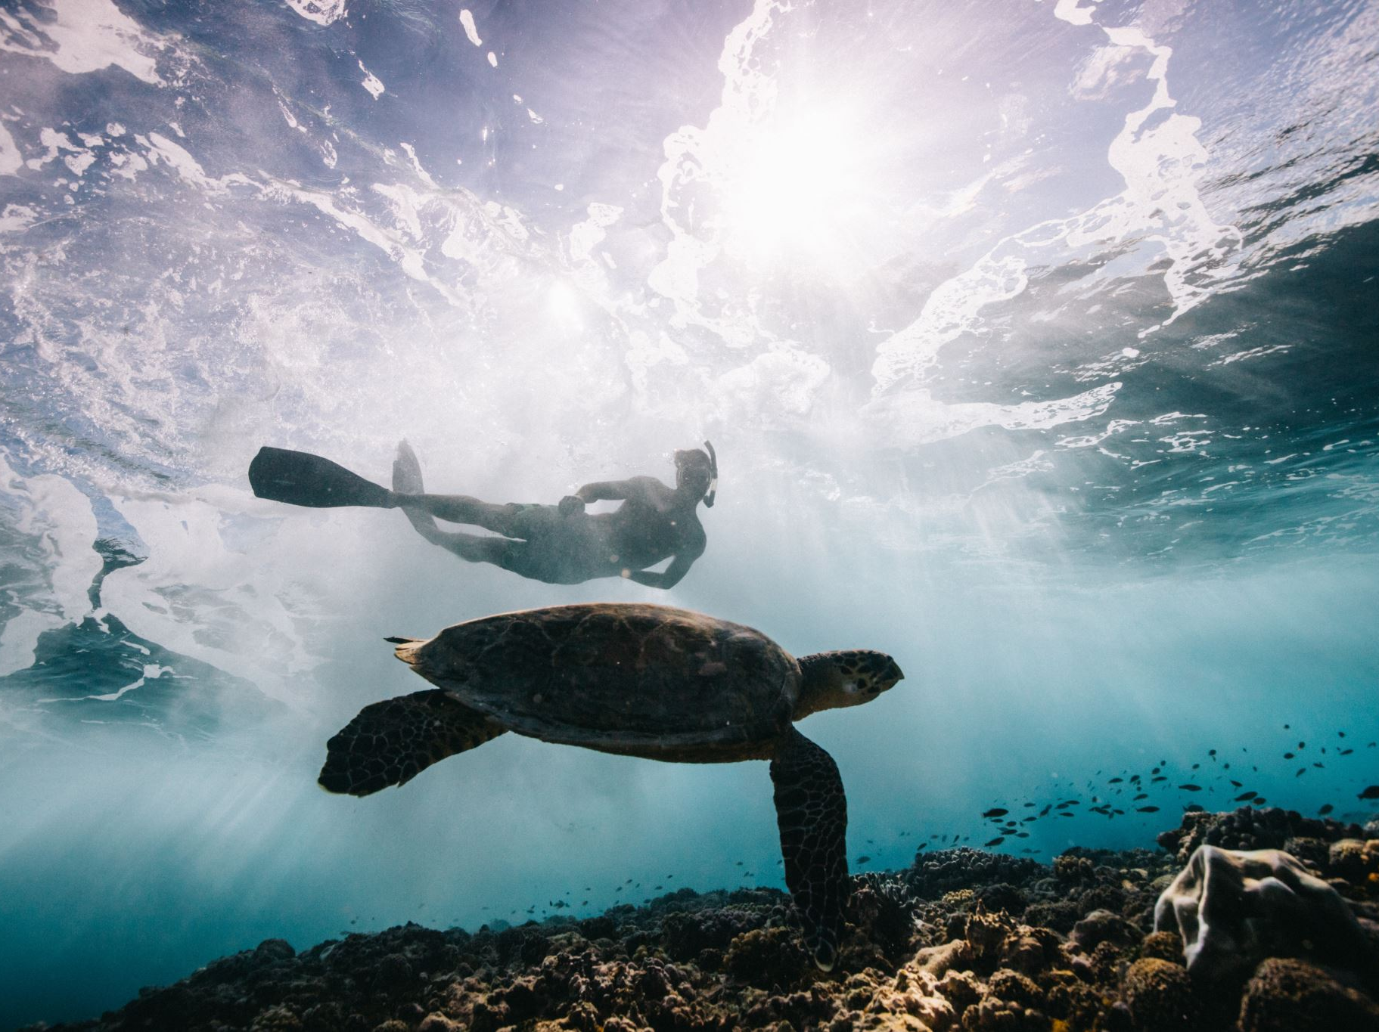
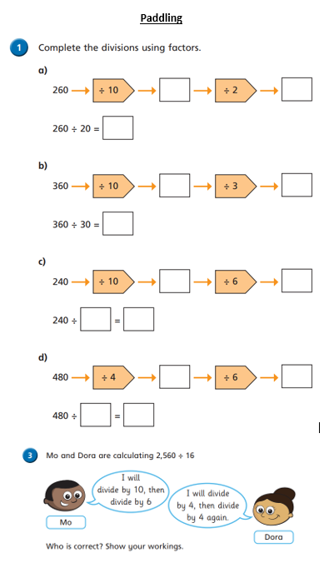
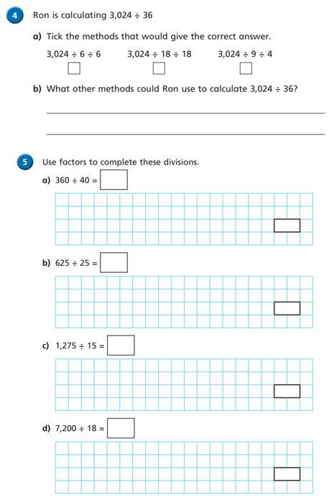
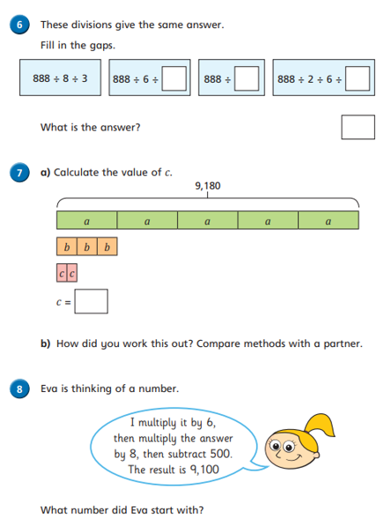
Independent Activity
Paddling Snorkelling Diving

Slide 19
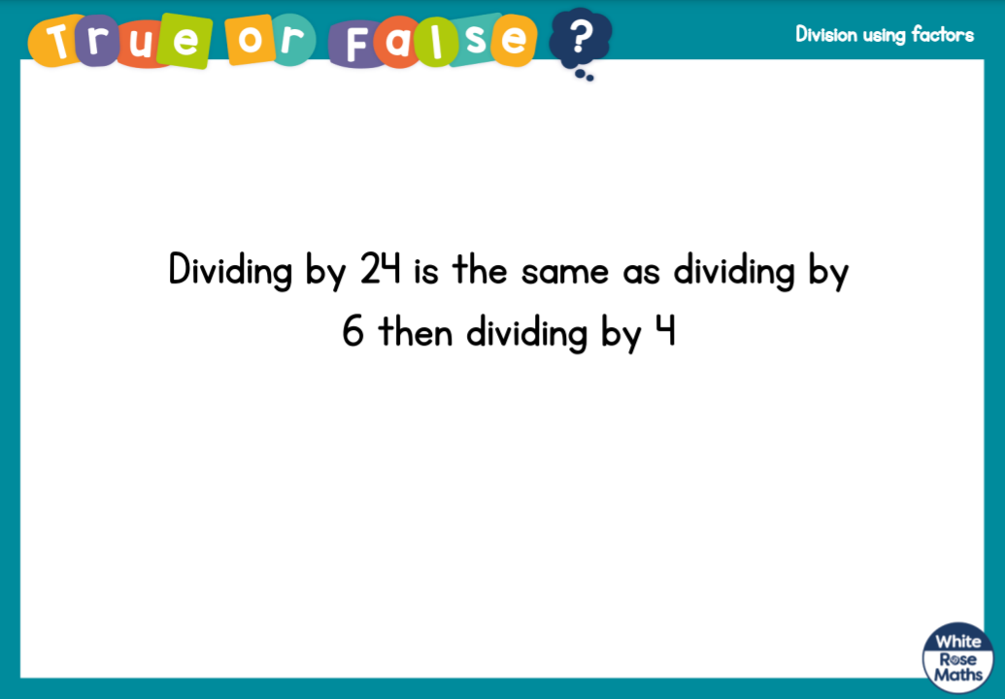




Slide 20


