Slide 1
Monday 11th October 2021
LO: to write with purpose
C: Informal Recounts

Slide 2

Starter
How are we going to start our diary entries this week?
What colloquial starting sentences could we use?
e.g. You won’t believe what happened to me today!
I had the most horrendous day!

Slide 3
Starter
What about ending our diary entries? What could our last sentence be?
Try to look to the future/the next day and change the tense here to future tense.
e.g. Tomorrow, I will go back and try to help those weak, defenceless children.
I really hope that the children will be freed soon. It really isn’t fair!

Slide 4
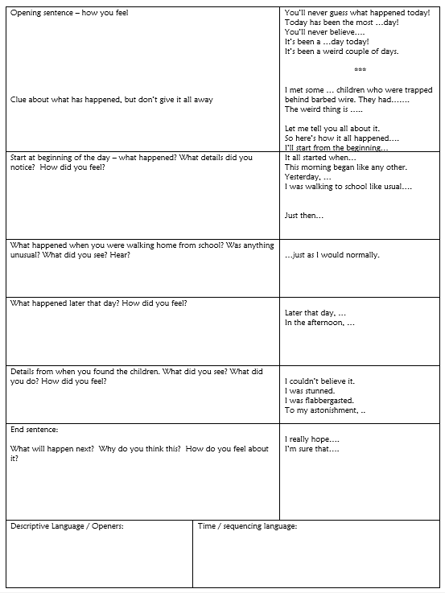
You are going to plan your diary entries today!

Slide 5
Activity
Plan your diary entries using the planning template.
Red Pen: Using your highlighters, highlight some of the exemplar phrases on the planning template that you would like to use in your diary entry.
Add in any additional sentence starters/phrases that you are going to use.

Slide 6
Tuesday 12th October 2021
LO To write with purpose
To use imaginative description
C: Informal Recounts

Slide 7

Starter
You should be writing in paragraphs in your diary entries.
When should we start a new paragraph?

Slide 8

Starter
We should start a new paragraph when the person, place, time or topic changes.
When could we start new paragraphs in our diary entries?
e.g. Rose walking home from school and seeing the truck, Rose following the truck, Rose seeing the children etc.

Slide 9
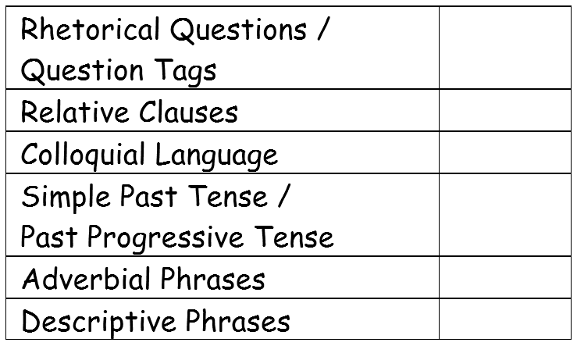
You are going to be writing your diary entries this week!
I am looking for all of these things in your writing this week.
You don’t have to include everything on the checklist in your writing today.

Slide 10
You will have 2 days to write your diary entry, so you won’t be writing everything today!
You will only be writing up to the part where Rose sees the truck and follows it.
Look back at your planning template from last lesson and consider what you will write in your diary entry today.
Jot any new ideas down on your whiteboards.

Slide 11
Dear diary,
Today has been the most horrendous day! I feel sick to my stomach. You won’t believe what happened! Where do I even begin? I met some skeletal, pale children who were trapped behind towering, intimidating barbed wire. Let me start from the beginning…
This morning began like any other. I went to school just as I normally do, but this afternoon was different. As I was walking, I strolled along the peaceful river bank which was my usual route home. I was walking down a dark, narrow path when I heard a peculiar sound. There was a broken-down wagen with two soldat’s trying to fix it. Before I knew what was happening, the backdoor flung open and a young boy, who was only about five years old, jumped out and ran. Who was he? The soldat, who proudly wore his blazing red, Nazi armband, demanded he stop or be shot. I realised then that the boy was running for his life and so did he. How dare a soldat threaten a young, defenceless boy like that! Frightened, he ran straight into the plump, greedy mayor’s arms. Foolishly, I believed that the mayor would save and protect the little boy. I was wrong, wasn’t I? An evil smirk formed on his face as he grabbed the slim, helpless boy by his hair and dragged him aggressively to the wagen. When they threw him into the khaki-grey wagen, I saw at least 10 panicked, sorrowful faces crammed into the overcrowded wagen. I clasped my hand over my mouth in disbelief. The mayor and soldat’s eyes glistened with power and delight as though it was a joy to see the children suffering. What did the children do to deserve this horrible treatment? I was about to find out.
What features of writing can you spot?
What has impressed you with my writing?
Is there anything I could do to improve?
What have I included from the checklist?
What is left to include?
Jot down any impressive words/phrases that you would like to magpie on your whiteboards.

Slide 12
Activity
Use your planning template from last lesson to write the first part of your diary entry.
Challenge: Can you use wartime slang in your writing?
Diving Challenge: Can you use semi-colons in your writing?
Top Tip: use a semi-colon instead of ‘but.’
e.g. I crawled cautiously under the rigid barrier; I knew it was forbidden.
I wanted to say something; I couldn’t find the words.
Some believe the war is just and right; others believe it is a horrible waste of time.

Slide 13

Red Pen
Look back over your writing from today.
Do all of your sentences make sense?
Have you written in the first person?
Have you remembered all of your punctuation, e.g. commas in expanded noun phrases, embedded clauses, after fronted adverbials etc?
How many features of the checklist have you included?
Have you used them correctly?
Could you write a sentence or two now to tick off anymore items on the checklist?

Slide 14
Wednesday 13th October 2021
LO: To write with purpose.
To use imaginative description.
C: Informal Recount

Slide 15
You will be finishing your diary entries today!
You can now write about Rose finding the children in the forest.
Remember you should be looking to the future in your final sentence(s).
Look back at your planning templates from Monday and consider what you will write in your diary entry today.
Jot any new ideas down on your whiteboards.

Slide 16
Without a thought, I was running after the slow, black wagen. I was a fast runner, I knew all the shortcuts and I was furious which made me run even faster. Who did these people think they were? I followed the wagen for what seemed like forever. I passed a sign reading ‘verboten,’ but I still continued. I couldn’t help but think: why didn’t they capture me? With the bitter wind slapping my face, I ran under branches, crawled over logs and stumbled over twigs. As I finally came into a clearing, I couldn’t believe what I saw. The skin-piercing, gargantuan stacheldraht, that loomed ahead, whistled in the cold, icy wind and my heart shattered into a thousand pieces.
In front of me, stood distraught, hungry children, who were not the Aryan race, huddled together for warmth. Their pale faces were hungry and motionless and their large, frightened eyes were filled with sorrow. The upset, imprisoned children watched my every movement in hope. One boy, who was weeping in the corner, came up to the barbed wire and said something. Soon, all of the weak, exhausted children, who were desperate to go heimat, were pleading for food. I could see their bedraggled, dirty clothes hung loosely on their frail, skeletal bodies. Since they were clearly starving, I desperately tried to forage food for the feeble kriegsgefangener. Hidden by a pile of tangled leaves and branches, I found a blackberry bush. Quickly, I picked some ripe, juicy berries and passed them through the sharp barbed wire which was pulsing with electricity. When they had taken all of the food, I promised them I would come back tomorrow. I had to. I turned for home, but took one last glance at the starving, fearful prisoners who waited for their freedom.
Why did I follow that truck to the devastating sight? The children aren’t safe, are they?
I really hope that the poor, defenceless kriegsgefangener will escape soon. Until then, I have made it my einsatz to visit them every day and bring them as much food as I can.
This will be my geheim. I cannot tell a single soul.
What features of writing can you spot?
What has impressed you with my writing?
Is there anything I could do to improve?
What have I included from the checklist?
What is left to include?
Jot down any impressive words/phrases that you would like to magpie on your whiteboards.

Slide 17
Activity
Use your planning template from last lesson to write the first part of your diary entry.
Challenge: Can you use wartime slang in your writing?
Diving Challenge: Can you use semi-colons in your writing?
Top Tip: use a semi-colon instead of ‘but.’
e.g. I crawled cautiously under the rigid barrier; I knew it was forbidden.
I wanted to say something; I couldn’t find the words.
Some believe the war is just and right; others believe it is a horrible waste of time.

Slide 18
Red Pen
Look back over your writing from today.
Do all of your sentences make sense?
Have you written in the first person?
Have you remembered all of your punctuation, e.g. commas in expanded noun phrases, embedded clauses, after fronted adverbials etc?
How many features of the checklist have you included?
Have you used them correctly?
Could you write a sentence or two now to tick off anymore items on the checklist?

Slide 19
Thursday 14th October 2021
LO: to write with purpose
C: Informal Recounts

Slide 20
Look back at your work.
What have you done well?
What features have you correctly used?
What do you need to improve?
What features have you not included from the checklist?

Slide 21
Activity
Edit and improve your diary entry using the checklist to help you.
Red Pen: read through your work. What have you done well? What do you need to do to improve? Ask an adult to help you improve your work: it may be correcting spelling mistakes, rewriting sentences which don’t make sense, correcting the use of commas, improving your vocabulary choices etc.

