Slide 1
Why bully?
PSHCE

Slide 2

Bullying or not bulling?
Look at the statements on the next two slides.
Decide whether you think each statement is: ‘Bullying,’ ‘Not Bullying’ or ‘Not Sure.’

Slide 3

Bullying or not bulling?
1. Ismail spits into a glass of water and says he will make Ahmed drink it.
2. Anna keeps telling other girls in their group not to ‘like’ any of Marie’s posts and ignore her in school.
3. Jemma has a disability which means she can’t always control her movements and causes her to jerk her hands up. A group of girls always laugh at her when this happens and mimic her actions.
4. Maddie and Amy won’t let Jasmin play with them because they have fallen out.

Slide 4
Bullying or not bulling?
5. Jake and Ryan have had an argument. Jake kicks Ryan’s coat across the corridor and calls Ryan gay.
6. Jodie tells Marcus each day that if he doesn’t give her his dinner money, she will get her group to beat him up.
7. There was one occasion when Simmi called Ali a lesbian as an insult and she was really upset.
8. Stefan keeps on sending his mates photos of his sister kissing her boyfriend even though she keeps asking him not to.

Slide 5
Bullying:

Slide 6

Which of the statements show direct bulling? Which are examples of indirect bullying?
Direct
Indirect
Direct bullying is done directly to the person.
Indirect bullying is done behind their back.

Slide 7
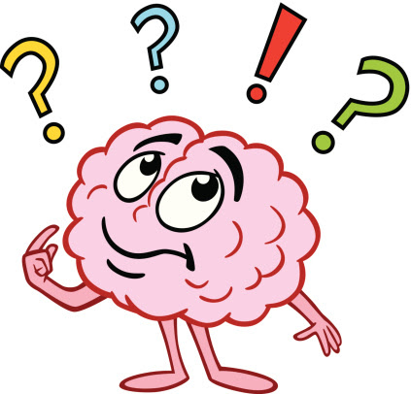
Direct or Indirect bullying?
1. Ismail spits into a glass of water and says he will make Ahmed drink it.
2. Anna keeps telling other girls in their group not to ‘like’ any of Marie’s posts and ignore her in school.
3. Jemma has a disability which means she can’t always control her movements and causes her to jerk her hands up. A group of girls always laugh at her when this happens and mimic her actions.
4. Maddie and Amy won’t let Jasmin play with them because they have fallen out.

Slide 8
Direct or indirect bullying?
5. Jake and Ryan have had an argument. Jake kicks Ryan’s coat across the corridor and calls Ryan gay.
6. Jodie tells Marcus each day that if he doesn’t give her his dinner money, she will get her group to beat him up.
7. There was one occasion when Simmi called Ali a lesbian as an insult and she was really upset.
8. Stefan keeps on sending his mates photos of his sister kissing her boyfriend even though she keeps asking him not to.

Slide 9

What might the different people in the scenario be feeling?
Jemma has a disability which means she can’t always control her movements and causes her to jerk her hands up. A group of girls always laugh at her when this happens and mimic her actions.

Slide 10

Why might people use bullying behaviours?
E.g. power, fear, because hey don’t know other strategies to get what they want etc.

Slide 11
How could the person being bullied manage their feelings in this situation?
What could they do about the bullying?

Slide 12
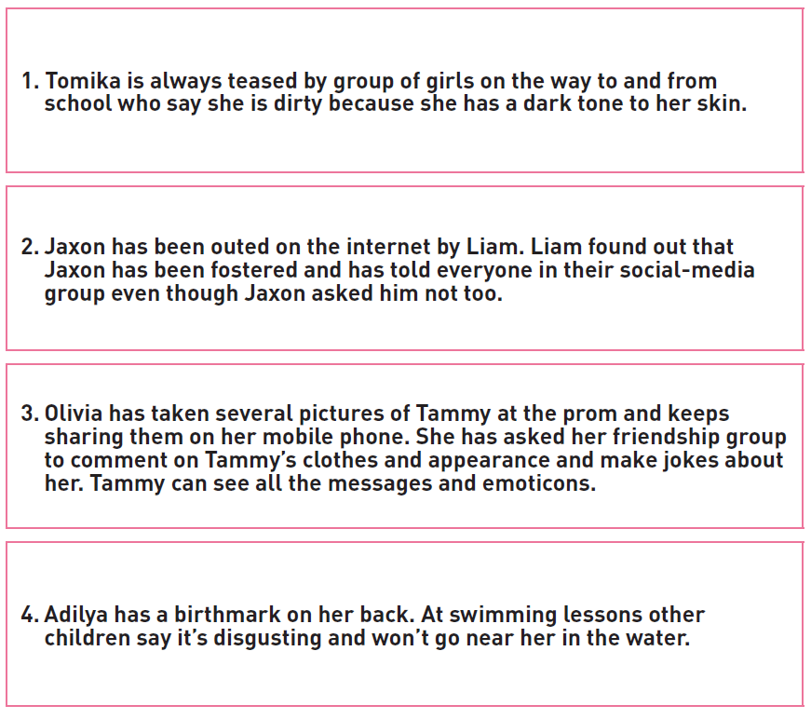
Look at the scenarios.
For each one, answer the questions below:
1. What might be the reasons for the person/people using bullying behaviours?
2. How did these behaviours make the recipient of them feel and what could they do to manage these feelings, e.g. calming techniques, talking to someone.
3. How could the recipient deal with/manage the situation?

Slide 13
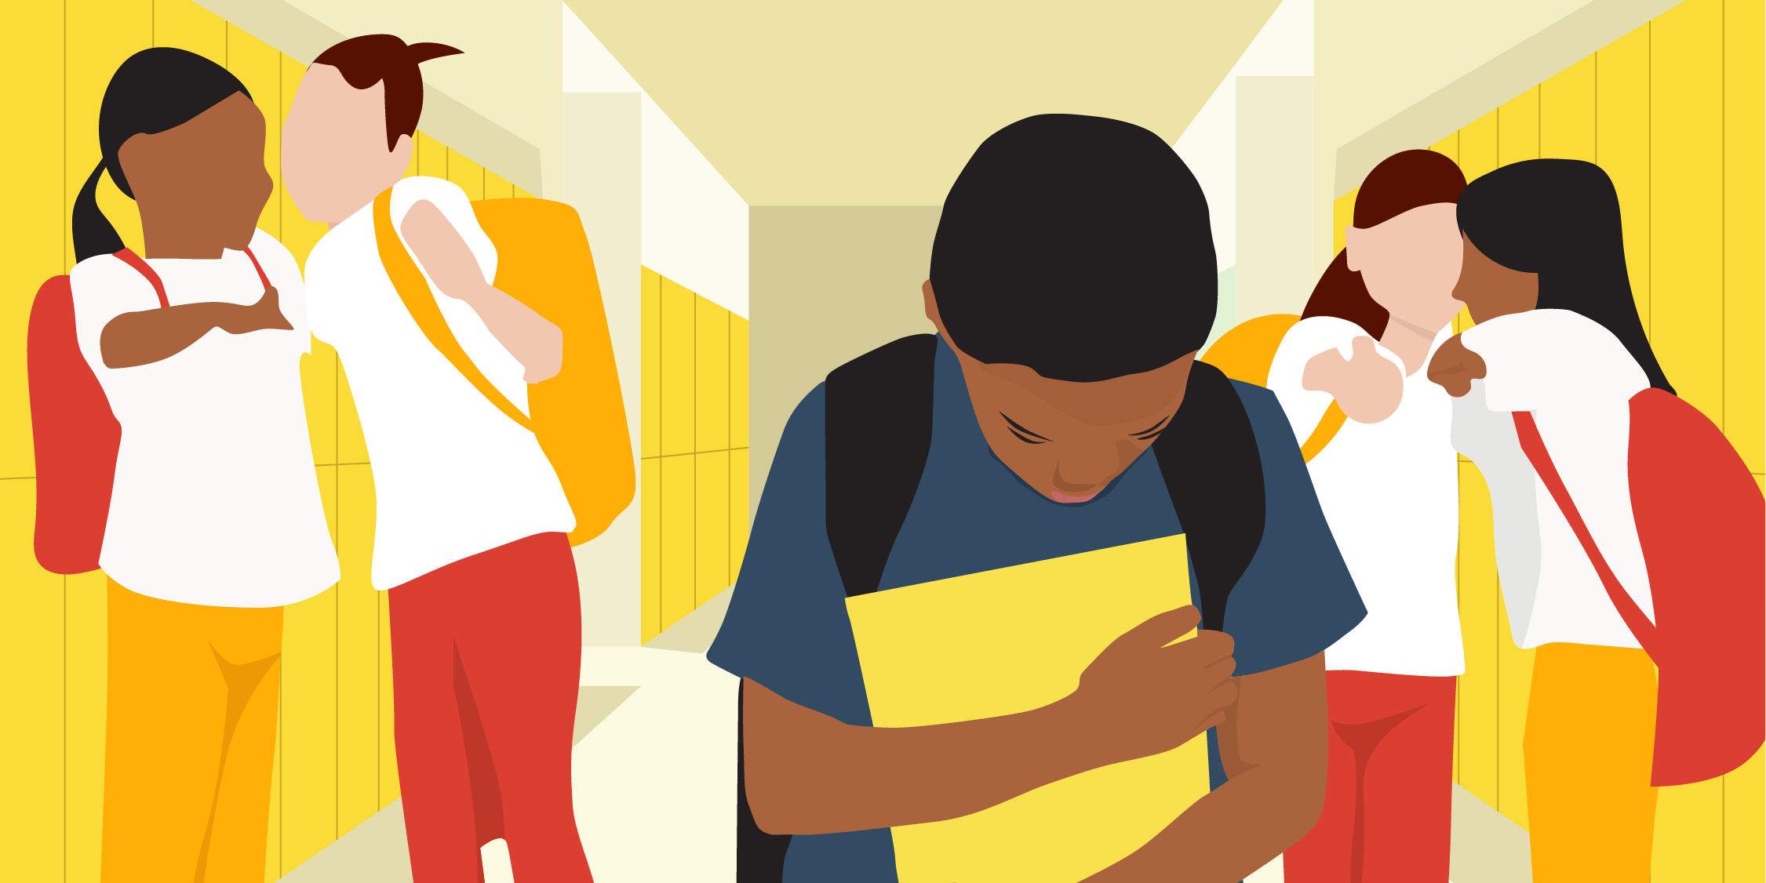
Create a list of strategies for managing feelings and dealing with bullying situations.

