Slide 1


14.1.2021
L.O: Multiplication and Division
C: Arrays.

Slide 3
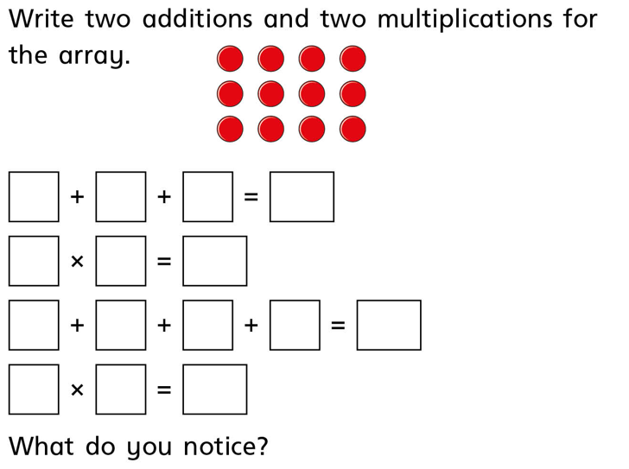

Slide 4
Array BINGO!
Draw a grid like this in the back of your book.

Slide 5
Array BINGO!
Fill it up with four of these things.
4
24
2x4
3x3
45
1x10

Slide 6

Array BINGO!

Slide 7

Array BINGO!

Slide 8

Array BINGO!

Slide 9

Array BINGO!

Slide 10

Array BINGO!

Slide 11

Array BINGO!

Slide 13
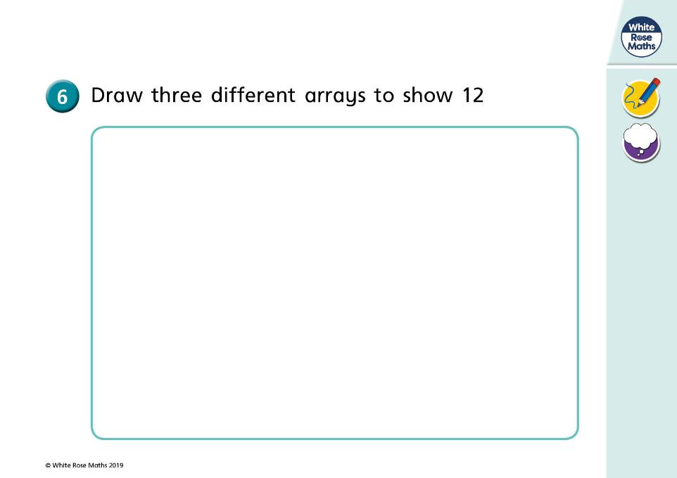

Slide 14
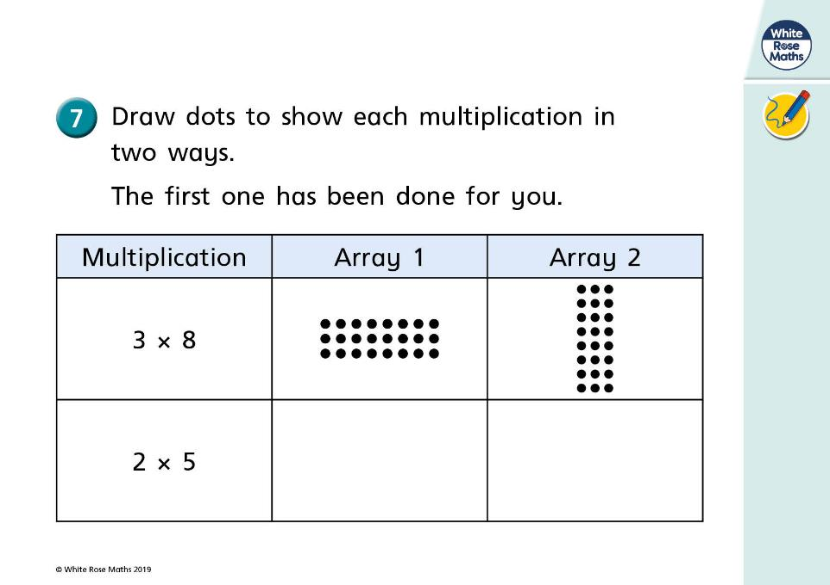

Slide 15

Your turn!
Try the top section of your sheet!

Slide 16

Let’s step it up a notch!
Buddy eats 2 meals a day, 7 days a week. Can you draw an array and number sentence to show this?

Slide 17
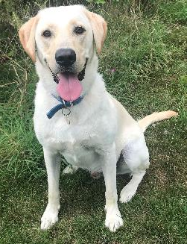
Let’s step it up a notch!
This week Buddy had 4 walks a day and saw 3 of his doggy friends on each walk. Can you draw two arrays and a number sentence to show this?
Last week he saw 10 doggy friends. Which week did he see more friends and why?

Slide 18
Your turn!
Try the bottom section of your sheet!

Slide 19
True or false!
I have made an array to show 2x3

