Slide 1
LO: To investigate living things
To work scientifically
C: Scientific Descriptions

Slide 2
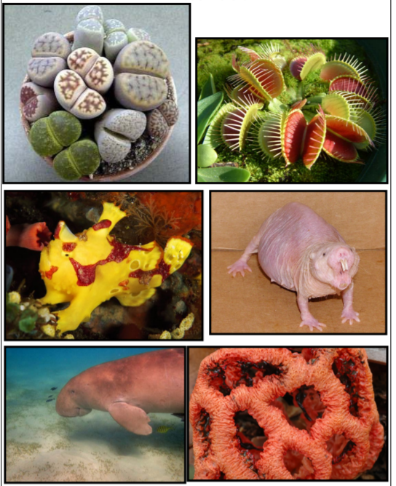
Starter – What On Earth?
Look at the are photographs of unusual animals from around the world.
Look at the common names of these living things.
Can you match the common names to the photographs?
Remember: when new creatures are found, their ‘common name,’ is often derived from a key characteristic or the name of the person who has discovered it.

Slide 3
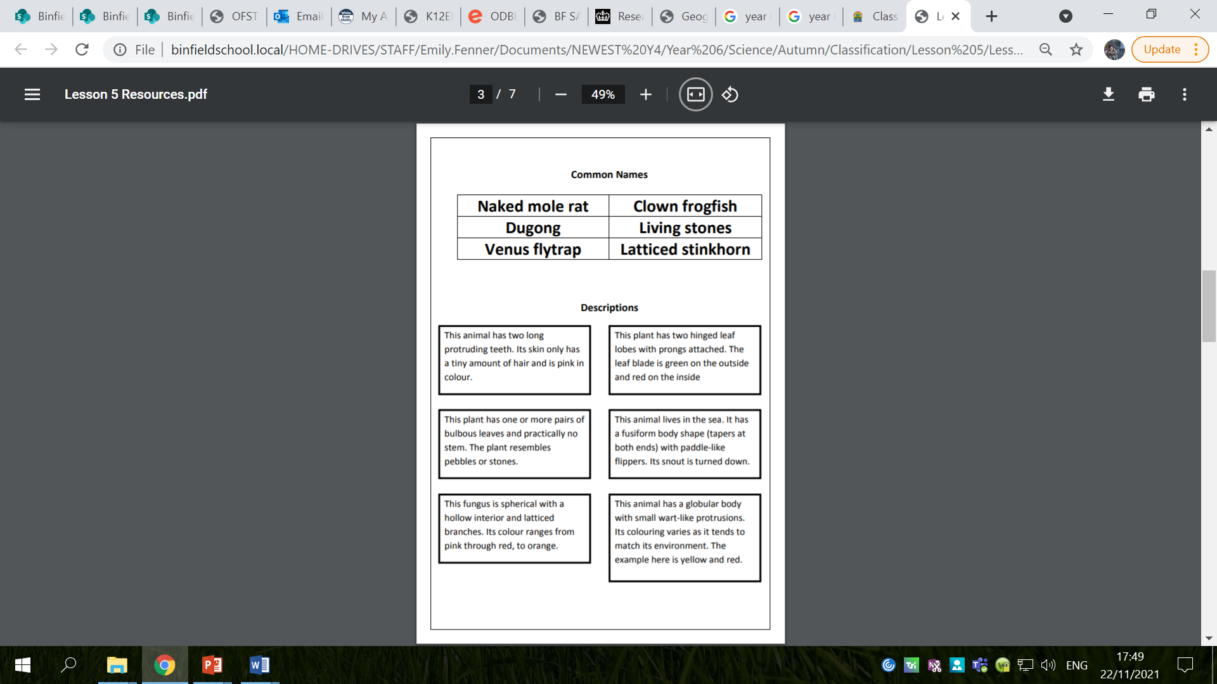
Starter – What On Earth?
Now, do the same with the description of the creatures, not the names.
Which approach was easiest?

Slide 4
Starter – What On Earth?
Look at the descriptions.
Notice that they don’t contain ‘imaginative’ language or subjective descriptions (beautiful, ugly etc.)
Why is this?

Slide 5
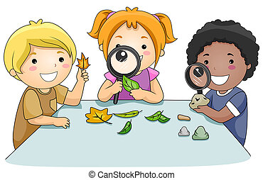
Starter – What On Earth?
Detailed scientific descriptions need to be written in plain English and need to be as objective as possible to ensure all that is recorded is accurate and clear information.
If two scientists were describing the same thing, they would likely write similar descriptions, although there may be deviations.

Slide 6
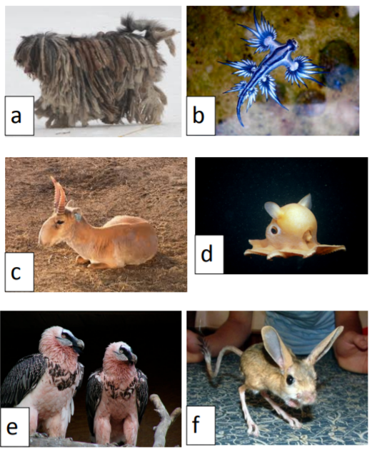
Today, you are going to be describing scientifically some unusual living things from around the world.
You will need to include very detailed descriptions of very specific characteristics.
Remember: you need to be able to distinguish similar creatures so this is very important!

Slide 7

What kinds of things might need describing for the plant, animal and fungi kingdoms?
Example: plant kingdom – leaves, flowers, fruit, seeds, height, colours, stem/trunk etc.

Slide 8
Activity
Look at the photographs of your unusual living things.
Describe each one in detail.
You can then come up with a common name and make suggestions as to what sort of habitat it might live in, based on its observable characteristics.
By the end of the lesson: you will have created a ‘poster’ with images of your unusual living things, a short, descriptive paragraph for each unusual living things, a common name for each unusual living thing and suggestions as to its habitat.

Slide 9
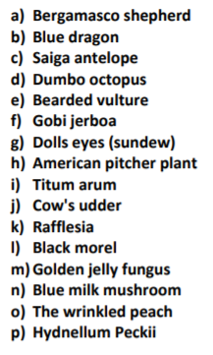
Extension
Look at the actual common names of the unusual living things and research the living things you have been describing, to find out how it is classified and where in the world (location and habitat) it is from.

Slide 10
Red Pen
Paddling Red Pen: Why is it important that scientific descriptions are objective?
Snorkelling/Diving Red Pen: Should scientific descriptions be subjective or objective? Why?

Slide 11
Plenary
Recently discovered living things: https://listverse.com/2016/02/12/10-recently-discovered-animals-with-amazing-features
Do you think that we have found and classified all living things on earth?

Slide 12
Do you think that we have found and classified all living things on earth?
No!
We are a long way from achieving this – there are estimated to be 8.7 million different forms of life on Earth and, so far, we have discovered about 14% of these.
Meaning 86% of the living world is yet to be discovered.

