Slide 1
LO: To understand beliefs and teaching
To understand how beliefs are conveyed
C: Christianity

Slide 2

Jesus was a surprising person who turned expectations on their head.
Christians believe he was, and is:
  A saviour who rescues through making peace with his enemies
  A humble, ordinary man, yet the Son of God
  Part of an older story, yet the first chapter of a new story

Slide 3
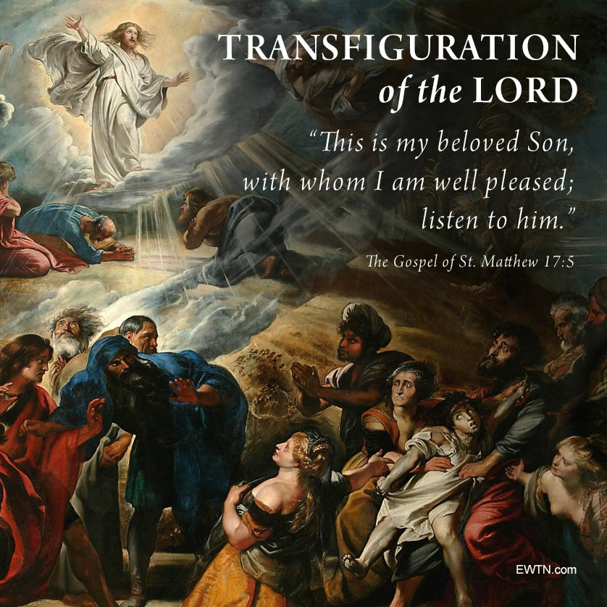
Some Christians celebrate the transfiguration of Jesus through the ‘Feast of the Transfiguration.’
Imagine how Christians might celebrate the Feast of the Transfiguration.
Bubble map some ideas for the kinds of things you think might be done, said or sung in a service.

Slide 4
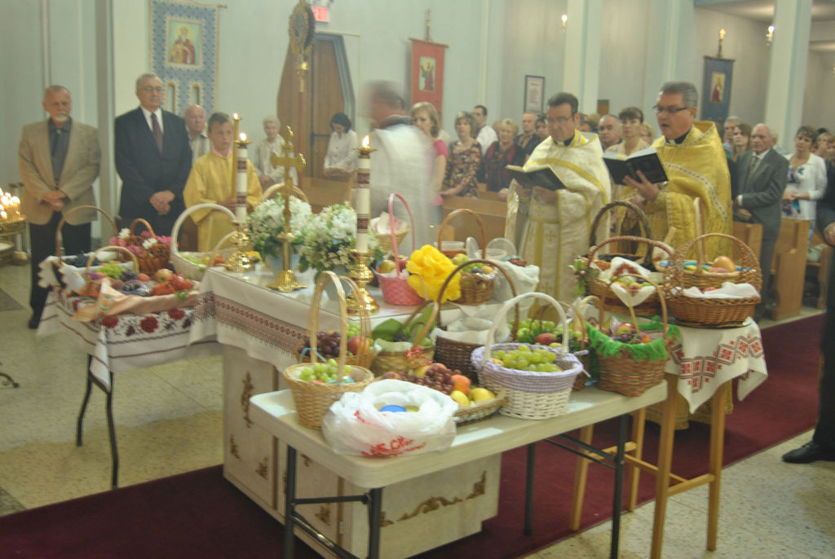
Christians celebrate the Feast of the Transfiguration:

Slide 5
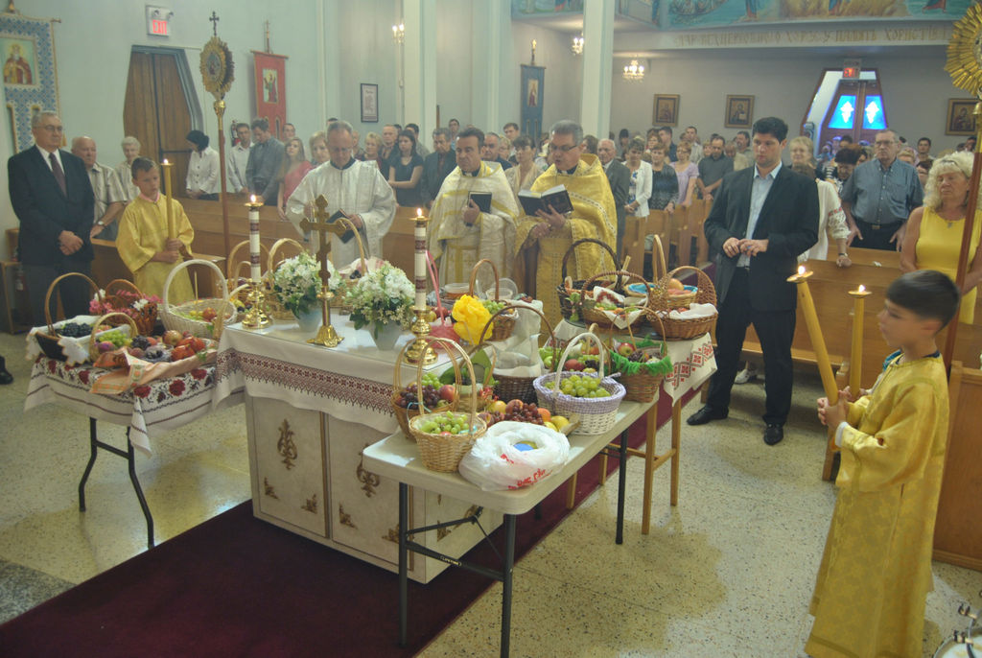
Christians celebrate the Feast of the Transfiguration:

Slide 6
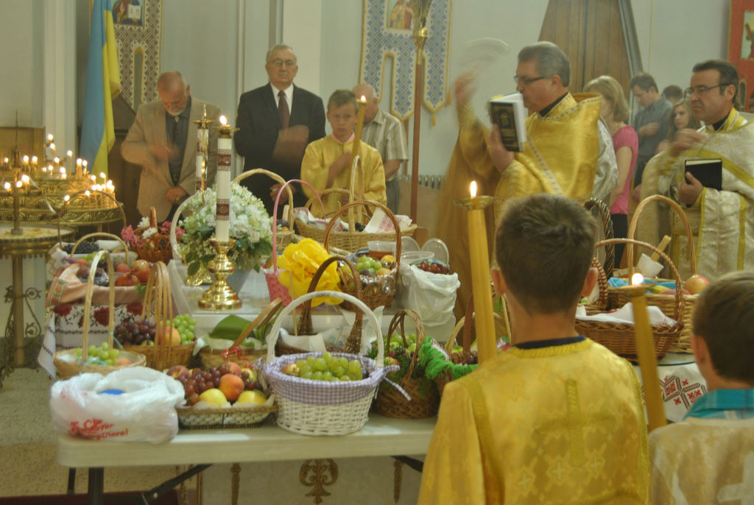
Christians celebrate the Feast of the Transfiguration:

Slide 7
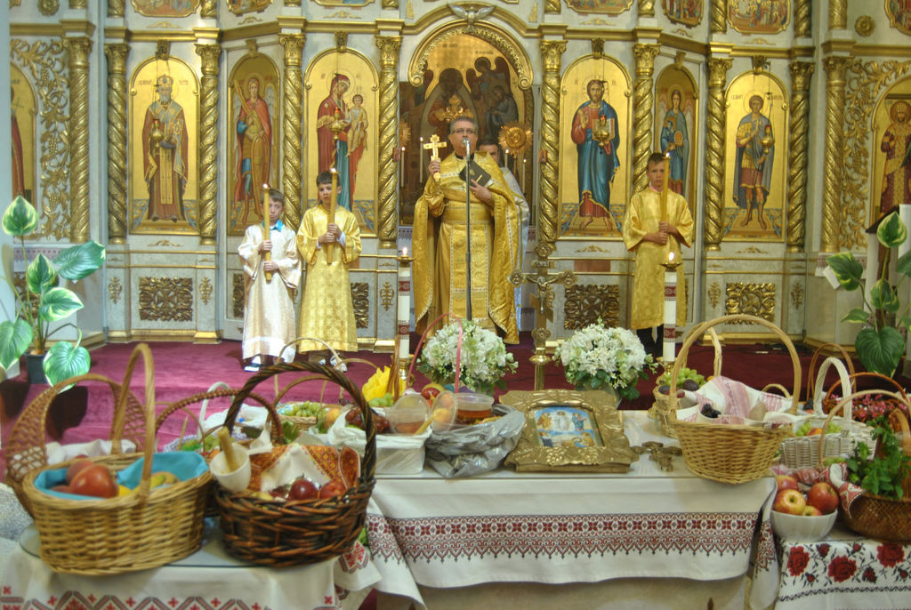
Christians celebrate the Feast of the Transfiguration:

Slide 8
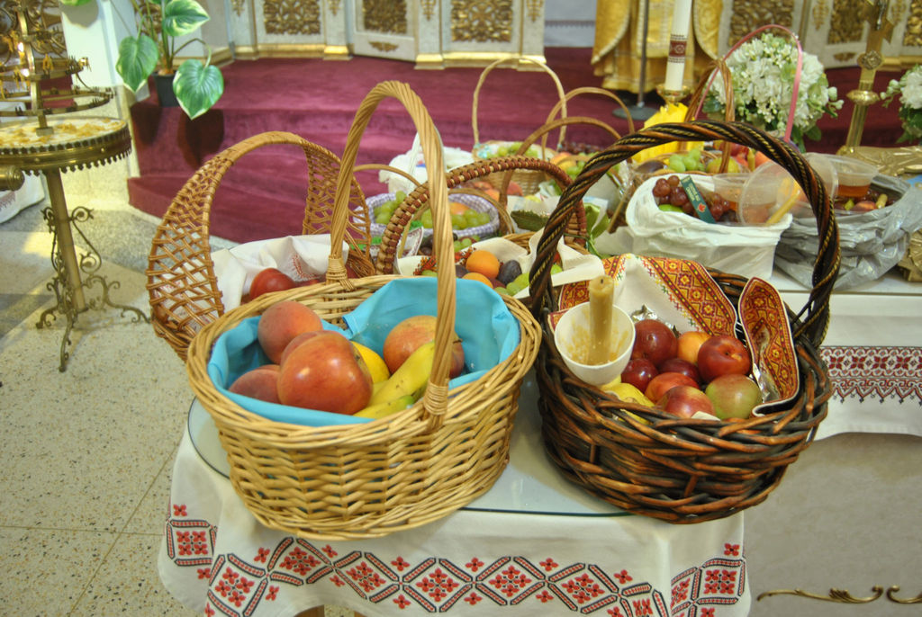
Christians celebrate the Feast of the Transfiguration:

Slide 9
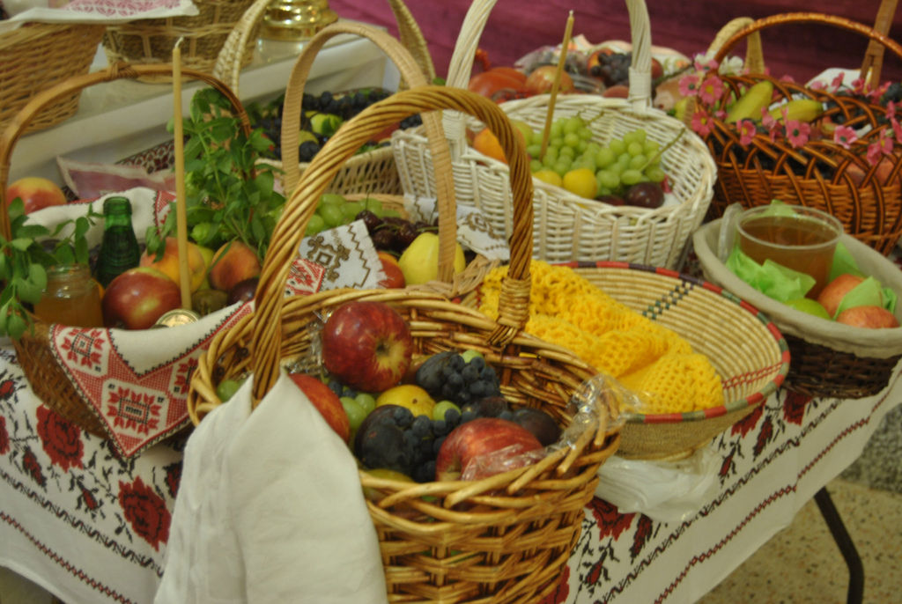
Christians celebrate the Feast of the Transfiguration:

Slide 10
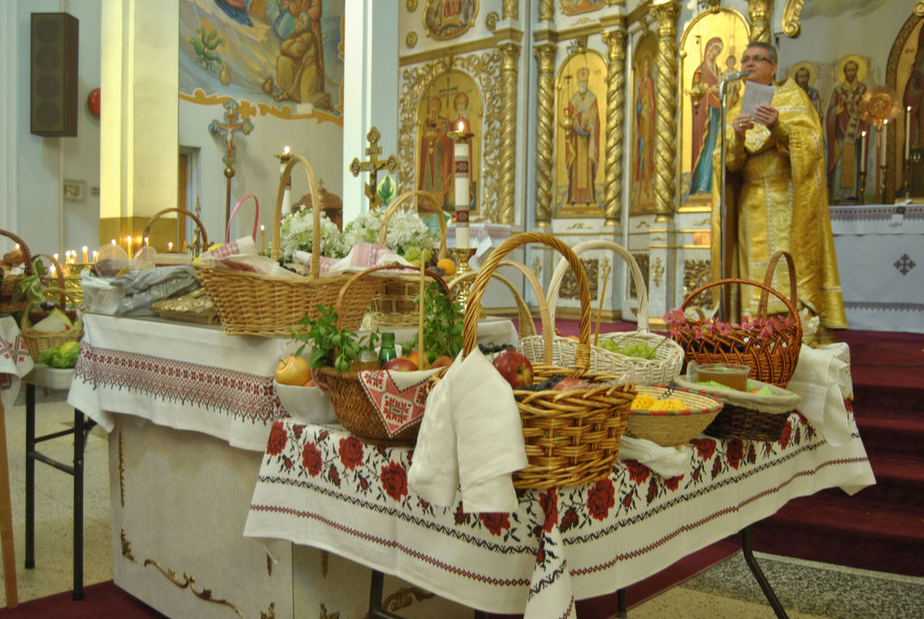
Christians celebrate the Feast of the Transfiguration:

Slide 11
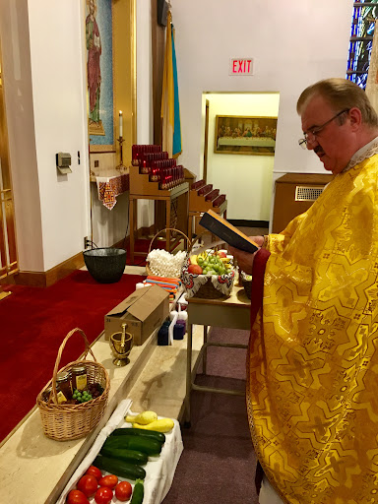
Tradition of the Blessing of the Fruits
Throughout the Eastern Mediterranean, it is customary to bring the first grapes of the summer harvest to be blessed on the feast of Holy Transfiguration. The grape is a symbol of transfiguration because it is crushed and fermented into wine, then transformed into the blood of Christ at the Eucharist.
The feast of the Holy Transfiguration is celebrated late in summer, at the time of the first fruits, which remind us of God’s great goodness and His infinite bounty. To express their recognition and gratitude to God for His generosity, some Christians bring some of these first fruits to the church for blessing.

Slide 12
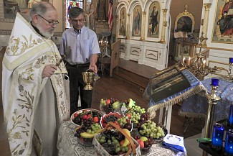
Watch: https://www.youtube.com/watch?v=lLIV_2gBcl4 OR https://www.youtube.com/watch?v=_KiJf_UR42g

Slide 13
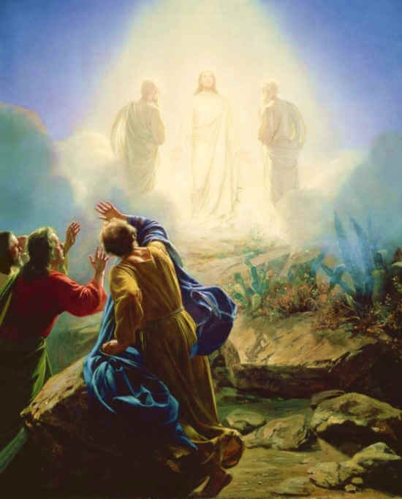
The
Transfiguration
https://www.reonline.org.uk/festival_event/the-transfiguration/

Slide 14
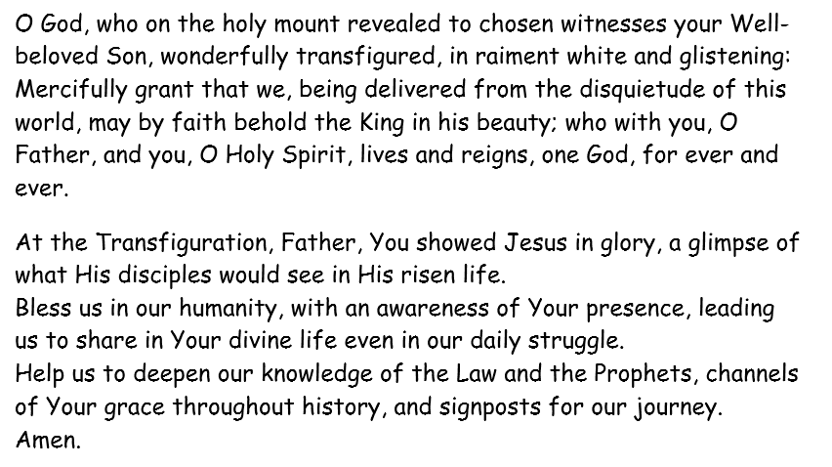
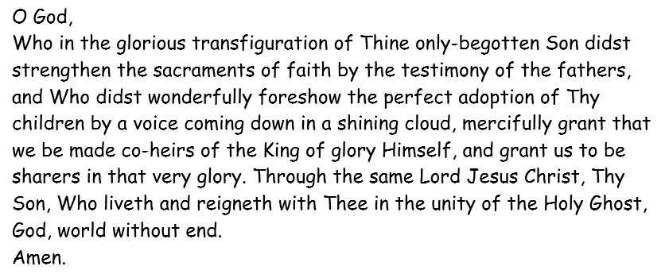
Prayers
What do you notice about the prayers?
What parts of the transfiguration can you identify?

Slide 15
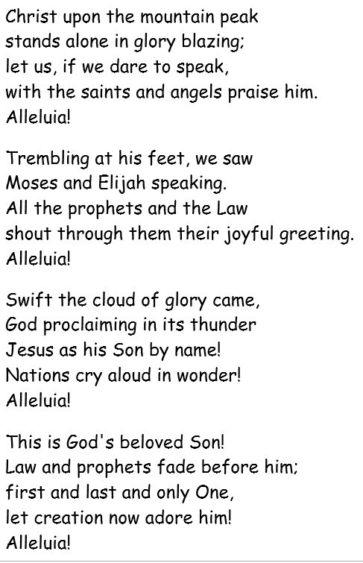
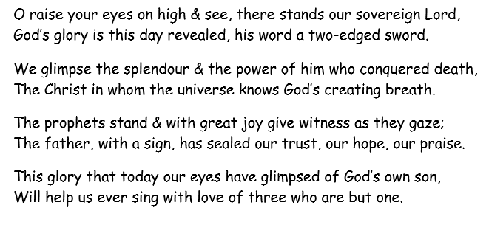
Hymns
What do you notice about the hymns?
What parts of the transfiguration can you identify?

Slide 16
Activity
Paddling and Snorkelling: choose from one of the activities below.
1. Write a hymn to be sung at the Feast of the Transfiguration. You may wish to use some of the words from the hymns we have explored today.
*Remember* hymns are very similar to rhyming poems/repetitive poems – you could write a ‘poem’ about the transfiguration.
2. Write a prayer to be said at the Feast of the Transfiguration.
Paddling – work in small groups
Snorkelling – work in pairs (if you wish)
Diving: choose one of the prayers/hymns and annotate it with references to the transfiguration, references to the wider Christian faith, any questions you have, any suggestions you have, any ‘I wonder’ statements etc.

Slide 17
Red Pen
Paddling Red Pen: Why do you think Christians choose to celebrate the Feast of the Transfiguration?
Snorkelling Red Pen: Why do you think it’s important that Christians celebrate the transfiguration?
Diving Red Pen: Do you think it’s important that Christians celebrate the transfiguration? Why/why not?

