Slide 1
Lesson 3
L.O: To understand how people protected themselves in WW2.
C: The bombing raid in Britain (The Blitz).

Slide 2
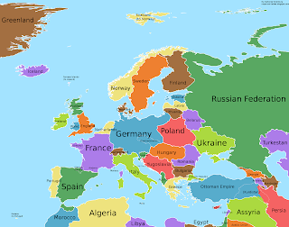


Why was Britain difficult to attack?

Slide 3
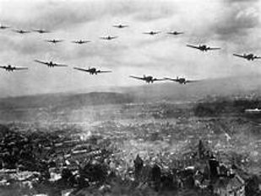
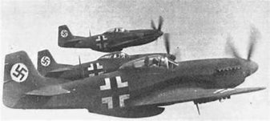
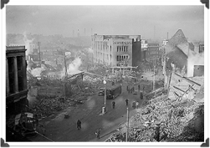
Germany couldn't attack with their troops because the Royal Navy could protect Britain from the sea.
So, in 1940, Hitler invaded Britain using the German air force, called the ‘Luftwaffe’. They began dropping bombs on the cities of Britain. These attacks were called air raids. The first bombing took place on 7th September 1940 with around 350 bombers flying across the channel to London.

Slide 4
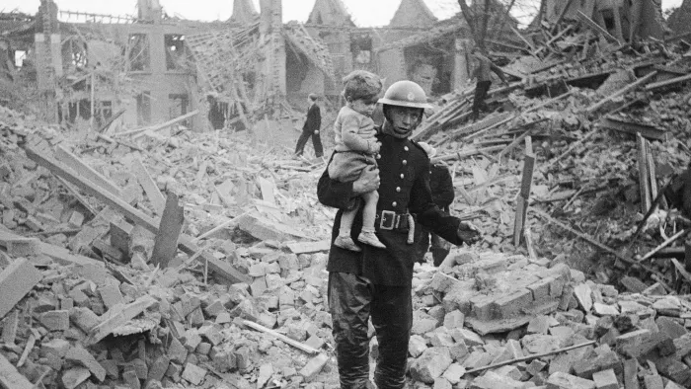
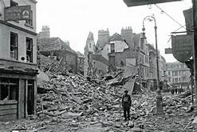
What or who were the air raids targeting?
It was mainly London that was targeted, but other British cities were also attacked. The Luftwaffe mainly targeted docks, factories and railways; they were military targets for the Germans as these places produced machinery for the war. Birmingham, Belfast and Coventry were heavily bombed.

Slide 5
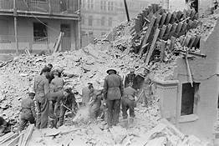
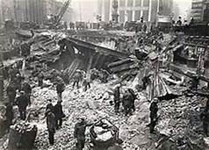
It wasn't just military targets that were bombed. Hitler also targeted the civilian population.
From that first night, when the Luftwaffe dropped bombs on London, every night for eleven weeks (except for one night) Britain was bombed by the Germans. One third of London was destroyed; this was known as 'The Blitz'. The word ‘blitz’ comes from a shortened version of the German word for ‘Lightening War’ - Blitzkrieg.​
https://www.youtube.com/watch?v=clKxrDza1d8
http://bombsight.org/#11/51.4801/-0.0999

Slide 6
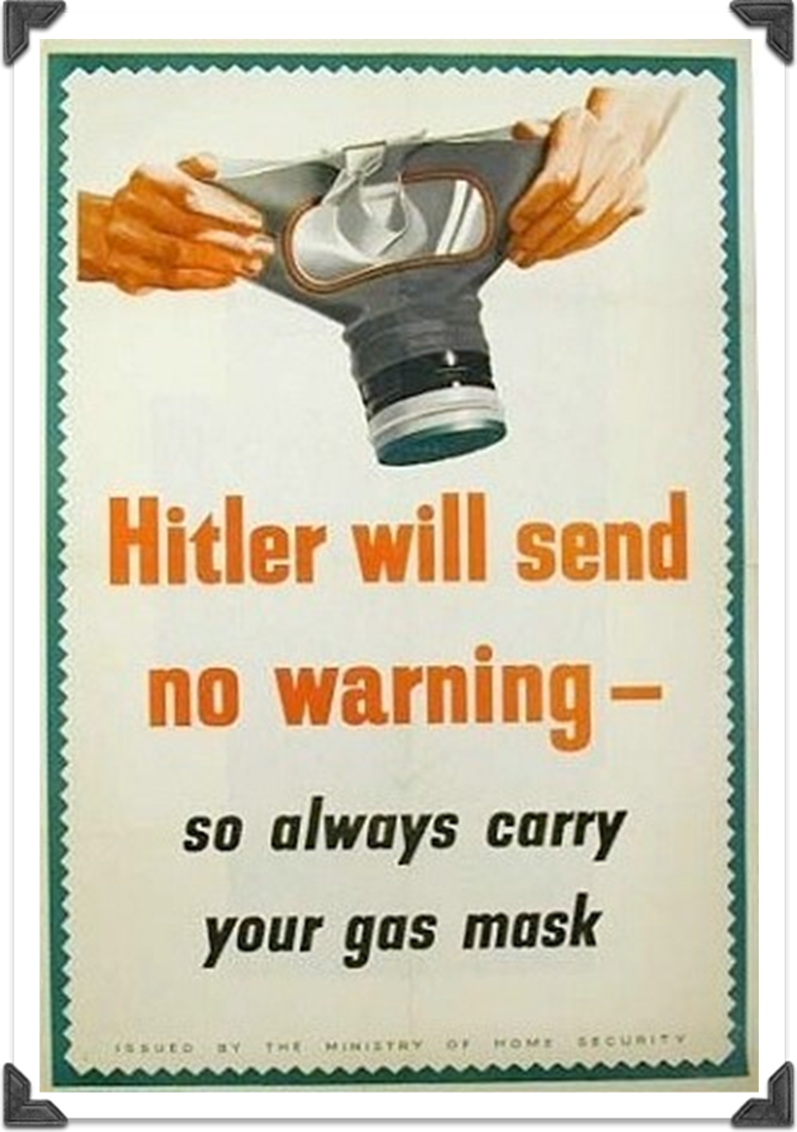
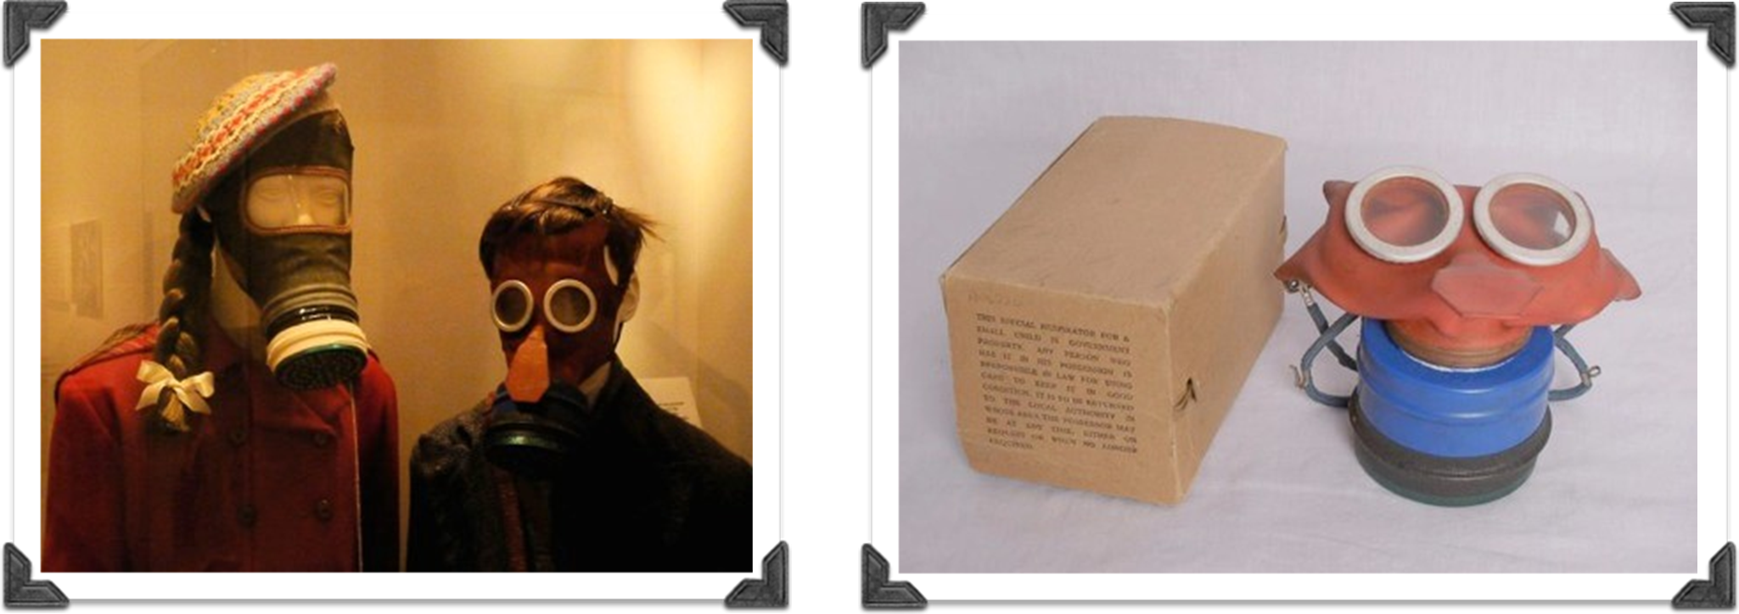
How do you think people protected themselves?
Even before the war officially started, the British government was concerned that during a war gas bombs could be dropped on Britain. For this reason, everyone was issued with a gas mask in a cardboard box in case a gas bomb was dropped.

Slide 7
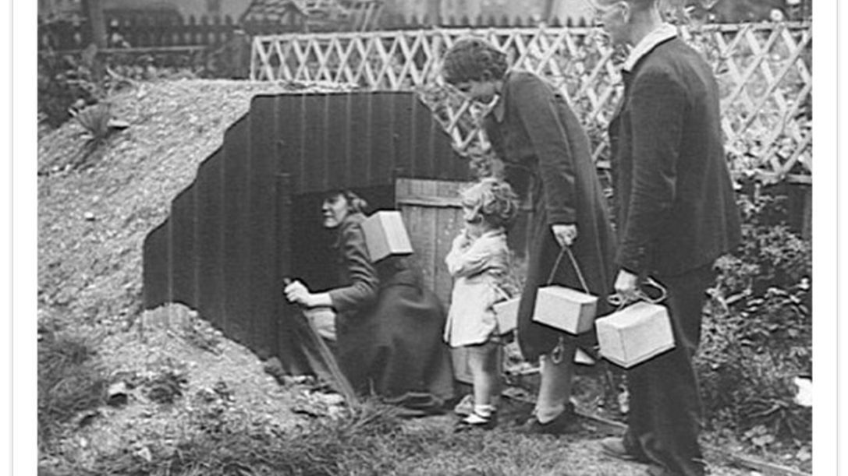
People were told to build shelters in their houses and gardens so they could protect themselves during air raids. One of the most popular was the Anderson shelter. These were made from iron sheets and dug half way into the ground. They were then covered with earth and soil. They kept people safe, but weren’t very comfortable and the sound of the bombs could still be heard.

Slide 8
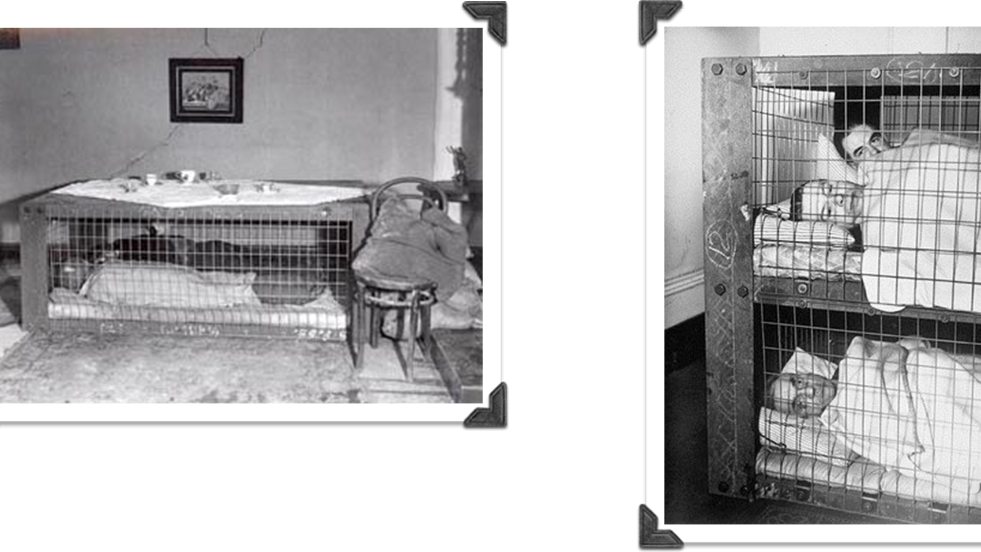
For those people who didn’t have gardens to build Anderson shelters in, another kind of shelter was introduced in 1941 called a Morrison shelter. This was made from steel and was simply a box big enough to crawl into if there was an air raid.
Some Morrison shelters were built on two levels like a bunk bed.

Slide 9
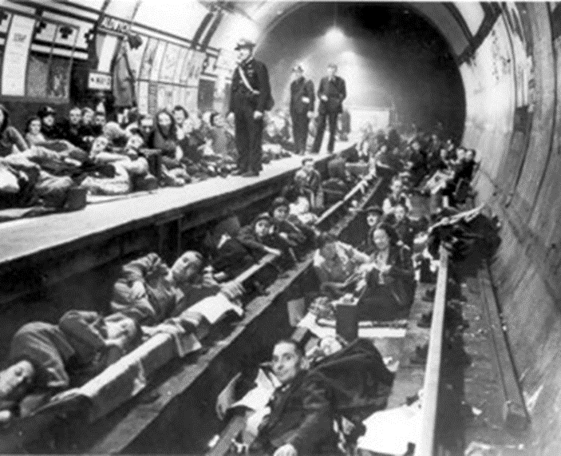
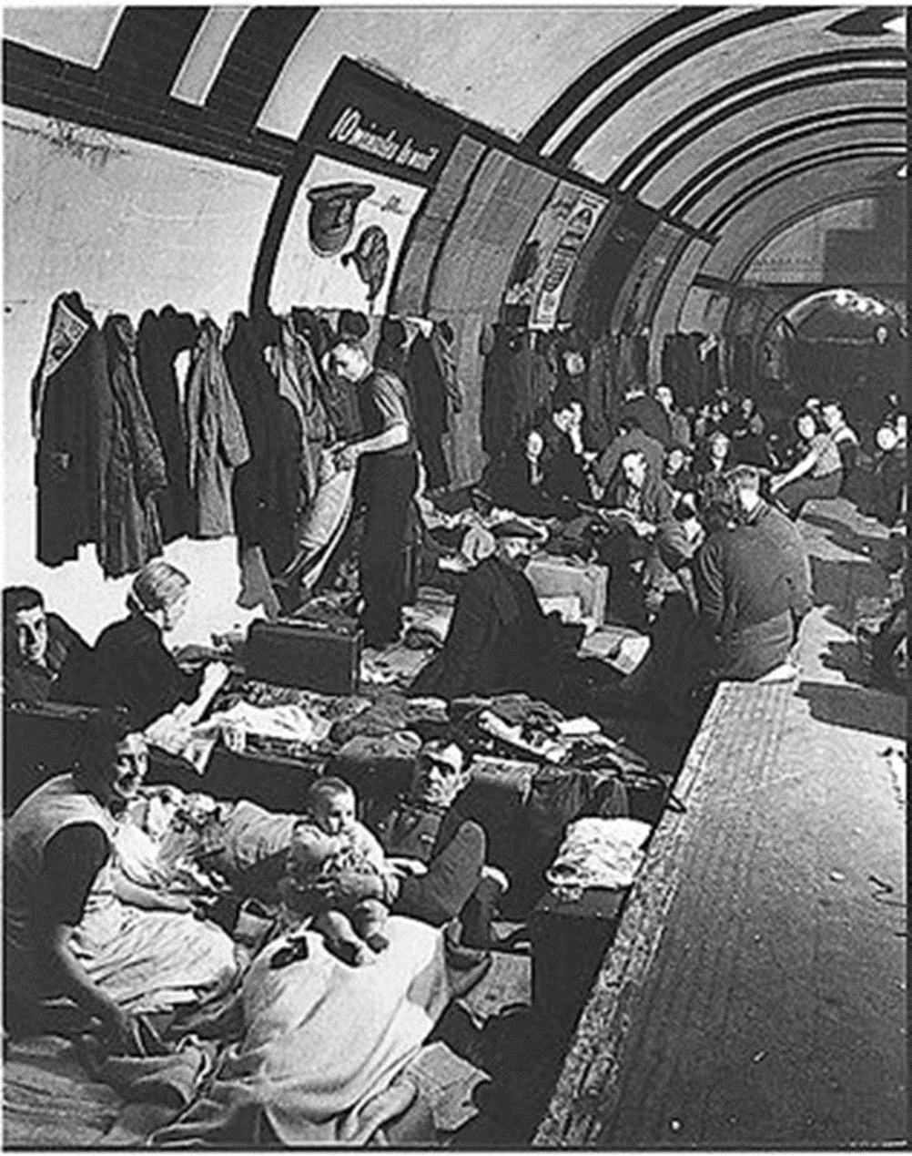
In London, people used the Underground as
a shelter during the Blitz. Hundreds of families
would squeeze onto the underground platforms to keep safe from the bombings overhead.

Slide 10
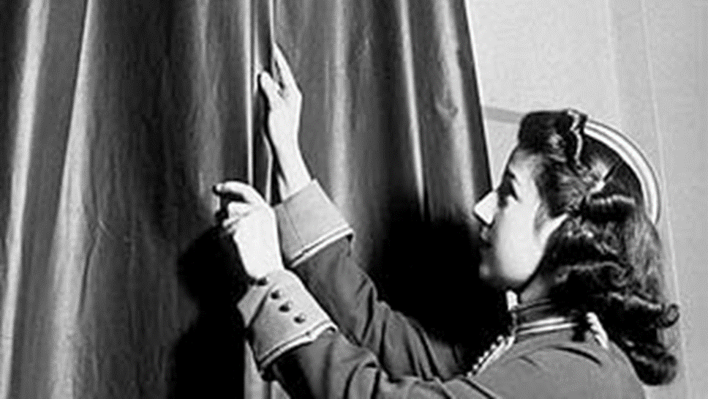
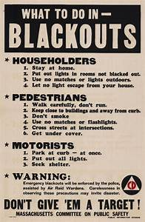
During the Blitz, the government told everyone to block out any light from their windows and doors using heavy blackout curtains, cardboard or anything else that would keep the light from being seen by the Luftwaffe. This was because they wanted to confuse the German planes so they wouldn’t know where to drop their bombs. The blackout could be dangerous though as car headlights and torches were not allowed. People often crashed into each other or fell over because they couldn’t see in the darkness.

Slide 11
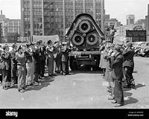
Air raid sirens
When radar detected the incoming Luftwaffe, an air raid siren would sound throughout London.
Imagine you were living in London during the Blitz.
You hear this sound – what do you do?
What are you thinking?
How are you feeling?
https://www.bbc.co.uk/programmes/p03tqqc7

Slide 12
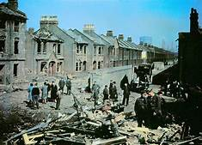
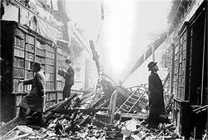

Was it fair that ordinary people were caught up in this?
Why did they still bomb if innocent women and children might be hurt?
Who would that affect?

Slide 13
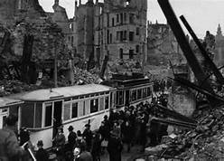
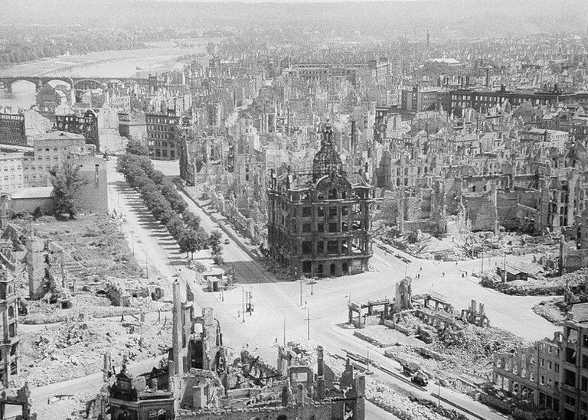
On 13 February 1945, British aircraft attacked the German city of Dresden. In the days that followed, they and their US allies would drop nearly 4,000 tons of bombs.
The ensuing firestorm killed 25,000 people.
Dresden was not unique. Allied bombers killed tens of thousands and destroyed large areas with attacks on Cologne, Hamburg and Berlin, and the Japanese cities of Tokyo, Hiroshima and Nagasaki.
How did the citizens of Dresden feel about this?
Do you think the Allied forces would treat German citizens in this way?

Slide 14
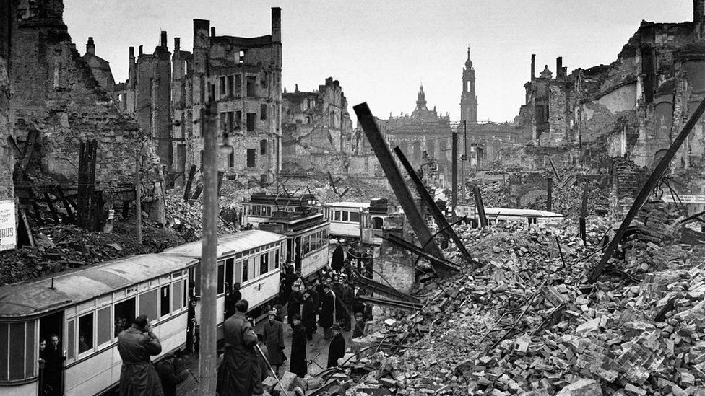
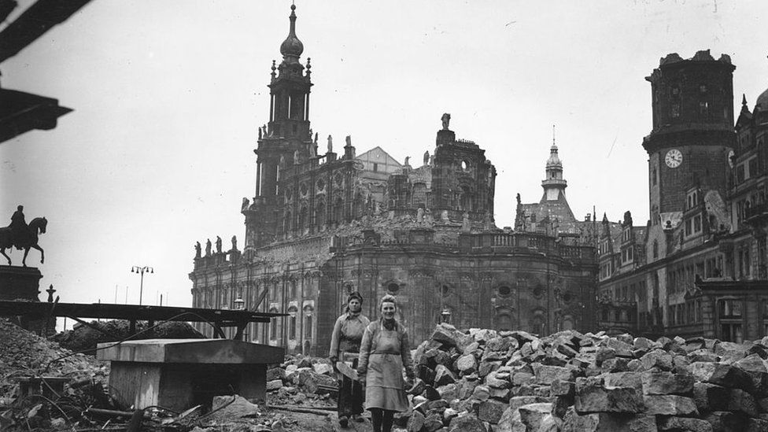
The bombing has become one of the most controversial Allied acts of World War Two. Some have questioned the military value of Dresden.
Even British Prime Minister Winston Churchill expressed doubts immediately after the attack.
"It seems to me that the moment has come when the question of bombing of German cities simply for the sake of increasing the terror, though under other pretexts, should be reviewed," he wrote in a memo.
"The destruction of Dresden remains a serious query against the conduct of Allied bombing."

Slide 15
Task:
Paddling: Work with CT/LSA to produce one paragraph of descriptive writing about the Blitz, using the blitz diary checklist to scaffold work.
Snorkelling and Diving: Write a diary entry describing your experience on one night during of bombing during The Blitz.
Red Pen: Were the Allied forces justified in bombing German cities just to terrorise the population?

