Slide 1
Monday 29th November 2021
LO: To write with purpose
To use paragraphs
To punctuate accurately
C: Persuasive Writing

Slide 2

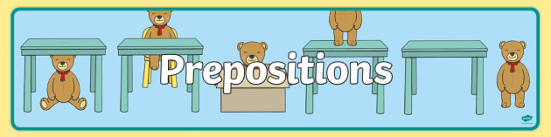
Prepositions
Can you remember what a preposition is?

Slide 3
A preposition is a word that tells you where or when something is in relation to something else.
Prepositions can convey time and place.
Can you think of any prepositions?

Slide 4
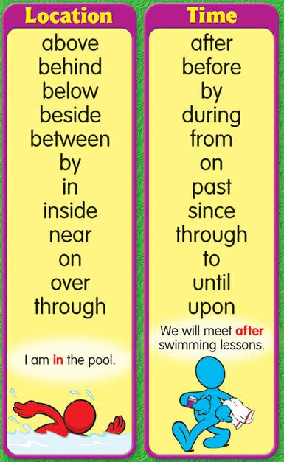
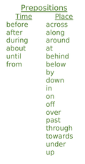
Can you use any of these prepositions in a sentence for your letter?
Write a list of prepositions that you would like to use in your writing.

Slide 5

Look back at your plan from last lesson.
How do we structure our persuasive paragraphs?

Slide 6
Step 1: introduce the argument
Step 2: explain what you mean in more detail, showing why your argument is important
Step 3: give some evidence to back up your argument

Slide 7


Remember:
The evidence and explanations you use need to link clearly to the point you are making!
Not everyone was doing this in their plan last lesson!
Example: You should introduce themed meals. / People waste so much food. / 100% of children want the menu to be changed.
Example: You should introduce themed meals. / This will help us to learn about cultures different to our own. / 100% of children would have a school dinner on themed days.

Slide 8
You are going to be writing one of your persuasive paragraphs today.
Remember the steps:
Step 1: introduce the argument? What is our point? What point do we want to make?
Step 2: explain what you mean in more detail, showing why your argument is important. What additional details do we want to share with Mrs Bell about our argument? Why is our argument important? Why does she need to know this?
Step 3: give some evidence to back up your argument. What data, statistics or anecdotes do we know that we can use to support our argument?

Slide 9
Example
Step 1: Firstly, isn’t it time to change, upgrade and improve your menu?
Step 2: Many children adore your flavoursome, home-cooked meals, but perhaps more children would enjoy school dinners if the menu were to change.
Step 3: Currently, 75% of children choose to have a school dinner now. However, our data identified that 100% of children would choose to have a school dinner if the menu changed. Moreover, 96% of children stated that they would like to change the menu. We are clearly blessed to have your food, but, evidently, it is no secret that an expanded menu is required.

Slide 10
Example
Step 1: In addition to this, a shameful amount of food is wasted with your current menu.
Step 2: Our school is carelessly discarding precious food that vulnerable, starving children do not have.
Step 3: Just last week, I observed every single child in my class leave perfectly edible food on their plate. Similarly, evidence suggests that 93% of the children in our school waste food. I’m disgusted by the amount of food wasted, aren’t you? It is an outrage, but you alone have the power to reduce this amount by making some desperately needed changes to the menu. If there was a wider variety of choice, then, arguably, there would be less food wasted, as children would choose the food they wanted to eat.

Slide 11
Activity
Have a go at writing one or two of your paragraphs for your letter.
Use the steps and my examples to help you.
Red Pen: can you improve any of the language/vocabulary you have used? Could you make any of the words more powerful, descriptive or emotive?

Slide 12
Tuesday 30th November 2021
LO: To write with purpose
To use paragraphs
To punctuate accurately
To organise writing appropriately
C: Persuasive Writing

Slide 13
Remember: you are writing a formal letter to Mrs Bell.
What does a formal letter need?

Slide 14
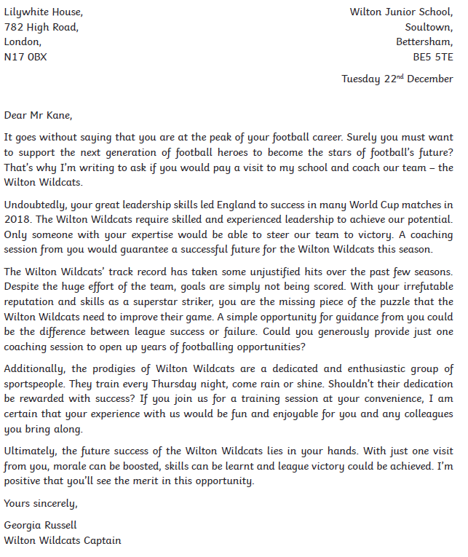
Are there any other features of formal letters we need to use in our writing?

Slide 15
Set out your page like a letter.
1: Write the sender’s (your) address in the top right hand corner
2: Write the date underneath
3: Write the recipient’s (Mrs Bell’s) address underneath on the left hand side
4: Write your greeting, i.e. Dear Mrs Bell

Slide 16

Remember that you need to choose one thing you would like Mrs Bell to do, i.e. introduce themed meals, upgrade and improve the menu OR introduce larger portion sizes.
If we ask her to do too much, we may overwhelm her and come across as ungrateful or demanding!

Slide 17
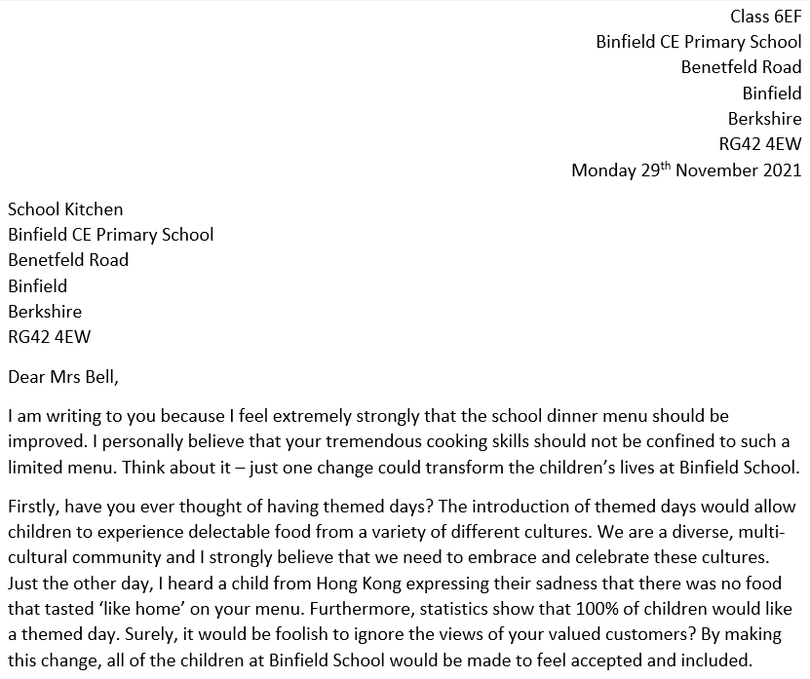
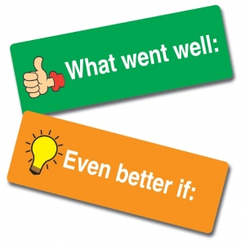
My letter to Mrs Bell

Slide 18
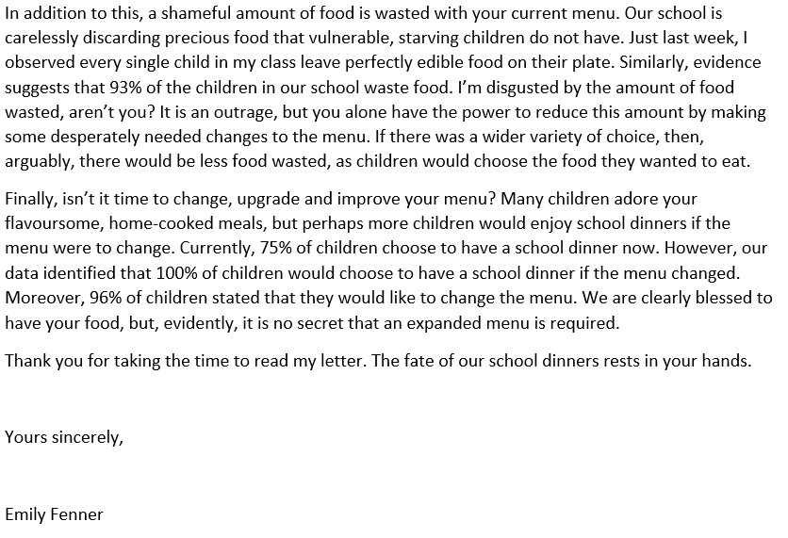
My letter to Mrs Bell

Slide 19
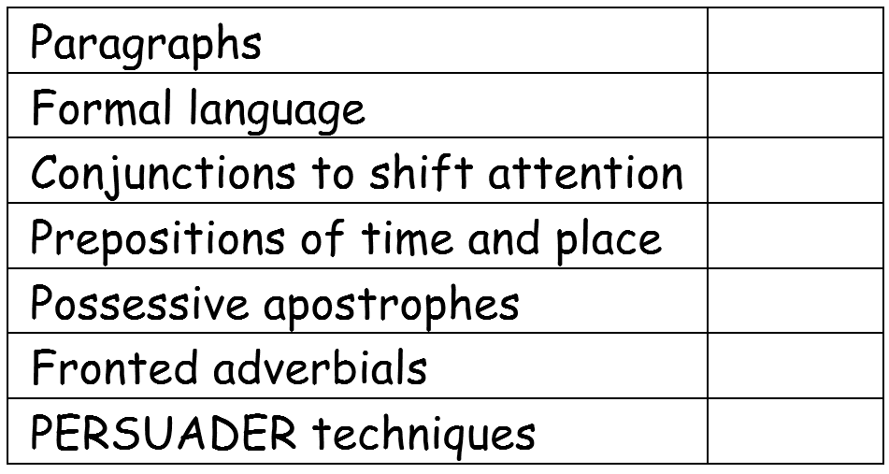
Do you know what all of the features are?
Can you find any examples of these features in my letter?

Slide 20
My letter to Mrs Bell

Slide 21
My letter to Mrs Bell

Slide 22

You will be starting to write your letter today and finishing it tomorrow.
I would expect you to have written the introductory paragraph and 1 of your main paragraphs by the end of the lesson.
Remember to use the paragraph(s) you wrote last lesson to help you structure your writing correctly.

Slide 23
Activity
Begin writing your letter to Mrs Bell using your work from last week and the checklist to help you.
Red Pen: read back over your work. Check that it makes sense.
  Have you used the correct punctuation?
  Have you used the correct spellings?
  Look at the writing checklist – which features have you used?
  Which features do you still need to include?
  Can you write a sentence or two to tick off any more features from the checklist?

Slide 24
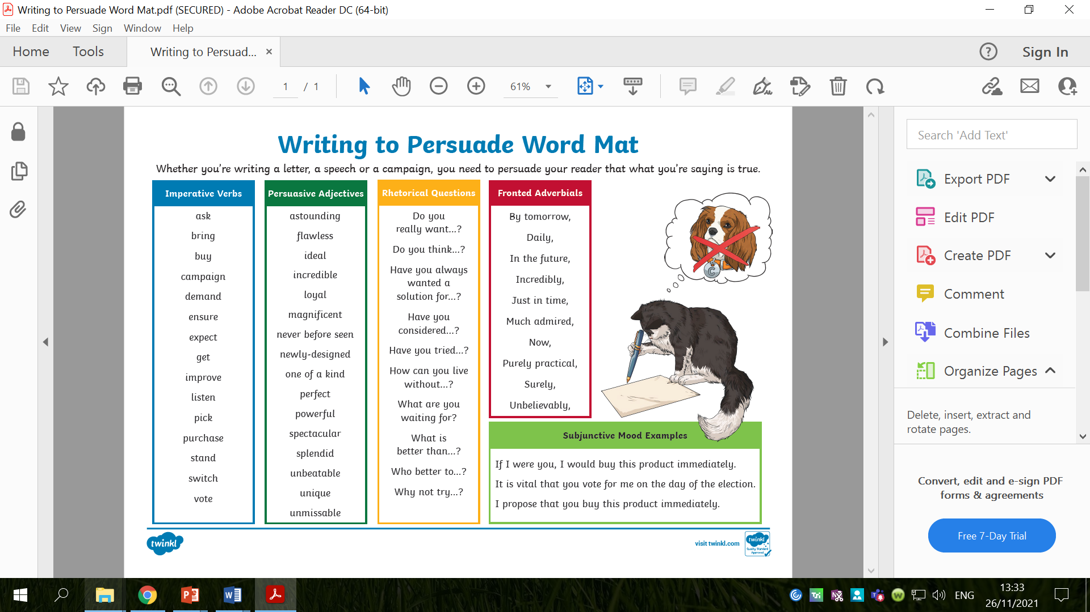

Slide 25
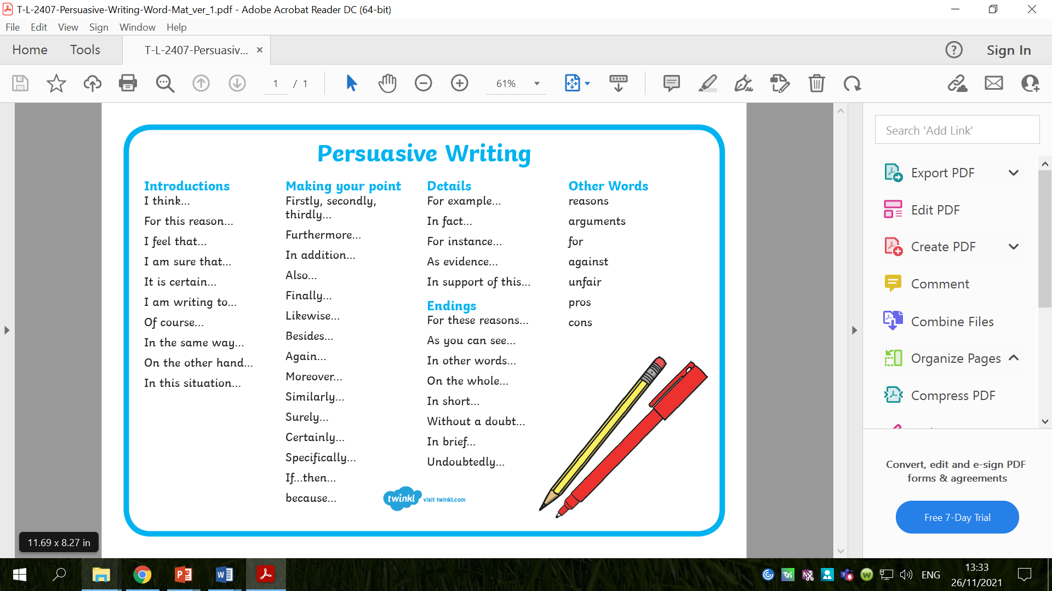

Slide 26
Wednesday 1st December 2021
LO: To write with purpose
To use paragraphs
To punctuate accurately
To organise writing appropriately
C: Persuasive Writing

Slide 27
What is a possessive apostrophe?
When do I need to use possessive apostrophes?

Slide 28
We use possessive apostrophes to show that one thing belongs to or is connected to something.

Slide 29
Examples
The cat's tail was fluffy.
Cat is a singular noun so you need to add an apostrophe and "s" to show that the tail belongs to the cat.
Charles' cat was naughty.
Charles is a singular noun that ends in an "s", so you need to add an apostrophe to show that the cat belongs to Charles.

Slide 30
Examples
The brothers' feet were muddy.
Brothers is a plural noun that ends in an "s" so you don't add another "s" after your apostrophe. You can just add an apostrophe to show the feet belongs to the brothers.
The children's toys were broken.
Children is a plural noun but it doesn't end with an "s" so you need to add an apostrophe and "s" to show that the toys belong to the children.

Slide 31
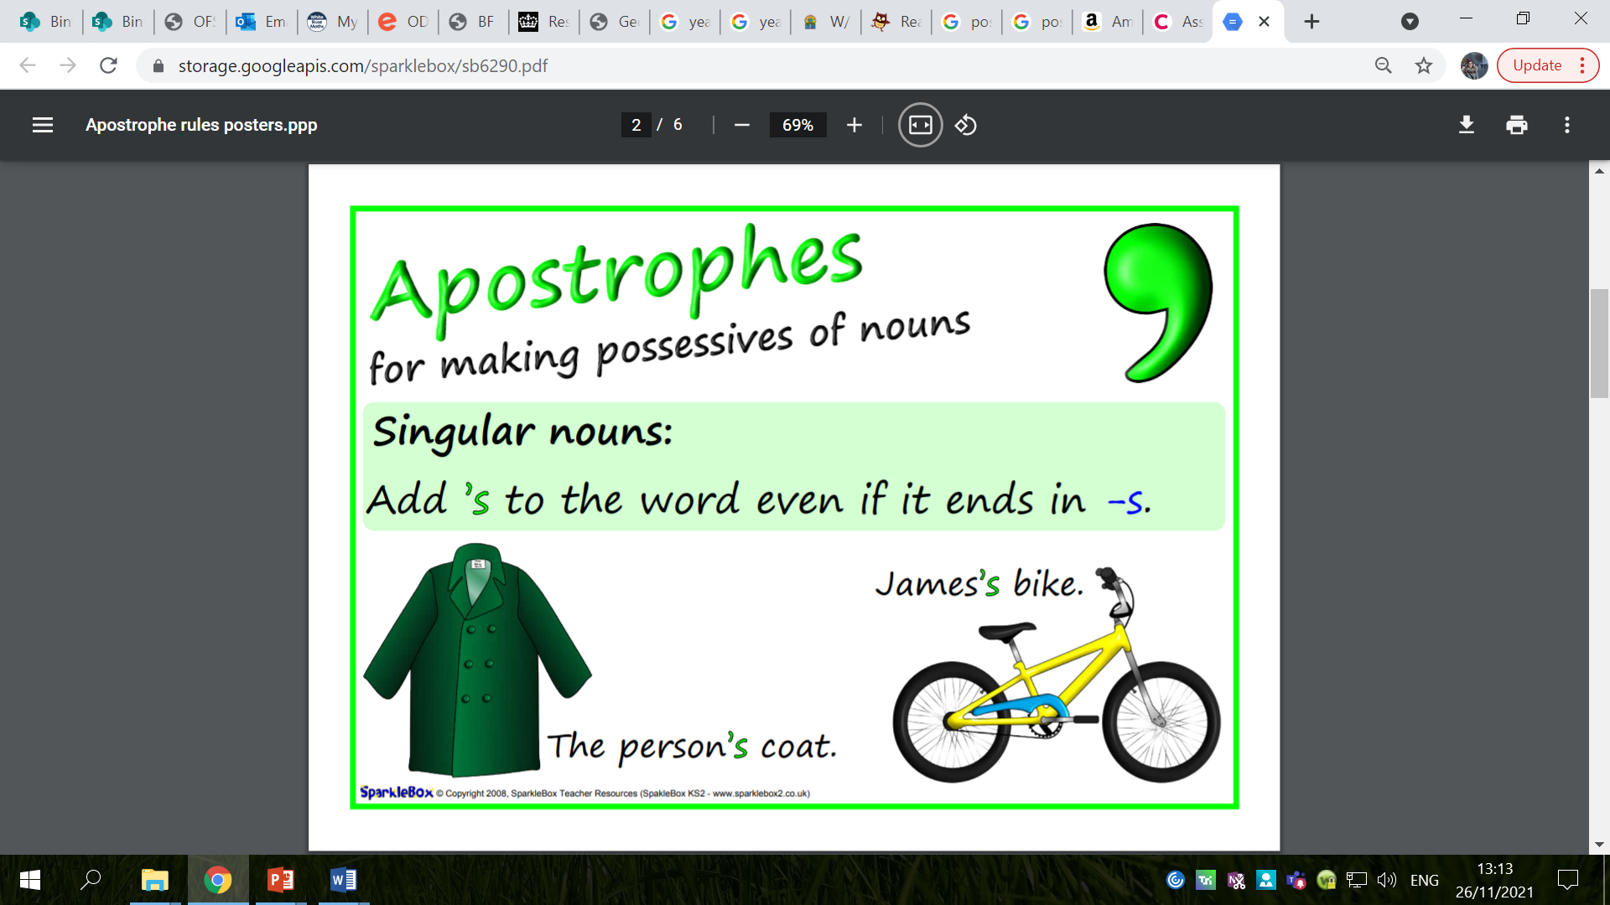

Slide 32
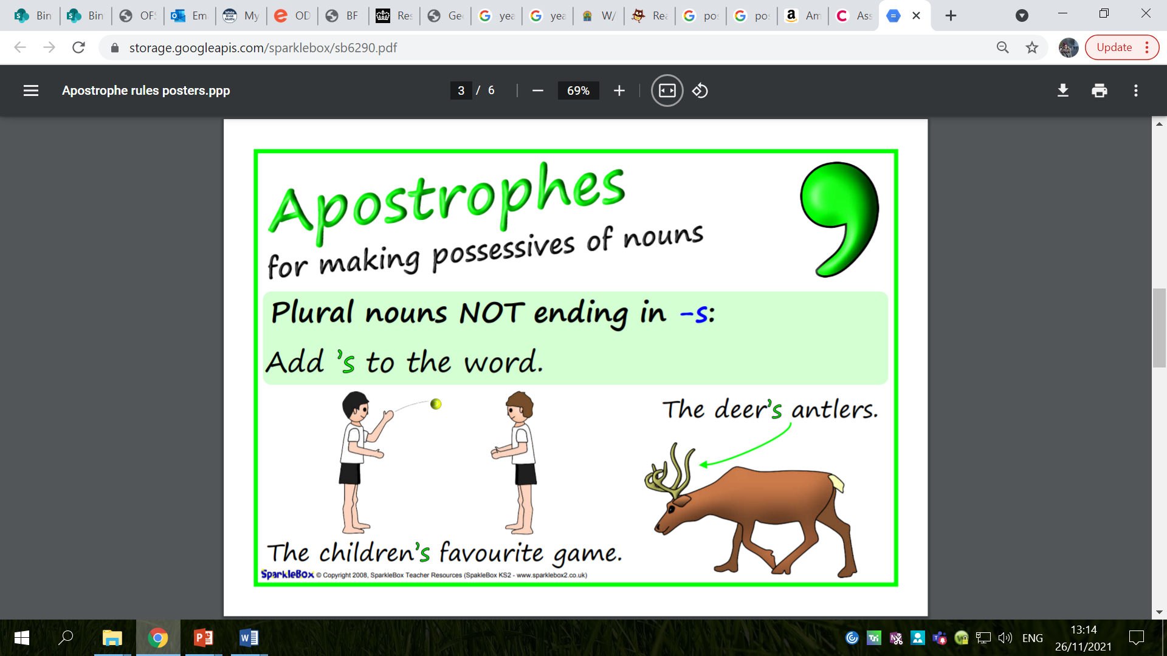

Slide 33
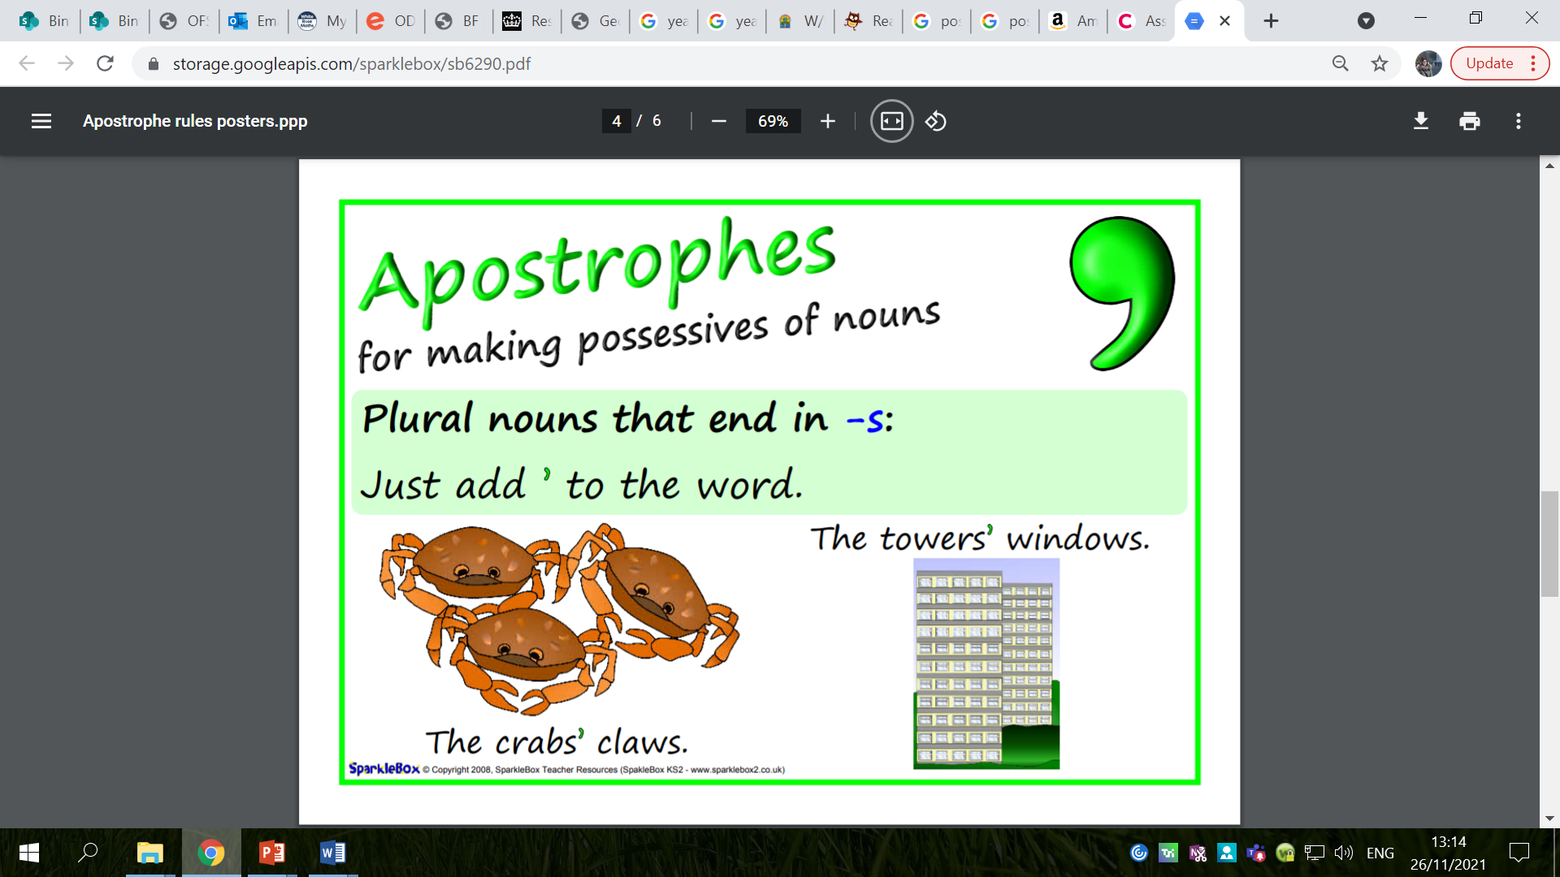

Slide 34
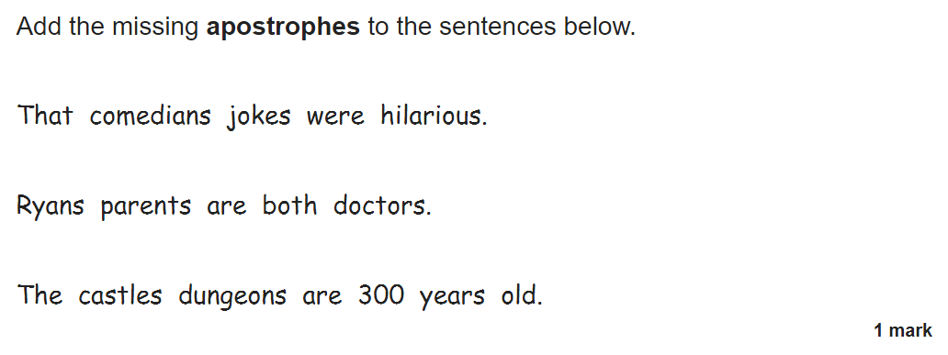

Slide 35
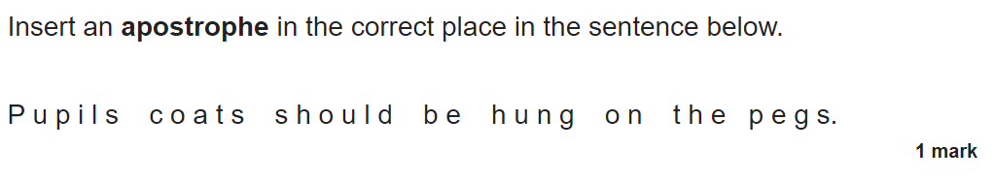

Slide 36
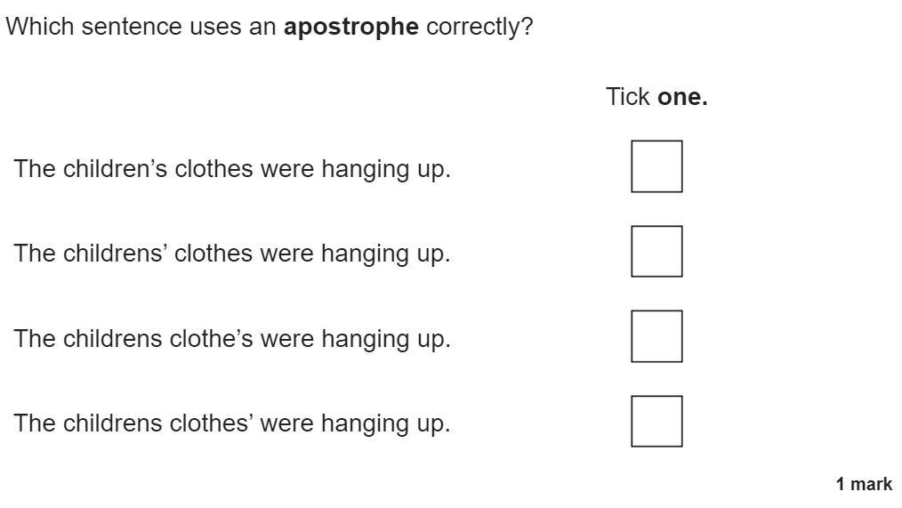

Slide 37
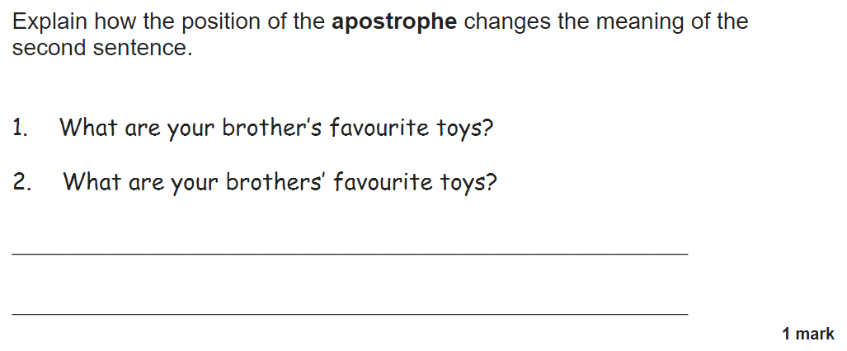

Slide 38
Look at your writing from yesterday.
What did you do well?
What do you need to improve?
What features of writing did you include yesterday?
What do you need to include together to complete the checklist?

Slide 39
You will be completing your letters today – we cannot send an incomplete letter to Mrs Bell!

Slide 40
How does this letter end?
How should we end a letter?
Look at my letter to Mrs Bell – how have I ended it?

Slide 41
If you know the person’s name, you should use ‘Yours Sincerely.’
If you have used ‘Sir’ or ‘Madam,’ you should use ‘Yours Faithfully.’

Slide 42
Activity
Finish writing your letter to Mrs Bell using your work from last week and the checklist to help you.
Red Pen: read back over your work. Check that it makes sense.
  Have you used the correct punctuation?
  Have you used the correct spellings?
  Look at the writing checklist – which features have you used?
  Which features do you still need to include?
  Can you write a sentence or two to tick off any more features from the checklist?
Look back at the vocabulary you have used. Use a thesaurus to improve the vocabulary. Try to make it as powerful, descriptive and emotive as possible.

Slide 45
Thursday 2nd December 2021
LO: To write with purpose
To organise writing appropriately
To use paragraphs
To spell correctly
C: Persuasive Writing

Slide 46
Look back over your writing.
Think about what you have done well in your letter writing and what you need to do today to improve it.

Slide 47
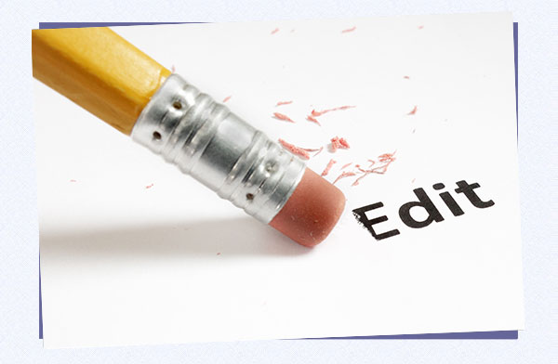
You will be editing and improving your letters today.
Next week, we will be writing our letters up in neat so we can give them to Mrs Bell!
Try to edit your writing independently!
If you are really stuck – then ask an adult to help you find the mistake!

Slide 48
Activity
Edit and improve your letters using the highlighting, checklist and marking comment to help you.
Try to edit your writing independently before you ask an adult.

