Slide 1
Power Struggles
PSHCE

Slide 2
Underline words that represent acceptance and equality.

Slide 3
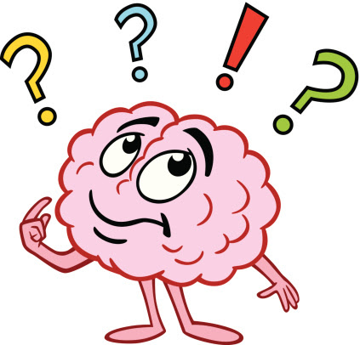
How might it feel to not be accepted by being different in some way?

Slide 4
Scenario
A boy knows something secret about another child.
How might this give the boy ‘power’?
His knowledge.
How does power affect acceptance and equality?

Slide 5
Scenario
A girl has a reputation for organising her friends to beat
people up on the school bus.
How might this give the girl ‘power’?
She has power because she manipulates her friends and because others are frightened of her.
How does power affect acceptance and equality?

Slide 6

There are many different ways that people gain power over others.
They can only use this power if you let them!

Slide 7
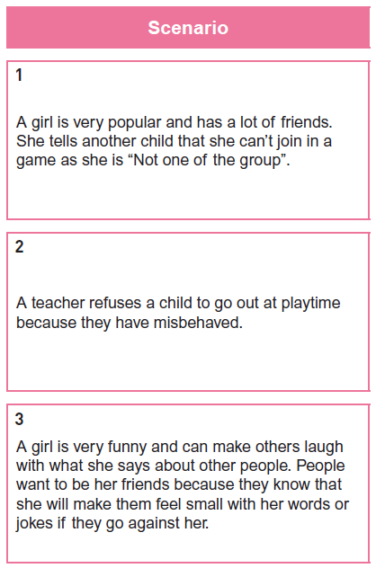
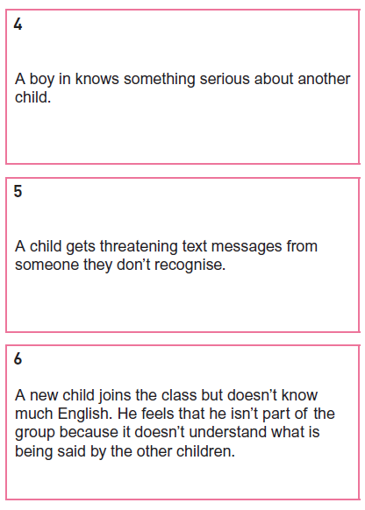
Discuss each scenario to establish what gives power to the people.
Make a list of the ways people can be allowed to gain power over others.
How can we prevent someone gaining power over us?

