Slide 1
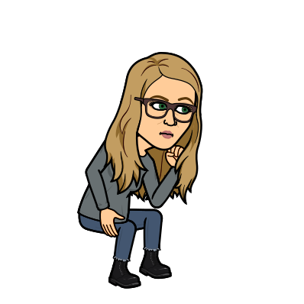
Lesson 2
L.O: To investigate and interpret the past.
C: Recognise axis and allied powers and identify key leaders in WWII.

Slide 2

Q: Can you summarise the FIVE steps towards
the declaration of war from last week?
1. Nazi Germany seeks vengeance for defeat in WW1.
2. Invasions begin. (Austria, Czechoslovakia, Poland).
3. Britain and France threaten war.
4. War is declared!
5. Phoney war

Slide 3
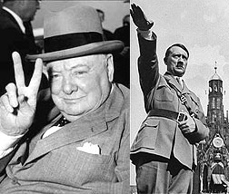
Allied and Axis Powers
The Second World War was fought by countries on two different sides, the Allies and the Axis Powers.
Tell your partner who the Allies and Axis powers were.
Make a list of the countries involved and whether they fought for the Allies or the Axis powers.

Slide 4
Allied and Axis Powers
The Second World War was fought by countries on two different sides, the Allies and the Axis Powers. Here are some of the countries on each side.
The Allies | The Axis Powers
Great Britain | Germany
The Soviet Union | Italy
France | Japan
The United States of America | Romania
India | Hungary
China | Bulgaria
Australia
New Zealand
Canada
What might ‘neutral’ mean? Why would countries remain neutral?
Some countries were neutral, including Spain, Sweden, Switzerland and the Republic of Ireland.

Slide 5
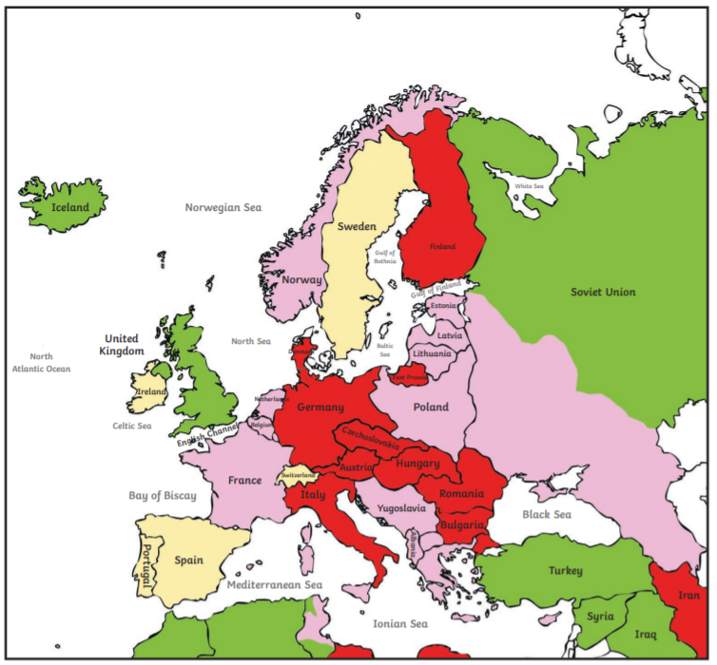
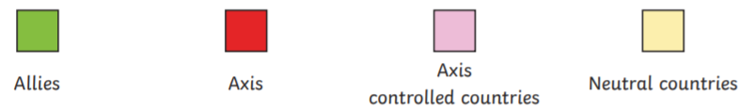
Europe on the Eve of World War II, 1939

Slide 6

The Allies and the Axis Powers
Here are some of the leaders from each side.
The Allies | The Axis Powers
Neville Chamberlain | Adolf Hitler
Winston Churchill | Benito Mussolini
Franklin Delano Roosevelt | Tadeki Tojo
Joseph Stalin
Can you recognise any of these names? Do you know which countries they led in WW2?

Slide 7
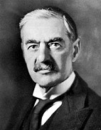
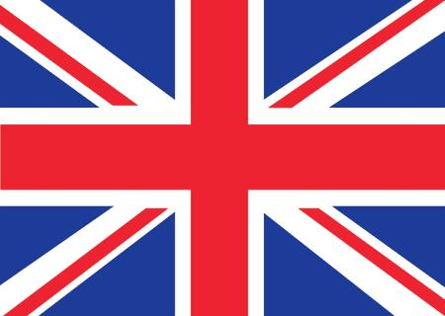
The Allies
Neville Chamberlain
Prime Minister of Great Britain in September 1939 at start of WWII
Notes:
In May 1940, after the disastrous Norwegian campaign, Chamberlain resigned and Winston Churchill became prime minister

Slide 8
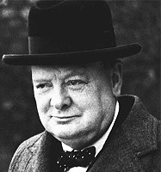
The Allies
Winston Churchill
Prime Minister during most of the war, from 1940 to 1945
Notes:
An early opponent of Hitler, he came into power after the Invasion of Poland.
During the Battle of Britain, Churchill's speeches boosted the British morale during the darkest moments. He became prime minister on May 10, 1940

Slide 9
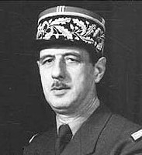
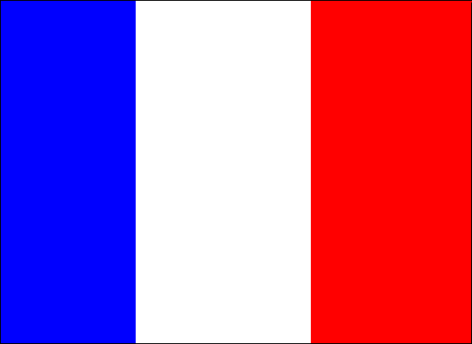
The Allies
Charles de Gaulle
French general who led the French in their fight against Germany. After WWII, he became president of France.
Notes:
Brutal dictator
In the years before WWII Stalin murdered or imprisoned almost all of Russia's senior military officers, and millions of other Russian citizens, in a paranoid and unprecedented wave of political terror- so had total control

Slide 10
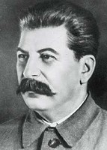
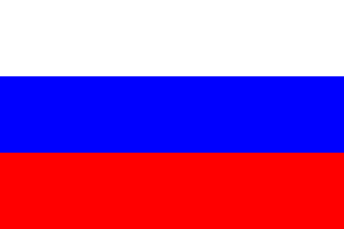
The Allies
Joseph Stalin
Communist dictator of Russia (1928-1953)‏
Notes:
Brutal dictator
In the years before WWII Stalin murdered or imprisoned almost all of Russia's senior military officers, and millions of other Russian citizens, in a paranoid and unprecedented wave of political terror- so had total control

Slide 11
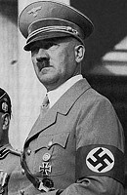
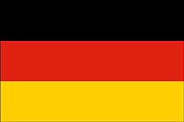
The Axis
Adolf Hitler
German dictator (1933-45) who planned & started WWII.
Notes:
He rose to power by leading a group called the Nazis
He wanted to dominate Europe and exterminate those whom he viewed as inferior.

Slide 12
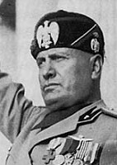

The Axis
Benito Mussolini
Prime minister of Italy (1922-1943). He joined forces with Hitler to fight the Allied powers.
Notes:
He joined forces with Adolph Hitler to fight the Allied powers.
Eventually, he was sacked as prime minister and executed by his own people.

Slide 13
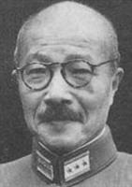
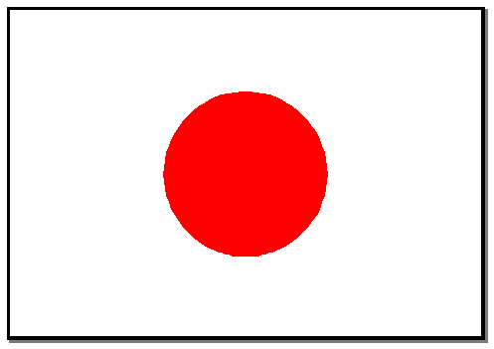
The Axis
Hideki Tojo
Prime minister of Japan (October 1941 - July 1944)‏
Notes:
He joined forces with Adolph Hitler to fight the Allied powers.
Eventually, he was sacked as prime minister and executed by his own people.

Slide 14
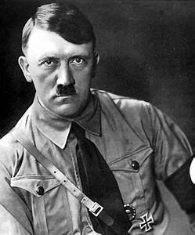
Adolf Hitler
Side: Axis Powers
Country: Germany
Lived: 1889 – 1945
Did You Know…?
Hitler fought for the German Army in the First World War and won the Iron Cross First Class for bravery.
Hitler’s Nationalist Socialist Party (the Nazi Party) won power in 1933. Their main beliefs were:
Germany needed more land;
all people who spoke German should live in one country and be ruled by one strong leader (Hitler himself was born in Austria);
that certain groups of people were better than others and people of the Jewish faith weren’t as good as others.

Slide 15
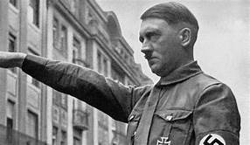
Adolf Hitler
Throughout the 1930s, Hitler built up Germany’s
armed forces and weaponry. He was known as a
skilled orator which is one of the reasons for his
huge popularity.
https://www.youtube.com/watch?v=FJ3N_2r6R-o
Initially, the war went well for Hitler. However, in 1941 he made the mistake of starting war on a second front by invading Russia. Eventually, fighting a war across such a huge area caused Germany’s defeat.
Realising the war was nearly at an end, Hitler went into hiding in his underground bunker in Berlin (the capital of Germany). There he married his long-term companion, Eva Braun on 30th April 1945. Rather than surrender to the Allies, Hitler took his own life.

Slide 16
Neville Chamberlain
Side: The Allies
Country: Great Britain
Lived: 1869 – 1940
Neville Chamberlain became Prime Minister in 1937.
At this time, Germany was building up its army, navy and supply of weapons, as well as invading several areas. All of these things were against the peace terms set out at the end of the First World War. Chamberlain felt the best way to avoid another world war was something called appeasement. This meant allowing Hitler whatever he wanted in order to keep peace.

Slide 17
Neville Chamberlain
In 1938, Chamberlain flew to Germany to meet with Hitler. Both leaders signed a document called the Anglo-German agreement which stated the “symbolic desire of our two peoples never to go to war again”. On his return to Britain, Chamberlain declared that there would be “peace for our time”.
The invasion of Poland in September 1939 showed that Hitler had no intention of sticking to the terms of the Anglo-German agreement. As Britain had made a pact with Poland, the invasion meant that Britain and Germany were now at war.
With the war going badly, Chamberlain resigned in 1940.
Chamberlain died on 9th November 1940, not long after his resignation.
Do you think Chamberlain was right to keep peace?

Slide 18
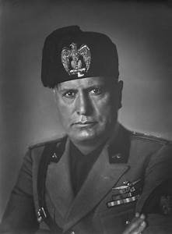
Benito Mussolini
Side: Axis Powers
Country: Italy
Lived: 1883 – 1945
Mussolini wanted to restore the Roman Empire. In March 1919, he started the Fascist Party. The Fascist Party’s main beliefs were:
that Italy should invade countries and make them part of their Empire;
that white people (the ‘Aryan race’) were better than everyone else, particularly Jewish people.
Members of the Fascist Party wore all black and became known as ‘Black Shirts’. They often became violent to people who disagreed with their beliefs.

Slide 19
Benito Mussolini
Mussolini was a dramatic orator which helped him gain popularity. In 1922, Mussolini took control of Italy and eventually became a dictator. Just like Hitler was doing in Germany, Mussolini started to build up his country’s armed forces and weapons. In 1936, Italy invaded Ethiopia in Africa. Like Hitler, Mussolini brought in anti-Jewish policies throughout the 1930s.
The Pact of Steel was a treaty signed in 1939 between Italy and Germany and in 1940 Italy entered the Second World War.
By 1943, Italy had suffered huge military defeats and on 23rd July of that year, Mussolini resigned. German forces rescued Mussolini before he could be arrested by the Allies. As the war neared its end and Allied forces captured more areas, Mussolini disguised himself as a German soldier on a convoy heading towards Austria. However, some Italian people recognised Mussolini and shot him.

Slide 20
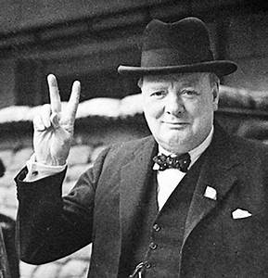
Winston Churchill
Side: The Allies
Country: Great Britain
Lived: 1874 – 1965
Churchill became Prime Minister following Chamberlain’s
resignation in 1940. Churchill was the head of the Royal
Navy during the Second World War. However, he made
some military decisions that went badly. He resigned and
went to fight in the war.
Churchill became a national hero for his leadership and has been voted as the 'Greatest Briton' in a national poll that attracted over 1 million votes.
In the darkest days of the war, when it seemed as though the Allies may lose, he made inspirational speeches that kept British morale high.
https://www.bbc.co.uk/bitesize/topics/zkrkscw/articles/zfq9pg8
https://www.youtube.com/watch?v=MkTw3_PmKtc

Slide 21
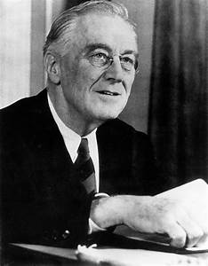
Franklin Delano Roosevelt
Side: The Allies
Country: United States of America
Lived: 1882 – 1945
Initially, the United States weren’t involved in the Second World War. Although Roosevelt felt the US should join, most American people were against it. It wasn’t until Japan bombed Pearl Harbour (a US naval base in Hawaii) in December 1941, that the United States joined the Allies and were involved in the war.
For the rest of the war, Roosevelt made many radio broadcasts: making speeches that boosted morale.
He died from his long-term health problems on 12th April 1945, before the end of the war.

Slide 22
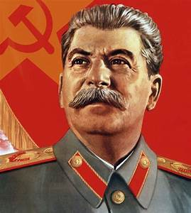
Joseph Stalin
Side: The Allies
Country: The Soviet Union
Lived: 1879 – 1953
Stalin came from a very poor family and had a hard childhood. In the early twentieth century, Stalin joined a group called the Bolsheviks, who lead the Russian Revolution in 1917. The revolution overturned the government and removed the Tsar (the Russian ruler) from power. In 1924, Stalin became leader of the Soviet Union.

Slide 23
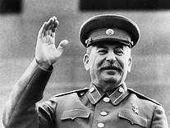
Joseph Stalin
Stalin’s alliance with the Allies was controversial because of two things:
His policies – he introduced purges, where his enemies were either killed or sent to prison camps. It is estimated that between 20 million and 40 million people were killed as a result of these policies.
Originally, Stalin had made an alliance with Hitler. Stalin only joined the Allies after Germany attacked the Soviet Union in 1941.
Despite this, the Soviet Union played a key role in the Allies’ victory. Over three quarters of all German soldiers killed, died fighting the Soviet Union. 26 million Soviet people died in the war and lots of the country was destroyed.
Despite being Allies in the war, relations between Stalin and the USA and Great Britain were not good and eventually turned into the Cold War.
Given the way Stalin led, do you think Great Britain were right to form an
alliance with him?

Slide 24
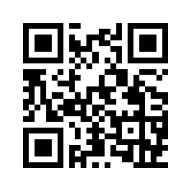



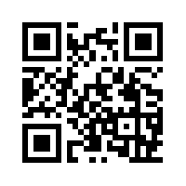
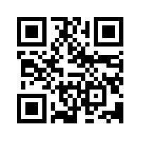
Task:
Using internet research and your resources, create a fact page on one of the world leaders we have learnt about today.
Go to our class page on the Binfield School website for links to the world leaders.
Red Pen: Assess the role of your chosen leader in the war – did they lead their country to the advantage of their people? Why?
Stalin
Chamberlain
Roosevelt
Churchill
Mussolini
Hitler

