Slide 1
LO: To investigate living things
To work scientifically
C: Classification Keys

Slide 2
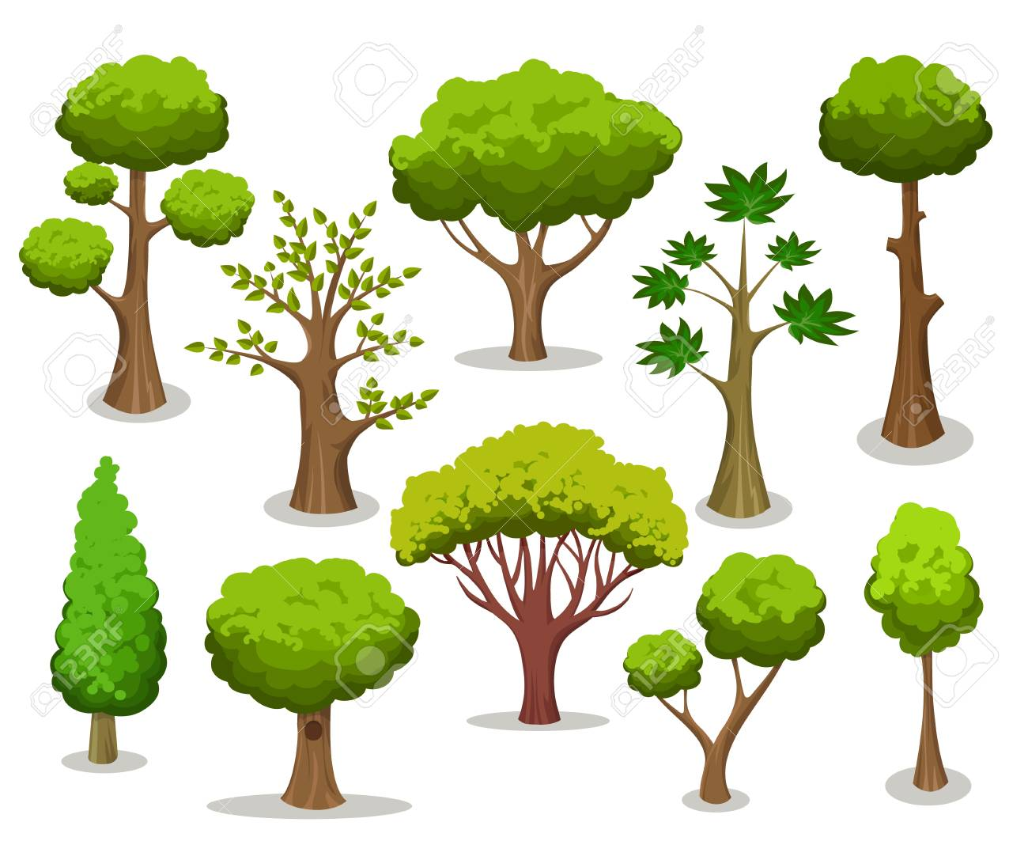
If you are able to, you are going to see what trees are outside (in your garden)!
You will be looking for a range of trees to classify.
Prediction: which tree species do you think you will find?

Slide 3
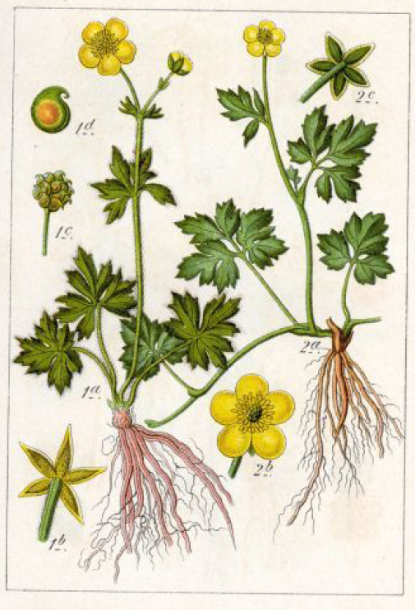
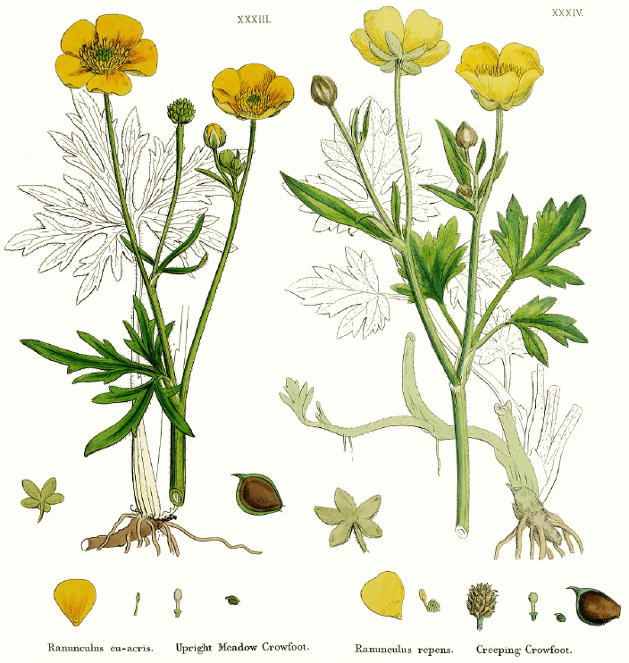
You will be sketching the trees outside (in your garden).
Artists who produce have to observe their subjects very carefully.
https://www.nhm.ac.uk/our-science/departments-and-staff/library-and-archives/collections/modern-botanical-illustration.html

Slide 4

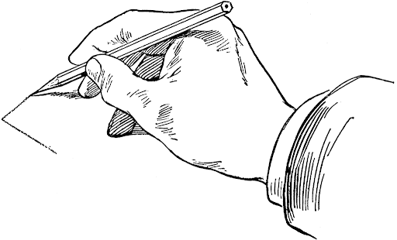
Outside (in your garden)
1. Sketch approx. 6 different trees or wildflowers that you can see outside (in your garden) and label these with either their names (f known) or A, B, C etc.
2. Collect leaf samples from the 6-8 trees/wildflowers that you drew outside (in your garden).

Slide 5
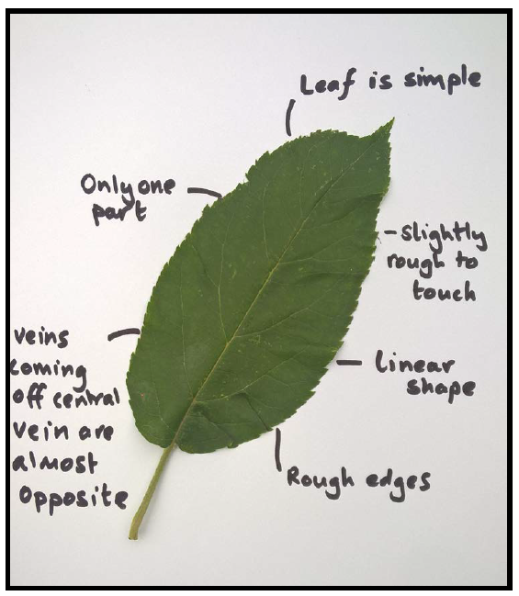
Activity 1
Once you have collected your specimens, look at your tree/wildflower sketches and add a detailed sketch of the leaf next to your tree/wildflower sketch.
Remember to focus on drawing what you see and using back and forth movements of the pencil to create accurately shaped lines.
Create leaf features files to ensure that you have noted the very specific features of the leaf.

Slide 6
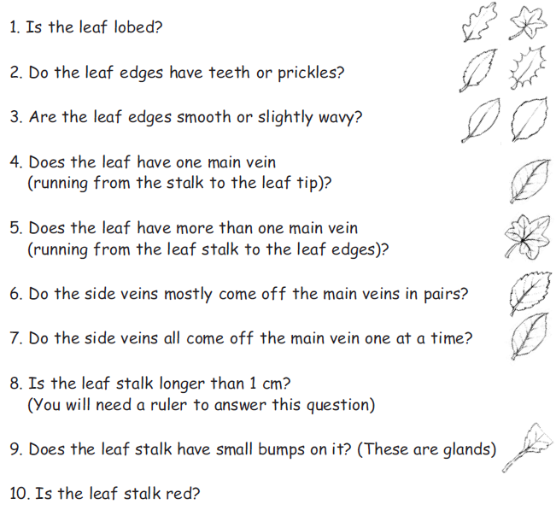
Activity 2
Create a classification key to classify your leaves.
Remember to look for obvious differences to separate the leaves into two groups first.
Then look at each group separately (there may be another obvious difference or there may be a smaller difference) to work out a question to separate those leaves.
Make a final copy of your classification key and stick the leaves into the right places.
Write the name of the wildflower/tree if you know it.

Slide 7
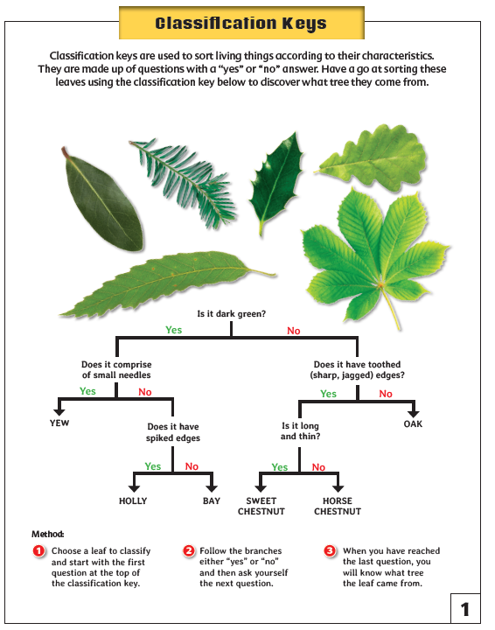
If you are unable to go outside:
Complete the leaf classification activity.

Slide 8
Red Pen
How easy/hard did you find classifying the leaves?
Explain why you felt this way.

Slide 9

Plenary
There are at least 50 species of native tree in the UK (many more if we include non-native species) and about 100,000 worldwide!
What does ‘native’ mean?
‘Non-native’?

Slide 10
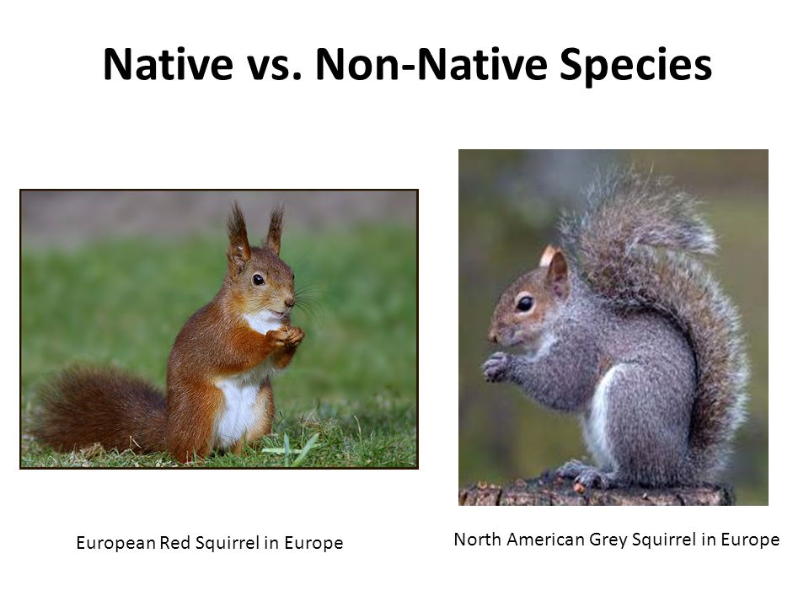
Native - living or growing naturally in a particular place or region
Non-native - living or growing in a place that is not the location of its natural occurrence

