Slide 1
Monday 22nd November 2021
LO: To write with purpose
To punctuate accurately
C: Persuasive Writing

Slide 2


Starter
Mrs Bell is looking to change the school dinner menu!
What is your favourite school dinner?
What new items do you think we should see on the new, revamped school menu?
Why?

Slide 3
Over the next few weeks, you are going to write a persuasive text to Mrs Bell to try and convince her that our menu items are the best ones to go on the new menu!

Slide 4

We all use persuasive techniques at one time or another – we do it to get our own way!
Persuasion is part of our everyday language.

Slide 5
What do you know about persuasive writing?
Can you think of a time when you have seen or used persuasion?
Under what circumstances would you try to persuade someone to do something?
Think about the last time you tried to persuade your parents to let you go somewhere or have something. What did you say?
Think about the last time your parents tried to persuade you to do something. What was it and what did they say?
Think about the tone you both used.
What was successful?
What failed?

Slide 6
Some texts are written to persuade the reader to think or do something.
The aim is to make the reader think or act in a particular way.
For example:
Advertisements – Buy now!
Health posters – Look after yourself!
To persuade in words, writers can use a range of techniques.

Slide 7
A good way to make your writing more persuasive is to think of the following:
Personal: keep your writing friendly, e.g. using personal pronouns (like you and your to make your reader feel special.
Emotive: use emotive language to make your reader have strong feelings.
Rhetorical Questions: to make your reader stop and think
Statistics and Facts
Undermine: mention different opinions to yours and say why they are wrong.
Alliteration and Anecdotes: a short, funny, real-life story will help the reader connect with you.
Description and Imagery
Exaggeration: make a big deal of what you say!
Repetition and Rule of Three: say it again – repeat your message!

Slide 8
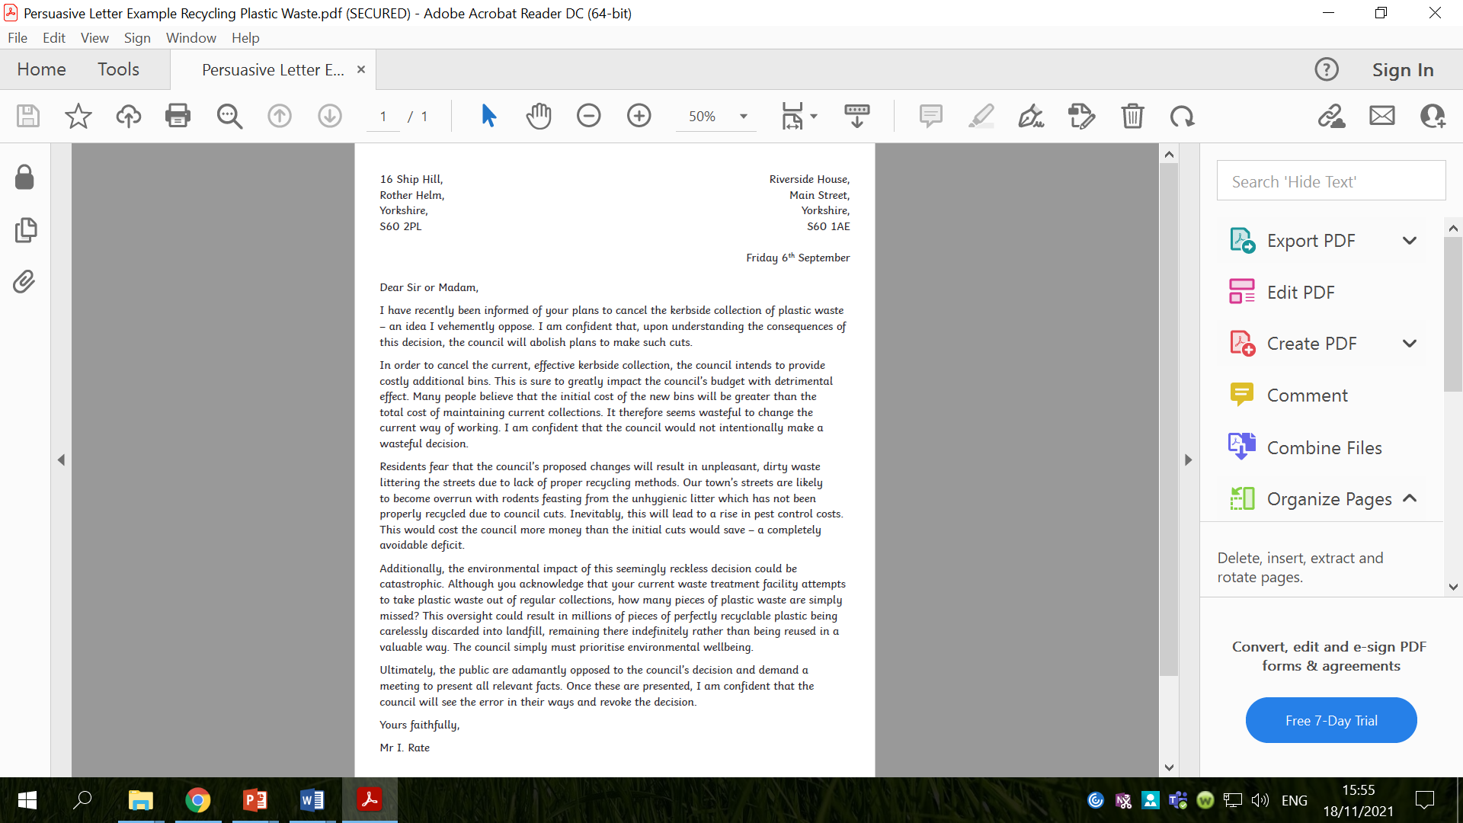
Activity
Read the text you have been given and analyse it carefully, identifying and annotating the persuasive techniques (PERSUADER) used.
Do all of the PERSUADER techniques appear?
Red Pen: create a bubble map of your ideas about how to persuade Mrs Bell to choose your menu idea(s).

Slide 9
Red Pen Example
metaphor
personal pronouns
simile
personification
emotive words
Imagery
Language
alliteration
senses
exaggeration
The Cool School café should
adopt my menu plans
repetition
undermine
rule of three
Techniques
anecdotes
statistics and facts
rhetorical questions

Slide 10
Tuesday 23rd November 2021
LO: To write with purpose
To punctuate accurately
C: Persuasive Writing

Slide 11
Starter
Watch:
https://www.youtube.com/watch?v=CtqO6wcuhOw
https://www.youtube.com/watch?v=5lwMQYxm23U&list=PL_yW5gr0lcwW3bfb0bTXEhhRs09ie-kX3&index=8
Create a list of the descriptive phrases used to describe food.

Slide 12
Sensory Description
Appearance | Aroma | Flavour | Texture
Appetising Attractive Bright Browned Bubbly Chunky Clear Cloudy Colourful Crisp Crumbly Delicate Dry Fancy Firm Flaky Flat Fluffy Foamy Fresh Golden Greasy Healthy Hot Moist Mushy Nutritious Smooth Sticky | Aromatic Cheesy Citrus Floral Fragrant Fresh Lemony Mild Minty Pungent Savoury Scented Spicy Sweet Tart Zesty | Buttery Cheesy Citrus Cool Creamy Flavoursome Fresh Fruity Hot Light Meaty Minty Nutritious Nutty Rich Salty Savoury Sharp Spicy Strong Sweet Tangy Tart Warm Zesty | Bouncy Bubbly Chewy Chunky Crispy Crumbly Crunchy Firm Fizzy Flaky Foamy Gooey Greasy Hard Hot Juicy Light Moist Mushy Smooth Soft Soggy Spongy Springy Sticky Stringy Tender Thick Thin Treacly

Slide 13
We are going to be exploring each of the PERSUADER features in turn over the next couple of days and considering what these features might look like in our persuasive letters to Mrs Bell.

Slide 14

Rhetorical Questions
A question that is asked which makes the reader think.
Example: How would you feel if you had 2 hours of homework every night?
What rhetorical questions could you ask Mrs Bell in your letter?
Create a bubble map – have you remembered to punctuate your questions correctly?

Slide 15
Rhetorical Questions
Do you think that…?
Don’t you think that…?
Isn’t it time to…?
Have you ever thought about…?
Why not…?
Need a …?
Worried about…?
Need to….?
Fancy …?
Fed up with …?
Bored by …?
Haven’t you always longed for …?
Thought about …?

Slide 16

Statistics
When truthful information is given to back up a point.
Example: 95% of pupils feel that there is too much homework.
What statistics or facts could you share with Mrs Bell in your letter?
Do you know any statistics or facts?
Create some data to use in your letter, e.g. number of children who eat food on their plate, number of children who want a certain food item on the menu etc.
Create a bubble map of your data.

Slide 17
Undermining
Undermine: to make (someone or something) weaker or less effective usually in a secret or gradual way.
Undermine opposing arguments - show that you recognise an opposing viewpoint and then undermine that argument.
Example: Many people may argue that these tests are essential for the progress of medicine. However, evidence shows that other ways of testing are just as effective.
What opposing viewpoints may there be? How could you undermine these opinions?
Create a bubble map.

Slide 18
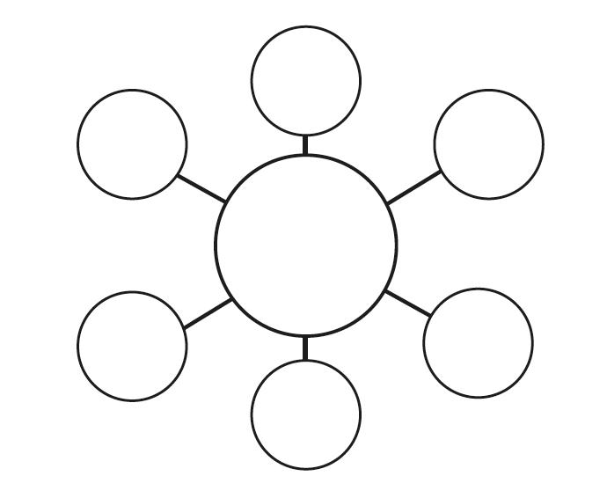
Activity
Create a bubble maps of your ideas for the PERSUADER features you have looked at today.
By the end of the lesson, you should all have 3 bubble maps in your books.
Red Pen: begin to write some sentences for your letter using the PERSUADER features you have looked at today. Make sure your sentences are correctly punctuated.

Slide 19
Wednesday 24th November 2021
LO: To write with purpose
To punctuate accurately
C: Persuasive Writing

Slide 20
Starter
Surely,
Firstly, / Secondly, / Thirdly,
In addition,
Furthermore,
Moreover,
Finally,
Likewise,
Again,
Similarly,
Surely,
Certainly,
Specifically,
If...then…,
Because,
Can you use any of these fronted adverbials in a sentence for your letter?
Write a list of fronted adverbials that you would like to use in your writing.

Slide 21
We are going to continue exploring each of the PERSUADER features in turn and considering what these features might look like in our persuasive letter to Mrs Bell.
What features do we have left to explore?

Slide 22

Emotive Language
Emotive language is used to make the reader feel something.
It could be pity/sympathy, anger or hope.
The easiest way to be emotive is to add adjectives or adverbs to your sentences.
Example: The dog has been left by its owners. Vs The innocent dog had been left cruelly by its neglectful owners.
A more subtle way to be emotive is to choose nouns or verbs that will influence the reader.
Example: The dog had been left by its owners. Vs The puppy had been abandoned by its owners.

Slide 23
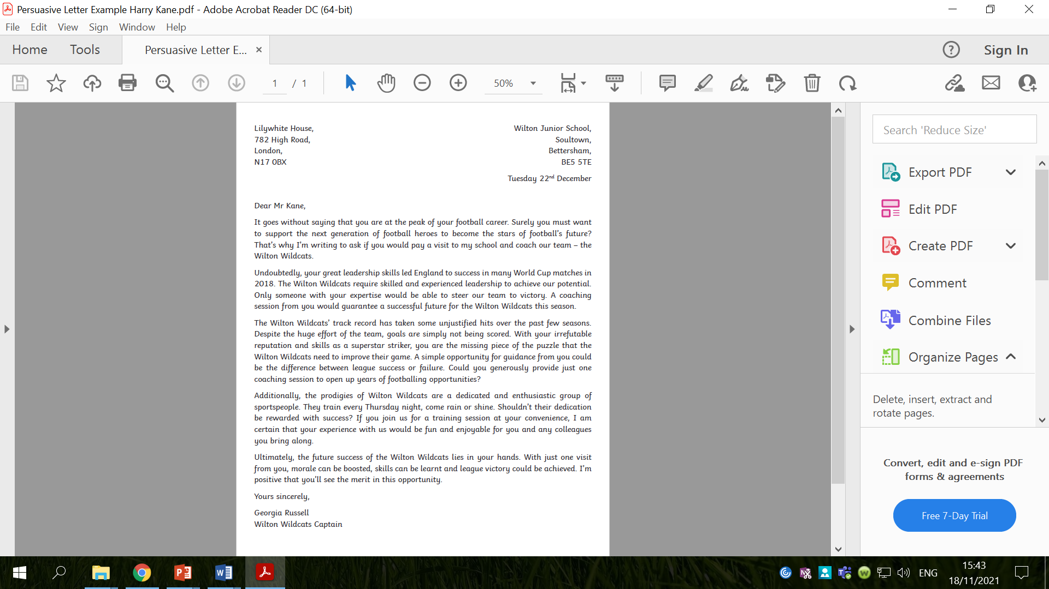
What emotive language can you see here?

Slide 24
What emotive language can you see here?

Slide 25
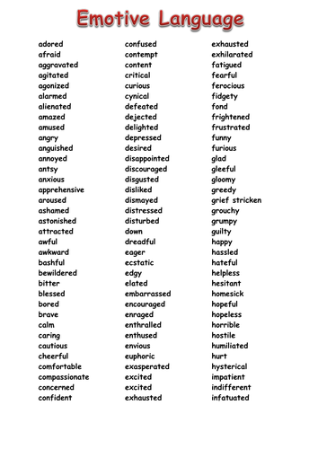
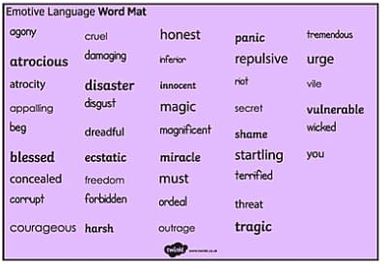
What emotive language could you use in your letter to Mrs Bell?
Create a bubble map of ideas.

Slide 26
Anecdotes
A short, often humorous story inserted into a wider narrative or conversation.
Anecdotes are usually told in the past tense, as they are about past events, although they can sometimes be recounted in the present tense to give them a sense of immediacy.
In non-fiction writing, a well-placed anecdote can help to persuade the reader to a point of view. The introduction of personal detail among facts can create a feeling of empathy in the reader.
Anecdotes can add a storytelling touch to your persuasive writing – connecting your ideas to real life and real people.

Slide 27
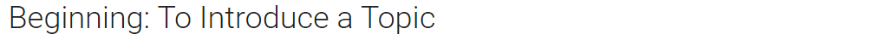
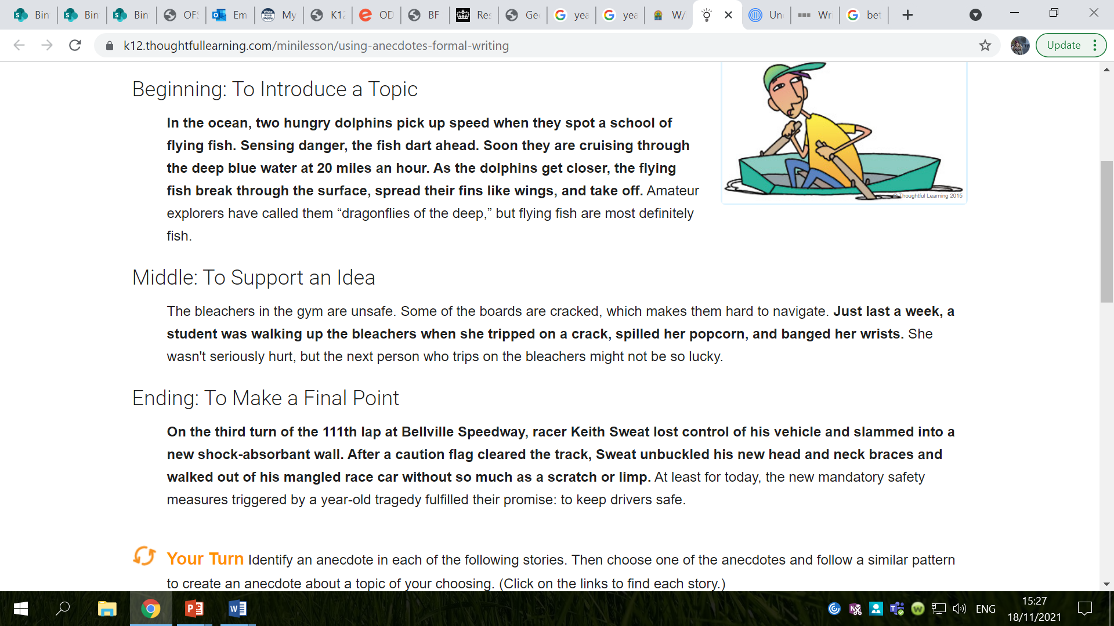

Slide 29
What anecdotes could you use in your letter to Mrs Bell?
Create a bubble map.

Slide 30
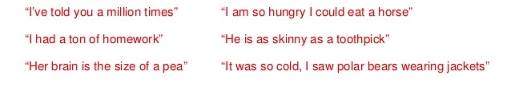
Exaggeration
When information is given that is over the top, or slightly untrue.
Examples:
If I get set one more piece of homework, I am going to move to the moon!
How will you ever live with yourself if you ignore this?

Slide 31
What exaggeration can you see here?

Slide 32
What exaggeration can you see here?

Slide 33
What exaggeration could you use in your letters to Mrs Bell?
Create a map of your ideas.

Slide 34
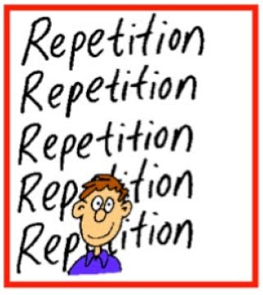
Repetition
Words or phrases are repeated so that they stick in the reader’s mind.
Examples:
Remember what is was like to be at school. Remember how much work your had.
We must all try to write with purpose, write with feeling and write using techniques to persuade.

Slide 35

Rule of Three
When three adjectives or phrases are used to emphasise a point.
Example: Homework is boring, dull and uninteresting.

Slide 36
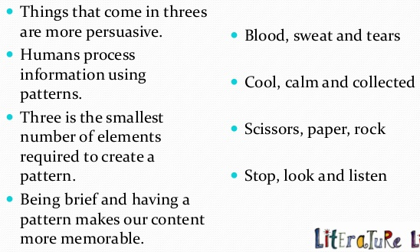
Rule of Three

Slide 37
What repetition could you use in your letter?
What alliteration could you use in your letter?
Create a bubble map of your ideas.

Slide 38
Activity
Create a bubble maps of your ideas for the PERSUADER features we have looked at today.
By the end of the lesson, you should all have 4 bubble maps in your books.
Red Pen: begin to write some sentences for your letter using the PERSUADER features you have looked at today. Make sure your sentences are correctly punctuated.

Slide 39
Thursday 25th November 2021
LO: To write with purpose
To punctuate accurately
C: Persuasive Writing

Slide 40

Starter
Conjunctions can be used to shift attention.
Example: however, nevertheless, on the other hand, in contrast, whereas, in addition to this, besides, moreover, furthermore
Can you use any of these conjunctions to shift attention in a sentence for your letter?
Write a list of conjunctions to shift attention that you would like to use in your writing.

Slide 41
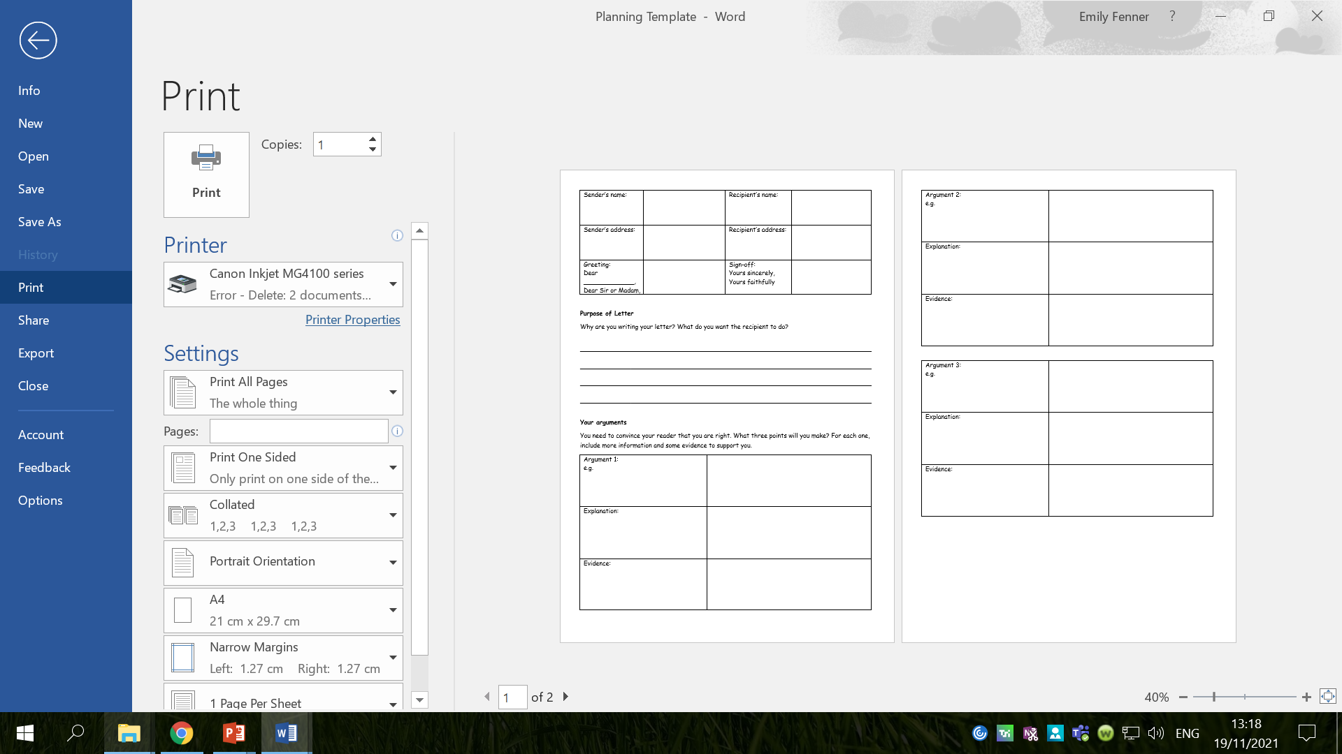
You are going to plan your letter to Mrs Bell today!

Slide 42
What does a formal letter look like?
What do you need to include in your formal letter?

Slide 43
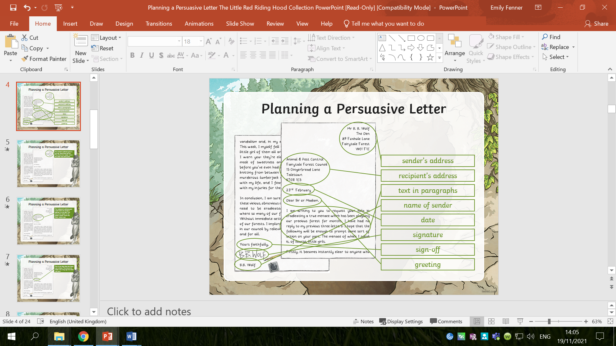

Slide 44

The greeting depends on who the recipient is. If you don’t know who will eb reading your letter, write ‘Dear Sir or Madam.’
Once the letter is finished, you will need to sign off your letter with either: ‘Yours Sincerely’ (if you know the person’s name) or ‘Yours Faithfully’ (if you used Sir or Madam)

Slide 45
The introductory paragraph of your letter should:
  Explain why you are writing
  Explain what you want the recipient to do
Why are we writing to Mrs Bell?
What do we want her to do?

Slide 46
Our letters should have one paragraph for each argument that we are presenting.
What arguments are we presenting to Mrs Bell?

Slide 47
Our paragraph are the most important part of our letters – they will persuade Mrs Bell to agree with us!

Slide 48
To build a persuasive paragraph:
  Introduce the argument
  Explain what you mean in more detail, showing why your argument is important
  Give some evidence to back up your argument
Think about why each argument is important and what evidence you will provide.

Slide 49
The final paragraph will be a conclusion.
It will:
  Summarise the points that you have made
  Repeat the main argument from your introduction
  Ask the reader to take some action

Slide 50
Which arguments will you use in your letter?

Slide 51
Activity
Complete the planning sheet.
Red Pen: practise writing one of your paragraphs.
Remember to:
  Introduce the argument
  Explain what you mean in more detail, showing why your argument is important
  Give some evidence to back up your argument

