Slide 1

Today, we are going on a hunt!

Slide 2
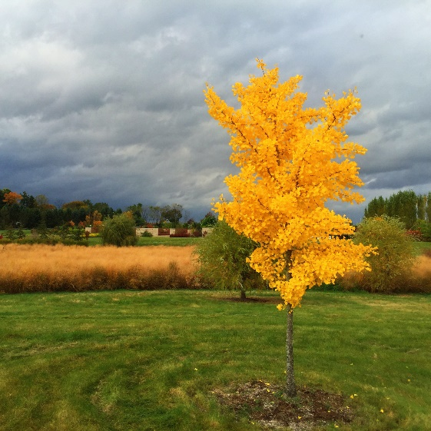
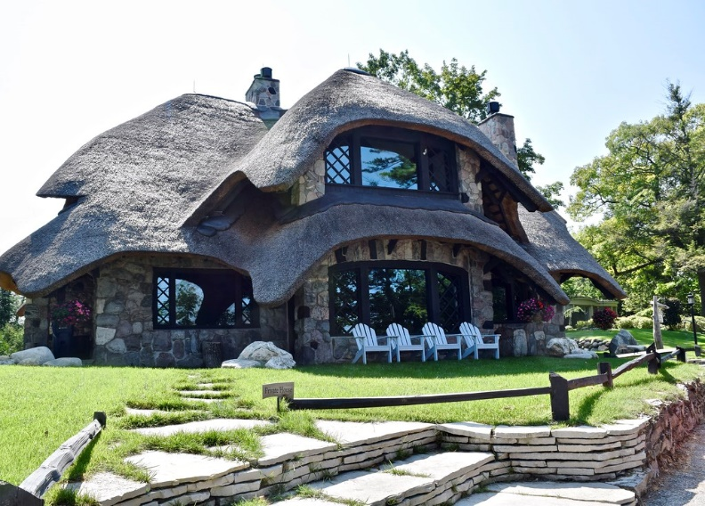
We are going to search the school grounds and note some physical and human
geographical features.
What are human and physical features?

Slide 3
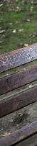
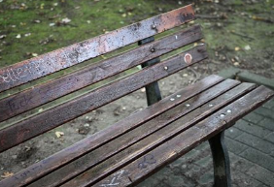
Your challenge is to go around the school grounds and take obscure photos of human and geographical features.
For example:
What could this be?
It is a bench!

Slide 4

It’s your turn to use the iPads to take
1 photo of an object around the outside of the school.

Slide 5
Now that you have everyone’s photos,
can you:
Identify the object
Locate it on the map of the school
Say whether it is human or physical geography

