Slide 1

Monday 24th January 2022
L.O: To understand texts
C: The Iron Man- retrieval skills.

Slide 2


Fastest Finger Challenge!
Class Read : p.33-40
Let’s play our fastest finger game!

Slide 3
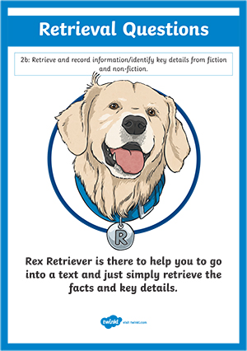
Rex Retriever Time
Today we are going to use our retrieval skills.
Let’s try the first two questions together.

Slide 4
Rex Retriever Time
Where did the farmers dig the “deep, enormous hole.”? (1 mark)

Slide 5
Rex Retriever Time
Find and copy two adjectives used to describe the hole. (2 marks)

