Slide 1
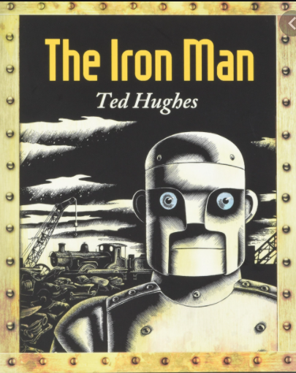
Thursday 27th January 2022
L.O: To understand texts
C: The Iron Man- prediction skills.

Slide 2

Warm up game!
Class Read : p.40-46
Blue
Black
Yellow
Green
Purple
Red
Say the name of the font colour!

Slide 3
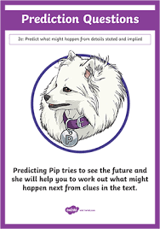
Predicting Pip!
What do you think Hogarth is going to do with the knife and nail? Draw a picture with a caption to show your prediction.

