Slide 1
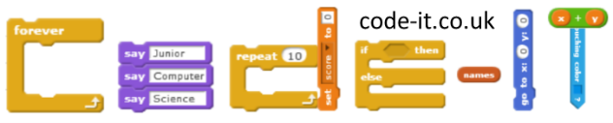

Learning about
Conditional Selection

Slide 2
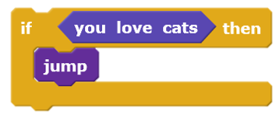
Condition starts action
If you are hungry
put your hand up
If you like computing
smile
If you are 8 or older
Stand
Sit

Slide 3
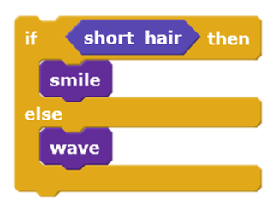
Condition switches between actions
If you are a girl
Stand
Else
Bow
If you like marmite
Wave
Else
Frown

Slide 4
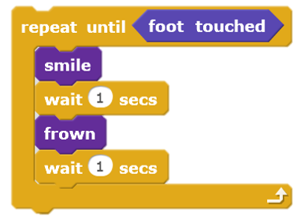
Condition stops repeated action
Repeat until shout stop
Stand
Sit
Repeat until teacher raises arm
Smile
Frown
Wave once

Slide 5
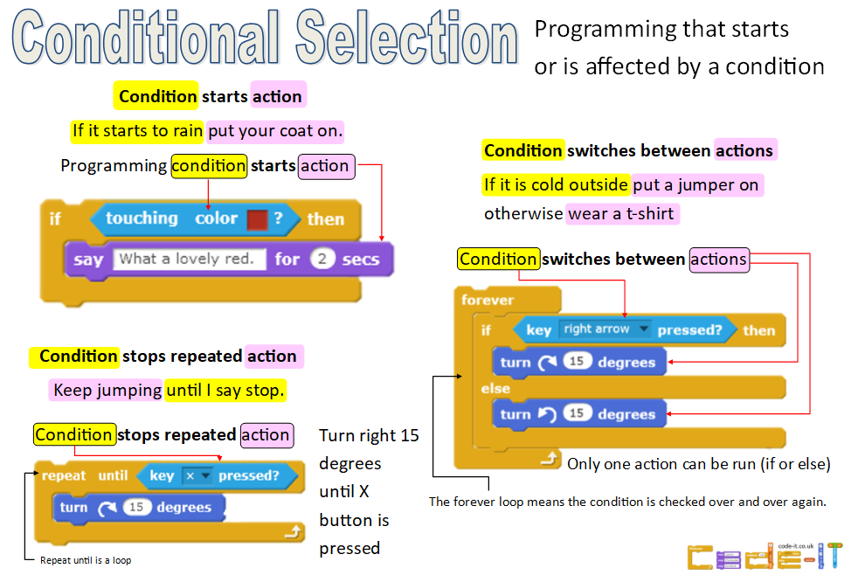

Slide 6





Introducing the ask input block and answer variable block
Information input through typing into a box shown on the screen.
Information input goes into the answer block.
The answer block is a type of variable used for storing information that has been input through typing into the ask input block.
Click on it to see what is inside or tick the box next to it.
to add an answer block to the screen.

Slide 7
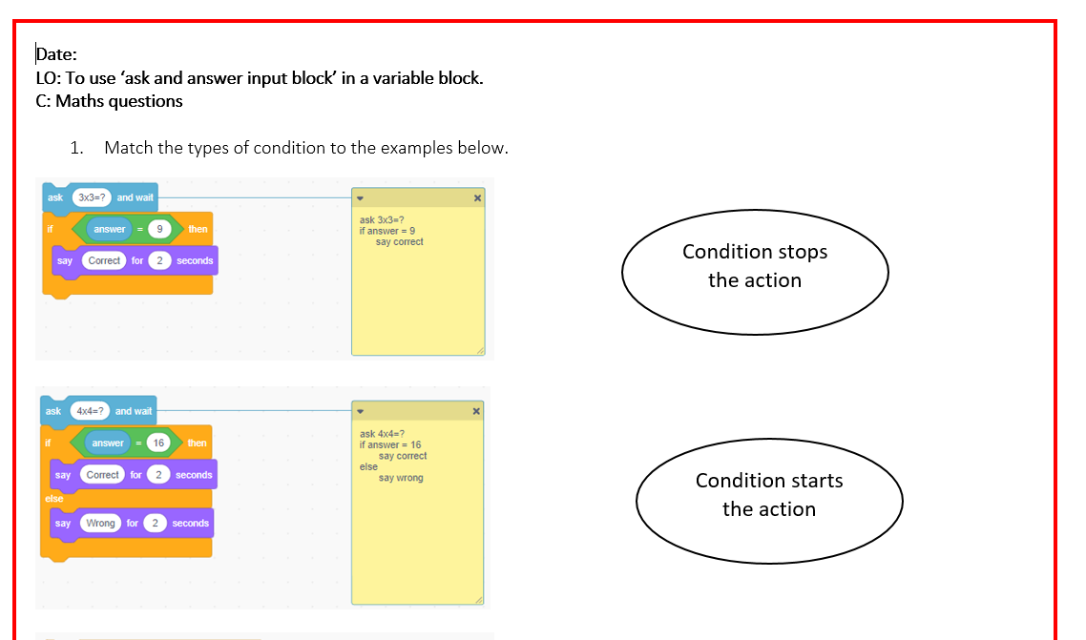
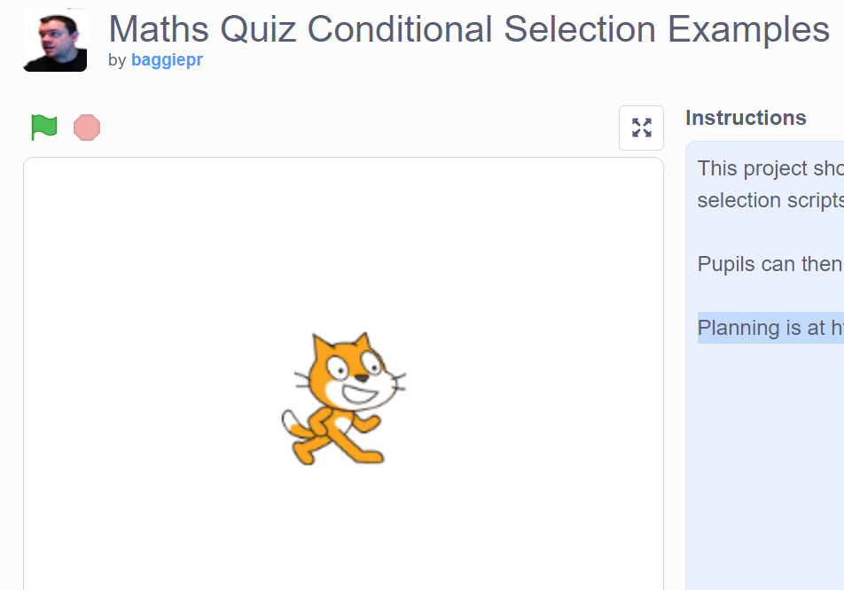
Have a look at this quiz and answer the questions
https://scratch.mit.edu/projects/230350130/

