Slide 1
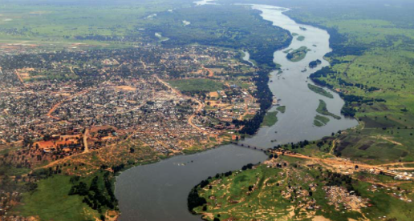
Thursday 9th December 2021
L.O: To communicate geographically.
C: The Nile

Slide 2
Facts about the River Nile!
The source (where is starts) is Lake Victoria in East Central Africa.
It is the longest river in the world passing through Egypt, Tanzania, Rwanda, Uganda,
Burundi, Kenya, Ethiopia, Sudan, and Zaire.
The Nile floods every year.
When the floods recede (go down) it leaves behind a rich silt (fine sand/clay) that is ideal to grow crops in.

Slide 3
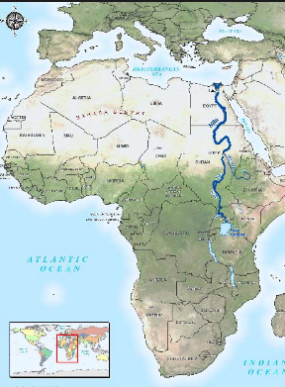
Why might the Egyptians have settled around the Nile?
https://www.bbc.co.uk/bitesize/clips/z3rwmp3

Slide 4
Key Words:
Drought – when there is not much rain and water levels fall. Water might be hard to get hold of.
Recede – when a river has flooded, and the water levels start to go down again.
Irrigate/Irrigation – a way to control water supply to plants and crops.
Canal - waterways that are built by people and used for shipping, travel, and irrigation

Slide 5
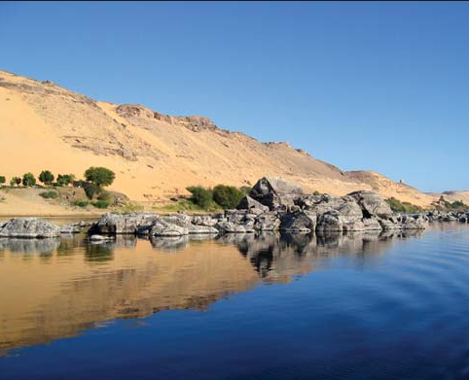
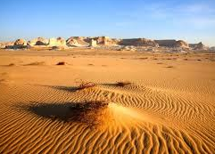
Let’s Recap!
It doesn’t rain much in Egypt and without The Nile no one could have lived in Egypt.
Every year The Nile floods the ground around it. It leaves a silt that is fertile to grow crops for food. The main crops were wheat, flax and papyrus. They were the first civilisation to make bread and used wheat for this.
The desert all around was called The Red Land and was uninhabitable – it was only lived in by animals.

Slide 6
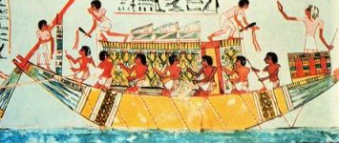
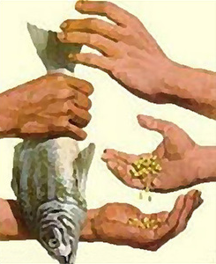
Without The Nile it was very difficult for the ancient Egyptians to travel. The Nile made travelling much easier.
It also allowed them to be able to trade easily. They travelled to trading markets but also to other countries. Nubian traders supplied Egypt with animal skins, ivory, ostrich feathers, and beautiful woods. Nubia also traded gold for Egyptian wheat.

Slide 7
Each year, the Nile would flood, spilling over with water flowing down from the mountains to the south. Flood waters could raise the Nile River 45 feet over normal heights. As the waters receded, the flood waters left behind rich soil. This soil allowed the ancient Egyptian to grow crops.
The crops needed water to grow. These early people invented a system of canals that they dug to irrigate their crops. They also built gates into these canals so that they could control the flow of water. They built reservoirs to hold water supplies in case of drought.

Slide 8
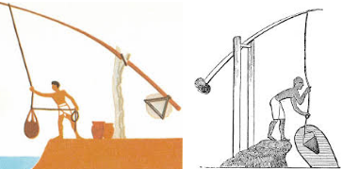
They would then use a Shadoof to lift the water from the reservoir to use.

Slide 9
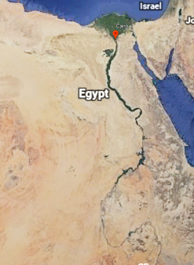
Let’s have another look at Google Earth!
Desert land
Impossible to grow crops in
Barren and dry

Slide 10
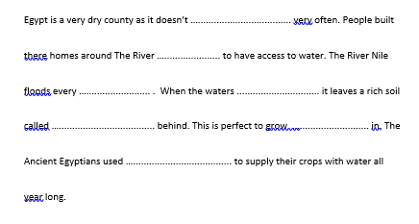
Your First Task

Slide 11
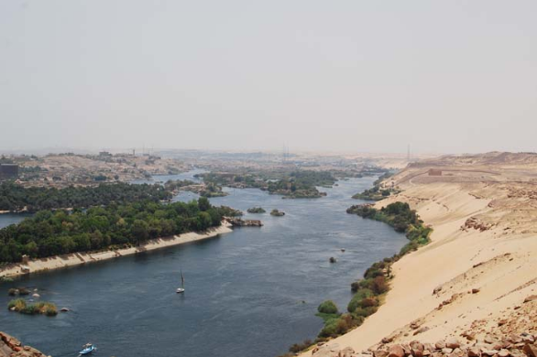
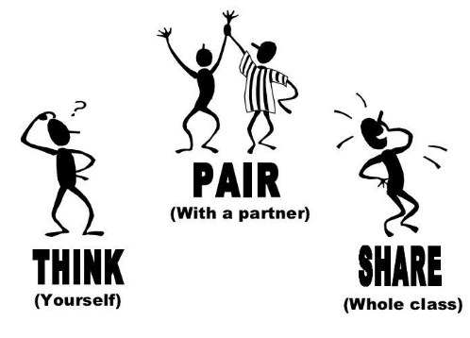
"Why might the Ancient Egyptians have thought the yearly flooding of The Nile was a gift from God?"

Slide 12
The Egyptians believed in many different God’s. Lets look at the story of Isis and her gift of The Nile.

Slide 13
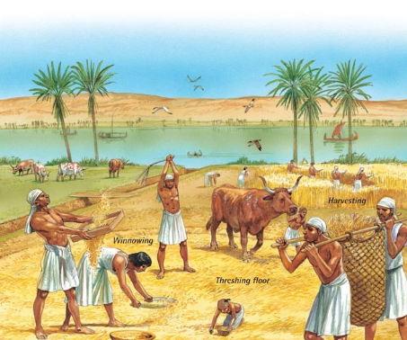
So how did the flooding influence Seasons?
There were three main seasons:
The growing season
The farming season
The flooding season

Slide 14
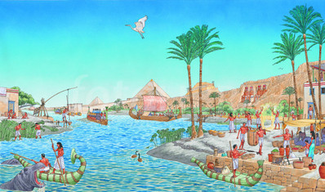
Akhet - the inundation (June-September): The Flooding Season.
No farming was done at this time, as all the fields were flooded. Instead, many farmers worked for the Pharaoh (King), building pyramids or temples. Some of the time was spent mending their tools and looking after animals.

Slide 15
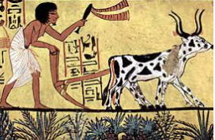
Peret (October-February): The Growing Season.
In October the floodwaters receded, leaving behind a layer of rich, black soil. This fertile soil was then ploughed and seeded.

Slide 16
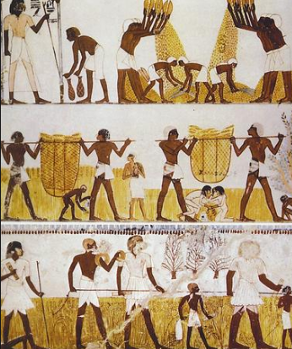
Shemu (March-May): The Harvesting Season.
The fully grown crops had to be cut down (harvested) and removed before the Nile flooded again. It was also the time to repair the canals ready for the next flood.

Slide 17
Paddling: Draw seasons and use key words from the handout to write bullet points about the seasons.
Snorkelling: Draw seasons and use key words from the handout to write facts about the seasons.
Diving: Draw and use technical language to describe the three seasons.

Slide 18
Akhet - the inundation (June-September): The Flooding Season.
No farming was done at this time, as all the fields were flooded. Instead, many farmers worked for the pharaoh (king), building pyramids or temples. Some of the time was spent mending their tools and looking after animals.
Peret (October-February): The Growing Season.
In October the floodwaters receded, leaving behind a layer of rich, black soil. This fertile soil was then ploughed and seeded.
Shemu (March-May): The Harvesting Season.
The fully grown crops had to be cut down (harvested) and removed before the Nile flooded again. It was also the time to repair the canals ready for the next flood.

