Slide 1
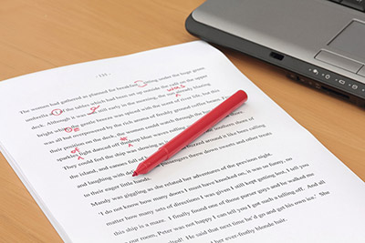
TIME TO EDIT

Slide 2
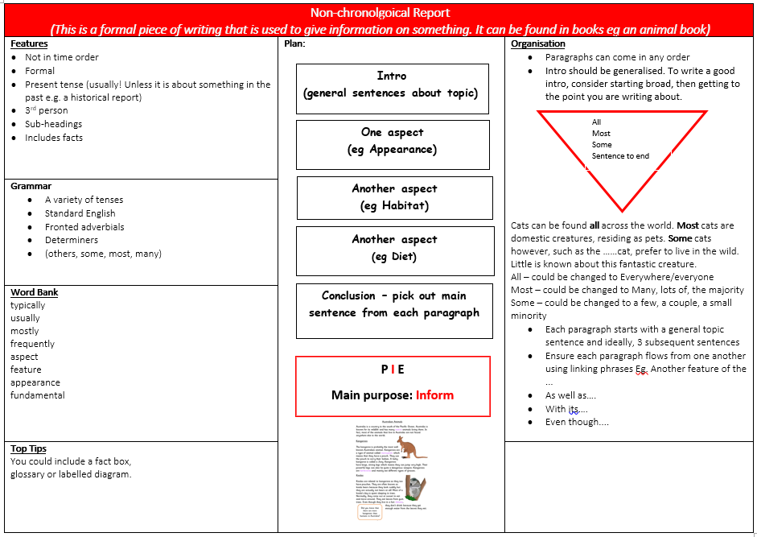

Slide 3
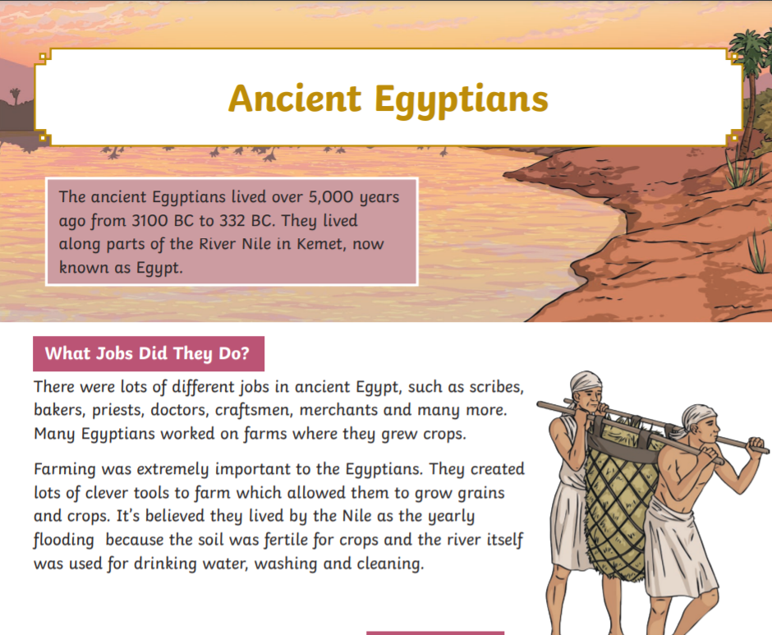
Let’s write a conclusion for this
non-chronological report together.

Slide 4
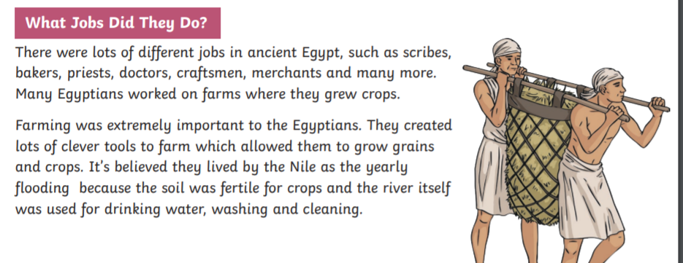
What is the main sentence in this section?

Slide 5
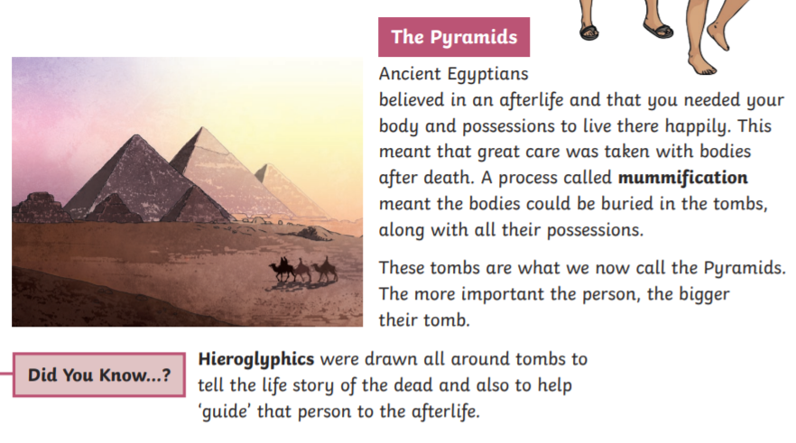
What is the main sentence in this section?

Slide 6
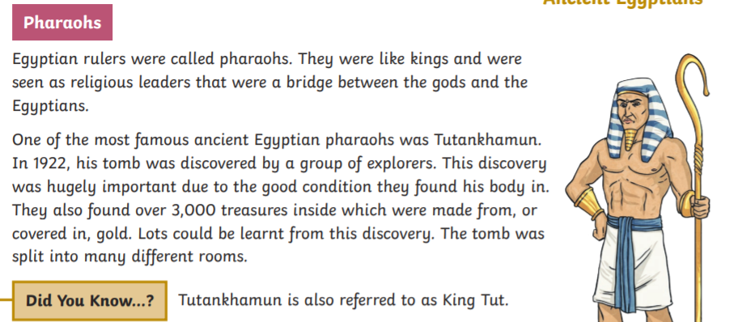
What is the main sentence in this section?

Slide 7
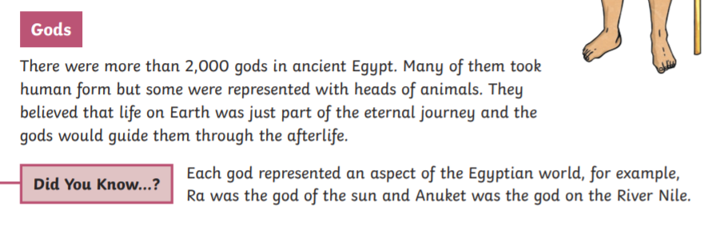
What is the main sentence in this section?

