Slide 1
INPUT -
Some of you will be with Miss George looking at conjunctions
Some of you will be with Miss Cox working on commas

Slide 2
What type of word are all of these?
Can you think of other ways of saying these words?
and
but
so

Slide 3
alternatively
whereas
although
but
on the other hand
since

Slide 4
also
Furthermore
In addition
and
As well as
Moreover

Slide 5
Can you add conjunctions to improve this section?
Most of Egypt is a vast desert with almost no rainfall. The River Nile is one of the longest rivers in the world and it flows northwards from the mountains of Tanzania for over 6,000km on its way to the Mediterranean Sea. For more than 6,000 years the river has enabled people to live in Egypt. Today, 50 million people live within a few miles of the river and completely depend on its water. The river is home to many fish and provides a valuable source of food. The ancient Egyptians invented a number of different ways to bring water from the Nile up onto dry land. The shaduf and wooden water wheels were designed thousands of years ago to enable farmers to water their crops, and such methods are still used by farmers today.

Slide 6
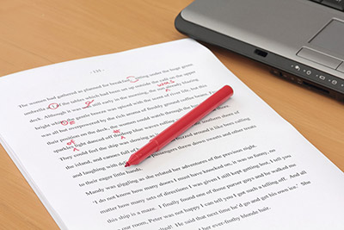
TIME TO EDIT

Slide 7
Let’s write a section together!

