Slide 1
INPUT -
Some of you will be with Miss George looking at nouns
Some of you will be with miss cox working on conjunctions

Slide 2
Miss George’s Group
football
Tom
Binfield
Manchester United
table
plant
What do all these words have in common?

Slide 3
What is a noun?
A noun is a naming word. It is a thing, a person, an animal or a place.

Slide 4
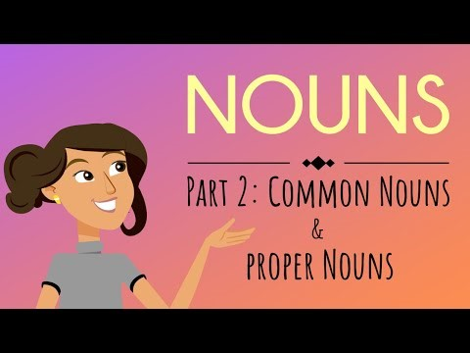
What type of nouns are there?
https://www.youtube.com/watch?v=ppNtch3wRJ4

Slide 5
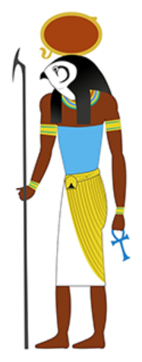
Be the teacher – check the proper nouns!
RA
ra starred in many stories, myths and legends in egyptian Mythology. Ra was said to have created himself out of the mound that emerged from the ancient waters. He then created Shu (air) and Tefnut (moisture), who then created the earth god Geb and the sky goddess nut. From Nut and Geb the gods osiris, isis, nephthys and seth were born.

Slide 6
RA
Ra starred in many stories, myths and legends in Egyptian Mythology. Ra was said to have created himself out of the mound that emerged from the ancient waters. He then created Shu (air) and Tefnut (moisture), who then created the earth god Geb and the sky goddess Nut. From Nut and Geb the gods Osiris, Isis, Nephthys and Seth were born.

Slide 7
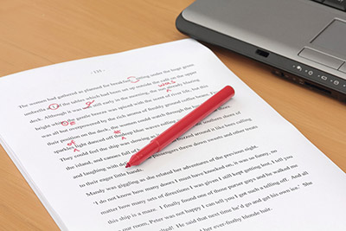
TIME TO EDIT

Slide 8
Let’s write a section together!

Slide 9

Talk to your partner -
Wwhat did you write about yesterday?
What are you going to write about today?
What are you the key facts?

