Slide 1

Monday 6th September 2021
L.O: To skim and scan.
C: Let’s do the Pharaoh!

Slide 2
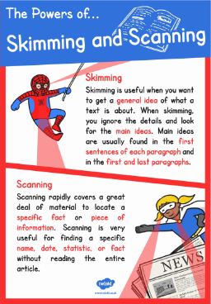
We are going to use these two skills to answer some questions today!

Slide 3
Let’s read chapter 1!
Let’s note down anything we learn about our main character using our Rex Retriever Skills.

