Slide 1
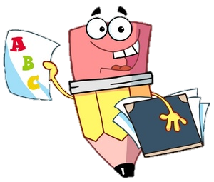
Monday 6th September 2021
L.O: To understand and apply expanded noun phrases.
C: English Games

Slide 2
Let’s start by playing a game!
I am going to show you a small piece of a picture!
Using your ninja whisper voices, discuss with your talk partner what you think they might be!

Slide 3
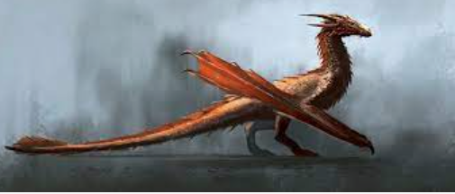
Picture 1:

Slide 4
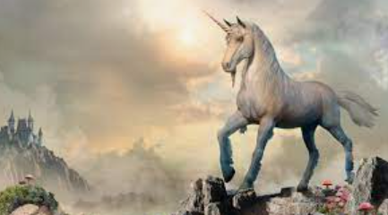
Picture 2:

Slide 5
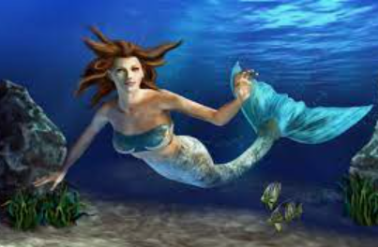
Picture 3:

Slide 6

Can you spot a link between the three pictures?

Slide 7
They are all mythical creatures!
Mythical creatures are supernatural creatures which have not been proven to exist.
All over the world, ancient folk stories discuss myths and legends.
Do you know of any more?

Slide 8
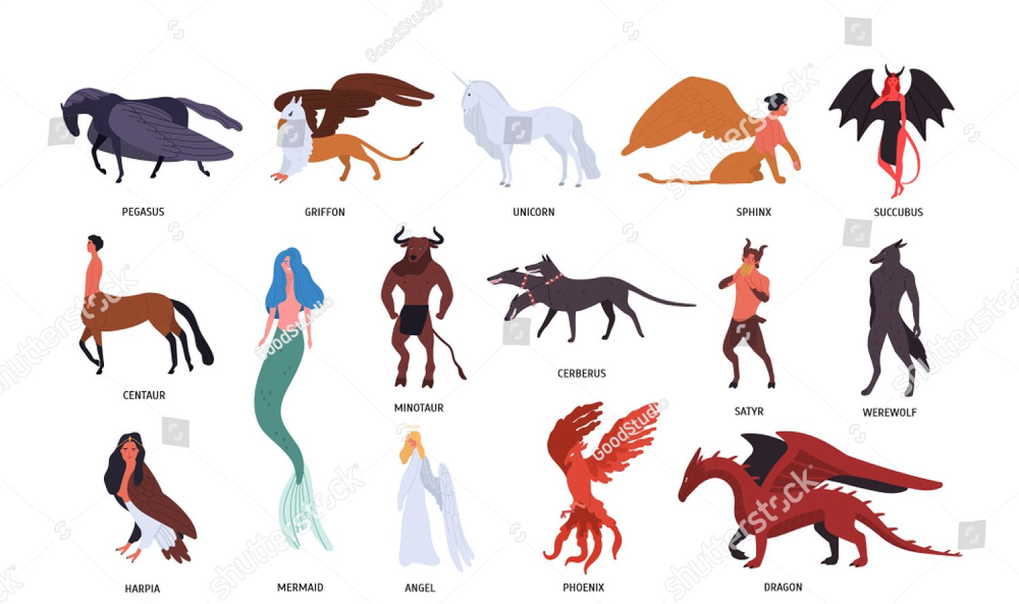

Slide 9
We are going to be designing our own mythical creatures!

Slide 10
We have our best ideas when we are inspired! So today we are going to explore a range of mythical creatures and write some expanded noun phrases to describe them!

Slide 11
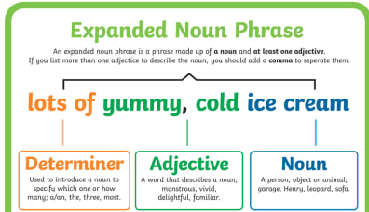
https://www.bbc.co.uk/bitesize/topics/zwwp8mn/articles/z3nfw6f

Slide 12
Your task!
Paddlers: Work with the TA to write 3 expanded noun phrases per creature.
Snorkelers: With the support of the word mat, write 2 expanded noun phrases per creature.
Divers: With the support of the word mat, write 1-2 expanded noun phrase sentences per creature. E.g The majestic, glistening mermaid was moving swiftly through the coral.

Slide 13
Dragons
Dragons are some of the most famous mythical creatures and they can be found in stories throughout history and across the world. They are usually described as reptile-like creatures, able to fly and breathe fire.

Slide 14
Mermaids
Mermaids are mythical creatures who have the body of a human and the tail of a fish. Stories of mermaids were told from different groups of people all around the world.
Sailors often believed that mermaids were unlucky and were signs that a voyage was doomed.
A carving of a mermaid, almost 1000 years old, can be seen in Durham Castle.
Mermaids have been in stories and films. Lots of them are based on Hans Christian Andersen’s fairy tale ‘The Little Mermaid’.

Slide 15
The Abominable Snowman
The Himalayas are a group of mountains that span across lots of countries, including Nepal, China and Bhutan. Mount Everest, the word’s tallest mountain, is in the Himalayas.
For many years, stories have been told about a huge ape-like creature that lives in the Himalayas. Locals call this creature ‘yeti’ or ‘Meh-Teh’. It was said that a long time ago, people in the area worshipped this creature as a god.
As more people began to explore the Himalayas, stories were told of a huge creature leaving massive footprints in the snow.
Himalayas

Slide 16
The Abominable Snowman
In 1921, a man named Charles Howard-Bury led an expedition to Mount Everest. On the trip, they saw huge footprints in the snow. The local guides said they belonged to the ‘wild man of the snows’.
The mysterious creature was given the name ‘Abominable Snowman’ by a journalist, who interviewed people who had been up Mount Everest.'
There have been photographs taken of the creature but they are unclear. Scientists and explorers have studied footprints and the photos but it is still unknown what the Abominable Snowman really is.

Slide 17
Griffin
Thousands of years ago, many different groups of people told stories of a creature known as a griffin.
A griffin was said to have the body, tail and back legs of a lion and the head, wings and front claws of an eagle.
Because the lion was considered the king of the beasts and the eagle the king of birds, a griffin was an important creature.
In ancient times, it was believed that griffins laid special eggs that contained pieces of gold.
Some historians think stories of griffins might have started after people found dinosaur fossils and didn’t know what they were.

Slide 18
Unicorn
A unicorn is a horse-like creature with a horn at the front of its head. Stories of unicorns have been told in many different cultures.
One story that explains why there are no unicorns today comes from the Bible story of Noah’s ark.
Two of every animal were supposed to be carried on the ark but in some versions, the unicorns were too busy playing and didn’t reach it in time.

Slide 19

Red Pen Challenge:
The goblin was lurking in the shadows.
Can you make this sentence more engaging for the reader by adding an expanded noun phrase for goblin?

