Slide 1
L.O. To work scientifically
C: To investigate light and shadow

Slide 2
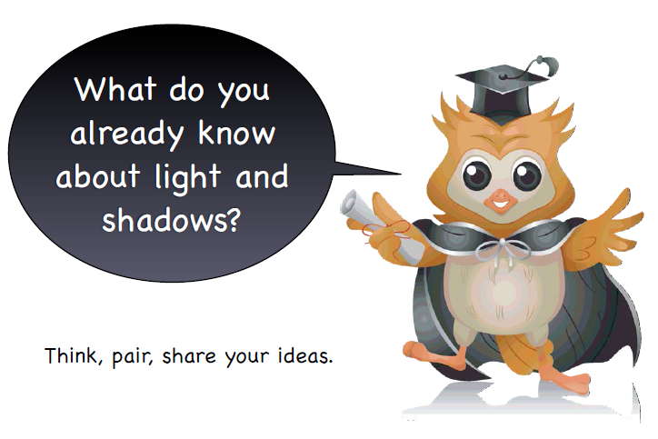
light, dark, night, day

Slide 3
What do we already know?

Slide 4

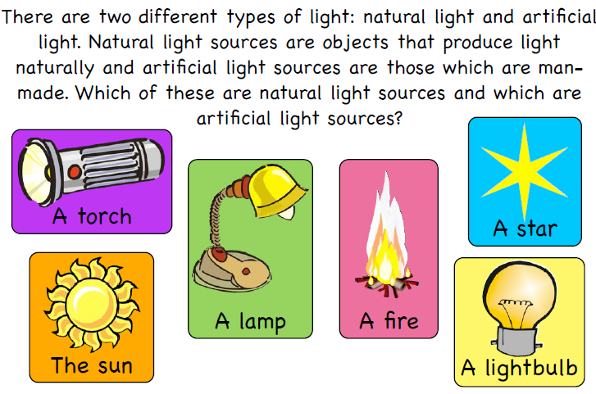
http://resources.hwb.wales.gov.uk/VTC/light/eng/Introduction/default.htm

Slide 5
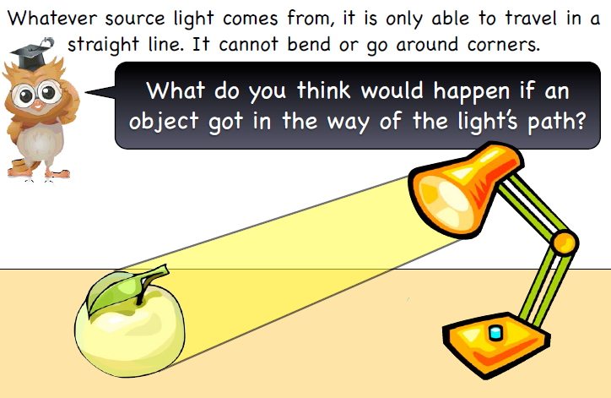

Slide 6
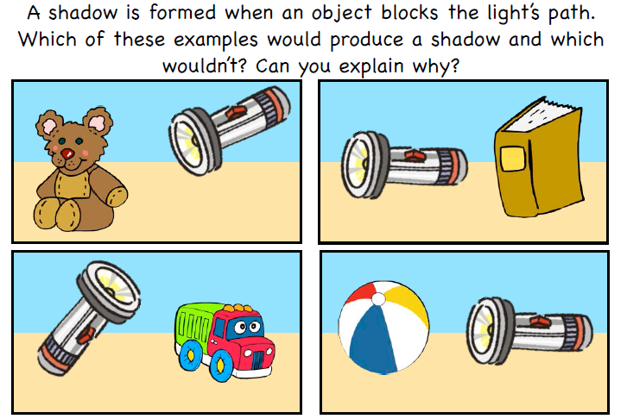

Slide 7
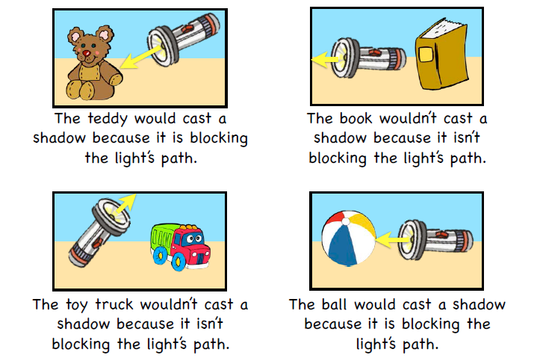

Slide 8

IWB Activity
http://resources.hwb.wales.gov.uk/VTC/light/eng/Introduction/default.htm

Slide 9
Revisit Circle Map
Is there anything you would like to add?
Do this in a different colour.

Slide 10
What are light sources?
Are some light sources brighter than others?
What makes a light source powerful?
What is a shadow?
How do you think shadows are formed?
Do all objects create shadows?
Is it possible to make shadows bigger?

Slide 11
Extension Question:
Why isn’t the moon a light source?

Slide 12
light, dark, night, day, light
source, seeing, shiny, Sun,
Earth, lighting up, sunshine

