Slide 1
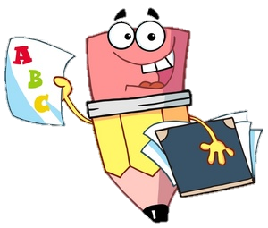
Thursday 9th September 2021
L.O: To create a realistic wanted poster.
C: English Games

Slide 2
Let’s recap!
You have designed some amazing Mythical Creatures!
Let’s hear about some of your creatures..

Slide 3
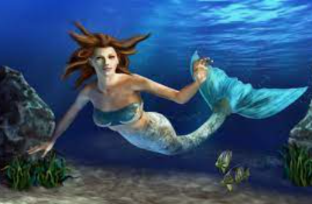
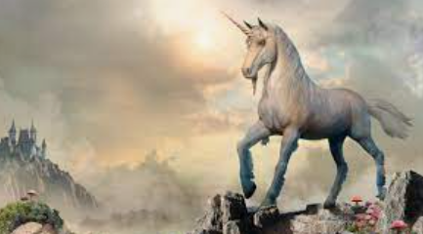
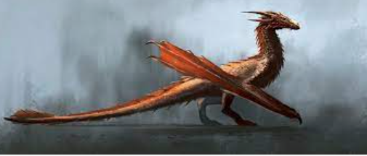
Why do you think someone might want to find this creature?
To harness its powers or prevent it from causing havoc?

Slide 4
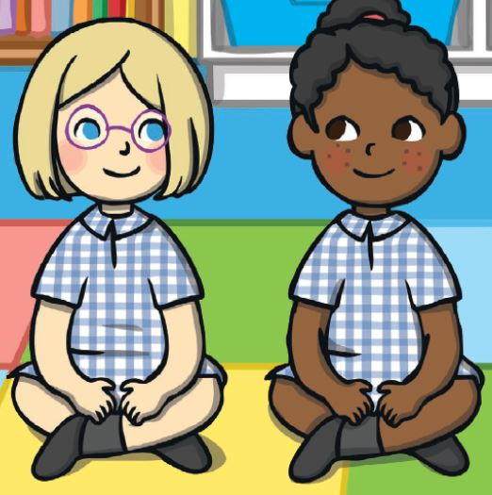
Talk to your partner:
How do we let people know that we are trying to find something?

Slide 5
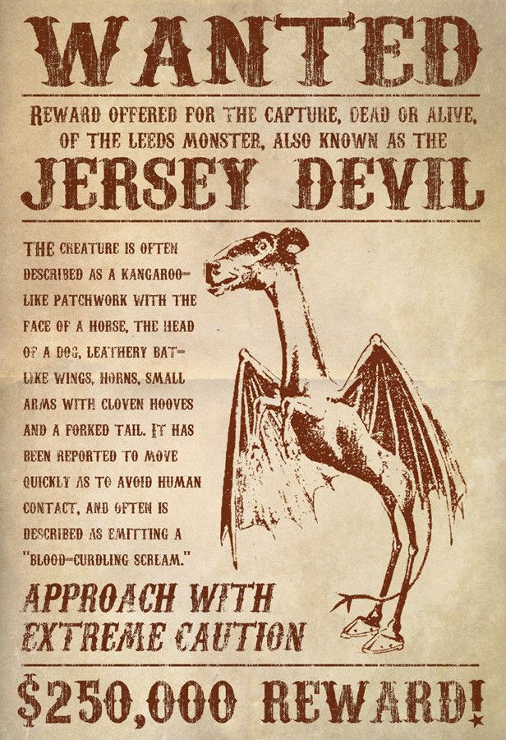
Today we are going to create wanted posters!
We are going to have fun practicing lots of special techniques!

Slide 6
We are going to work together and complete the wanted poster in stages!
Make sure you are super focused and following along. ☺

Slide 7

NAME OF CREATURE
This alliteration creature is half animal 1, half animal 2.
It was last seen verb(ing) prepositional phrase.
It has description (expanded noun phrase).
The adjective beast moves simile. People say that it came from place. If you see this adjective+noun then instruction.
Reward: Money/prize

