Slide 1

Thursday 9th September 2021
L.O: To summarise a chapter.
C: Let’s do the Pharaoh!

Slide 2

We are going to use our Summarising Sheba skills today!
I am going to describe my morning to you ☺

Slide 3
Can you summarise the chapter in 2 minutes with your partner?

Slide 4
Can you summarise the chapter in 1 minute with your partner?

Slide 5
Can you summarise the chapter in 30 seconds with your partner?

Slide 6
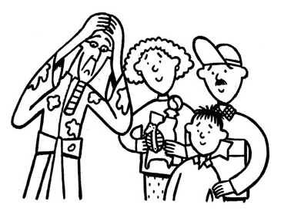
Your task:
With your group, some up the chapter with 3 freeze frames!

