Slide 1

Friday 10th September 2021
L.O: To predict.
C: Let’s do the Pharaoh!

Slide 2
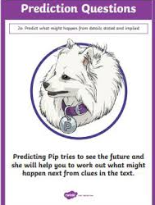
We are going to use our Predicting Pip skills today!
Let’s read the start of the chapter ☺

Slide 3
What’s going to happen next?
Paddlers: Write a collaborative prediction with the teacher. Snorkelers: Write independent justified prediction Divers: Write two mini predictions and justify which they feel is more likely.

