Slide 1

Tuesday 7th September 2021
L.O: To infer how a character is feeling.
C: Let’s do the Pharaoh!

Slide 2
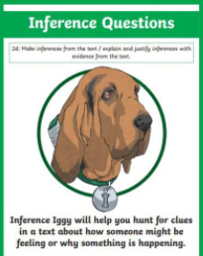
We are going to use our Inference Iggy skills to answer some questions today!
Let’s read chapter 3 up to page 35.

Slide 3
We are going to use our Inference Iggy skills to answer some questions today!
How do Carrie and Ben feel?

