Slide 1

Tuesday 7th September 2021
L.O: To design and describe an original character.
C: English Games

Slide 2
Let’s recap!
Today you are going to be super inventors and design your own mythical creatures.

Slide 3
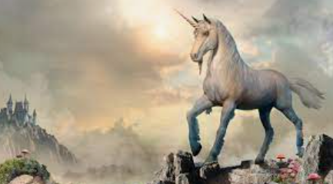
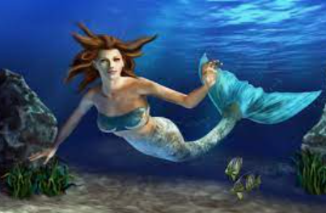
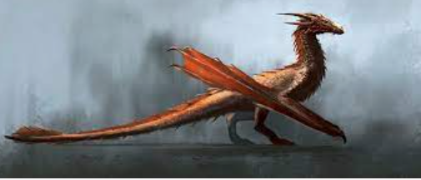
Let’s start by playing a game and practicing our skills from Monday!
Can you think of any expanded noun phrases to describe these creatures?

Slide 4
We are going to create mythical creatures by mixing animals together! https://switchzoo.com/newzoo/zoo.htm?fbclid=IwAR3ldhPf1Ml1hDrR2tPZZCnCCfy8tOVs8QCu9mGnEskQnUcsfqYOkqAoo04

Slide 5
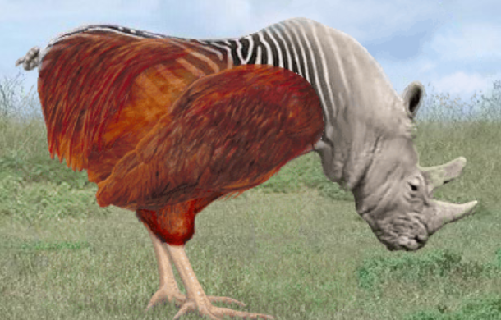

Can you describe what your creature looks like in as much detail as possible?

Slide 6
You now have 15 minutes to draw your mythical creature in as much detail as possible. Keep it neat please ☺

Slide 7
Now can you use your expanded noun phrase skills to label your creature! I will model this for you.
BRONZE CHALLENGE: 10 expanded noun phrases.

Slide 8
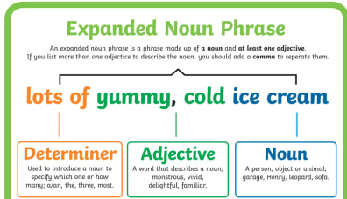
https://www.bbc.co.uk/bitesize/topics/zwwp8mn/articles/z3nfw6f

