Slide 1

Wednesday 8th September 2021
L.O: To infer how a character is feeling.
C: Let’s do the Pharaoh!

Slide 2
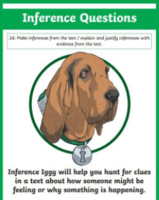
We are going to use our Inference Iggy skills to answer some questions today!
Let’s read some more of chapter 3.

Slide 3
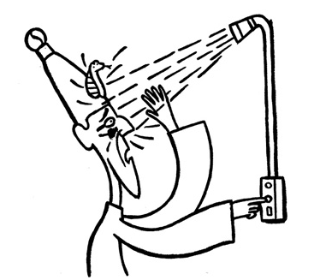
How does Sennapod feel in this picture?
How can you tell?

Slide 4
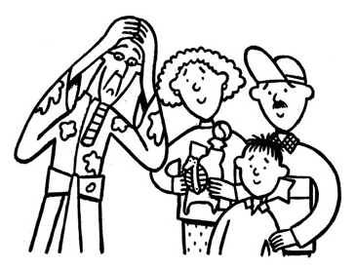
Your task:
Infer how Sennapod is feeling in this picture.

