Slide 1
Tuesday 6th October 2020
LO: To understand values
beliefs and teachings
C: The Miracles of Jesus

Slide 2
Jesus and Lazarus
Does anyone know what
this story is about?

Slide 3
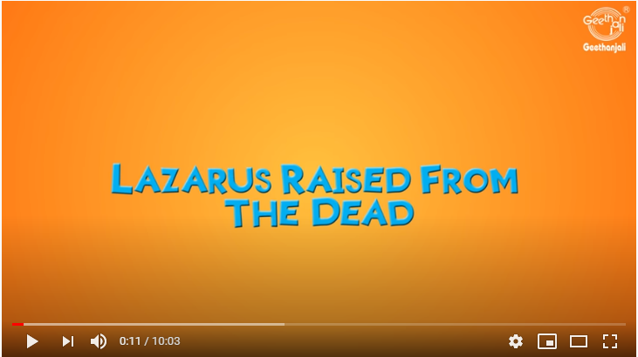
Jesus of Nazareth
Click to watch the video

Slide 4
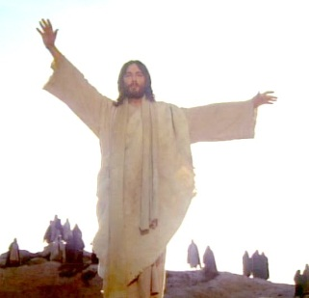
Jesus and Lazarus
What do you think happened?
Did Jesus really bring him back from the dead?
If not what happened?
Discuss with your neighbour. I will ask you to report back what
your neighbour said.
Paddling: describe what happened between Jesus and Lazarus
Snorkelling: describe and discuss what happened between Jesus and Lazarus
Diving: evaluate what happened between Jesus and Lazarus

Slide 5
Did Jesus raise Lazarus from the dead?
Yes
*
*
*
*
No
*
*
*
*
Paddling: describe what happened between Jesus and Lazarus
Snorkelling: describe and discuss what happened between Jesus and Lazarus
Diving:: evaluate what happened between Jesus and Lazarus

Slide 6

What do you think?
What does this story tell us about Jesus?
Paddling: describe what happened between Jesus and Lazarus
Snorkelling: describe and discuss what happened between Jesus and Lazarus
Diving: evaluate what happened between Jesus and Lazarus

Slide 7
What do you think?
Paddling: Think about what happened in this miracle. Draw the 3 most important parts and write a sentence about what you think Jesus did?
Snorkelling: Write the conversation between Rachael and James. Think about what each one might think and believe.
How does this relate to other miracles we’ve learned about?
Diving: Evaluate what happened between Jesus and Lazarus. Think about whether you think it actually happened and what we learn from the story. How do you think Martha and Mary felt?

