Slide 1
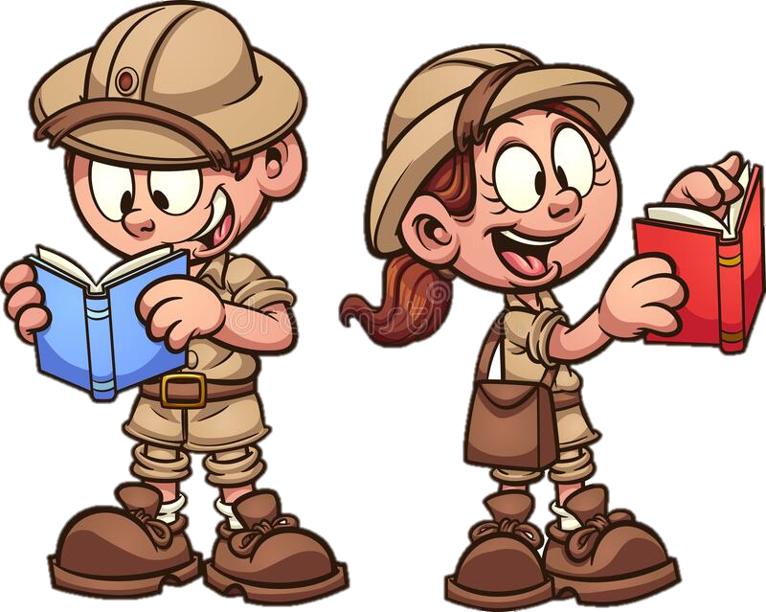
Tuesday 28th September 2021
LO: To write an ending.
C: Finding Something Tale

Slide 2

Can you edit yesterday’s work with red pen?

Slide 3
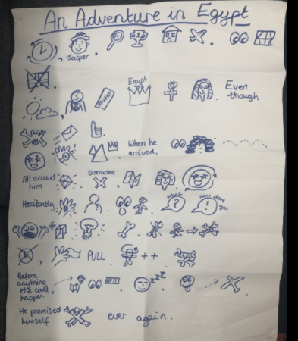
First, let’s recap the ending of our Jasper Story!

Slide 4
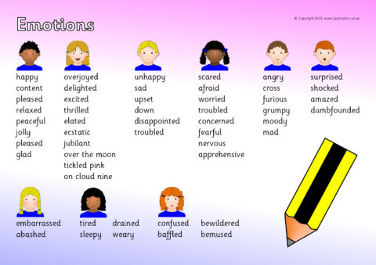
We made it to the end of the story!
Let’s reflect on your emotions...
……….yet……..

Slide 5
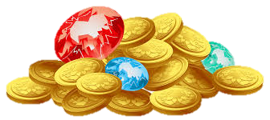
Now you need to return to England and do something with your treasure...

Slide 6

Final reflection:
Although it was an incredible adventure,

Slide 7
Plenary: Some children are going to read their work.
When you hear an emotion word/phrase please stand up.☺

