Slide 1
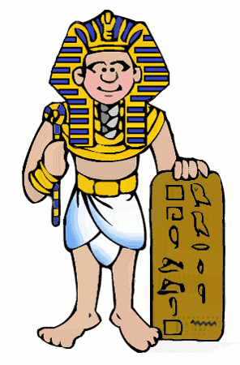
Wednesday 29th September 2021
L.O: To build an overview of world history
C: Howard Carter

Slide 2

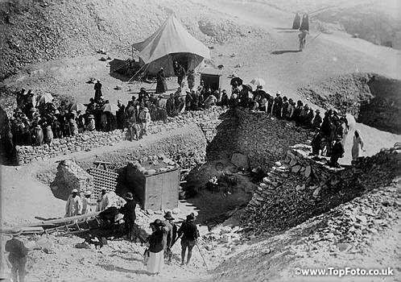
THE TOMB OF TUTANKHAMUN

Slide 3
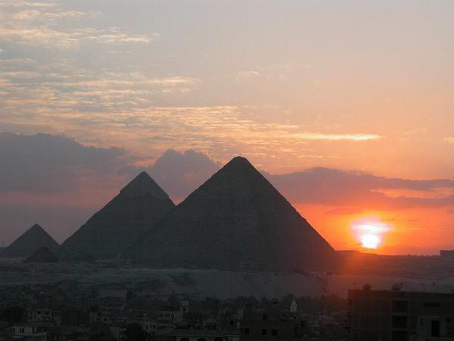

Journey back in time to 1922.
To a time when aeroplanes were very small and did not fly far.

Slide 4
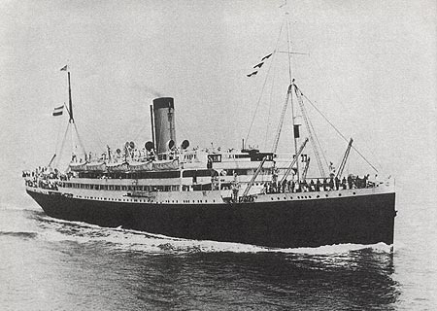
To a time when people travelling to Egypt from Britain went by ship. It took 2 weeks.

Slide 5
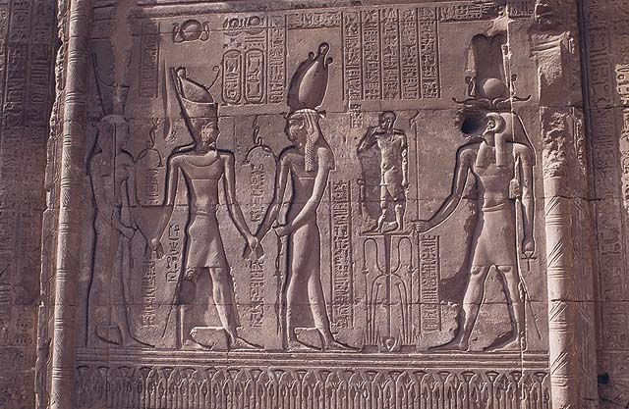
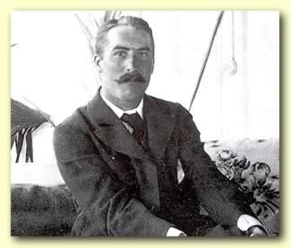
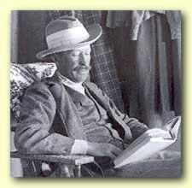
Howard Carter was a British archaeologist working in Egypt.
Howard Carter
Lord Carnarvon
Lord Carnarvan was a rich Englishman with an interest in Egypt. He paid the bills for Howard Carter’s work.

Slide 6
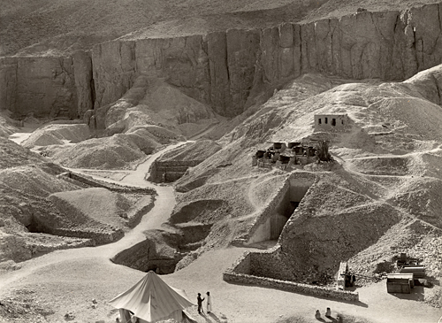
The people of Egypt buried some of their greatest pharaohs in this Valley of the Kings. By 1922 archaeologists thought they’d found them all.
Howard Carter worked out that there was still one tomb left – that of Tutankhamun!

Slide 7
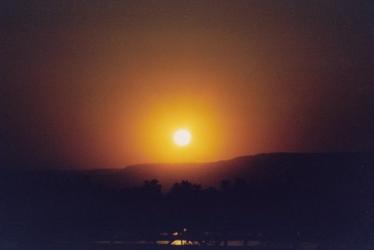
Early morning on the 3rd November 1922, in a hot and dusty valley in Egypt.
Egyptian workers were searching, digging away sand and stones.
They didn’t hold out much hope.

Slide 8
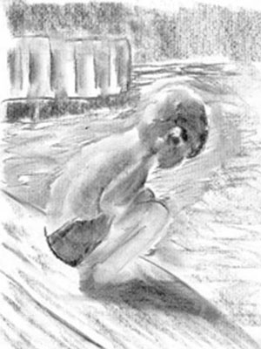
A young boy crouched a few feet away. His job was to fetch water to the workers. He sat digging in the sand with a stick. Suddenly he hit a hard surface.
He dug furiously and found a stone step.
He stared at it – then covered it over and ran to tell Howard Carter what he’d found.

Slide 9
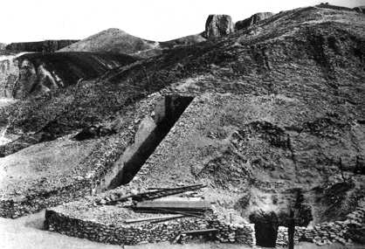
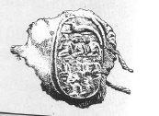
Carter ordered the workers to clear away the sand. Gradually they found 12 more steps.
Then they found the top part of a door made of brick and plaster. On the door was a stamp. This meant the tomb was royal and it was intact.

Slide 10
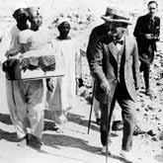
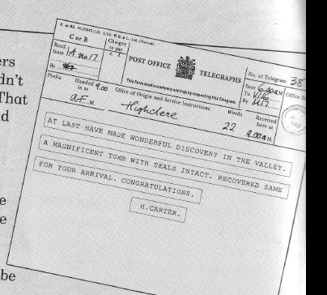
Carter ordered the workers to cover the steps over again so nobody else would find the tomb.
He sent a telegram to Lord Carnarvan in Scotland, asking him to come at once.
How long did it take Carnarvan to arrive?
Carnarvan and his daughter, Lady Evelyn arrived at the town of Luxor 2 weeks later and met Carter.

Slide 11
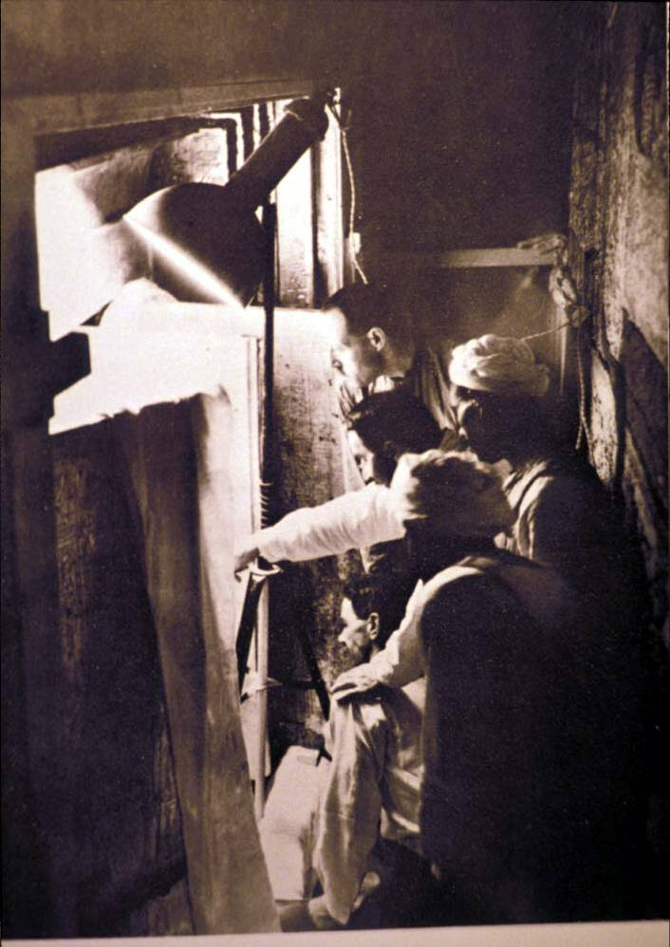
Next day, Howard Carter asked the workers to break down the door. They found a passage way blocked by rubble. Clearing them away they found...
A second door.
Carter took an iron bar and made a tiny hole in the top left hand corner. The bar passed through so the passage was clear.

Slide 12
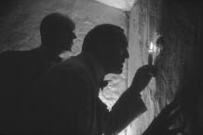
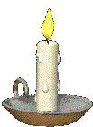
Carter took a candle and put it up to the hole to test for dangerous gas.
Then he widened the hole and looked in.
At first he saw nothing – then his eyes adjusted.
“Can you see anything,” asked Lord Carnarvan
“Yes”, replied Carter
“Wonderful things!”

Slide 13
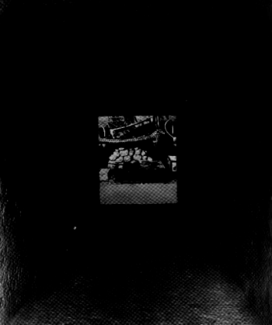
Both Carter and Lord Carnarvan were desperate to take a closer look. But Egyptian rules said NO!
Archaeologists had to have permission to dig in Egypt. They had to have an inspector with them when they first went in.
Frustrated, they closed up the hole and left one of the workers on guard. Then they got on their donkeys and rode back to Carter’s house.

Slide 14
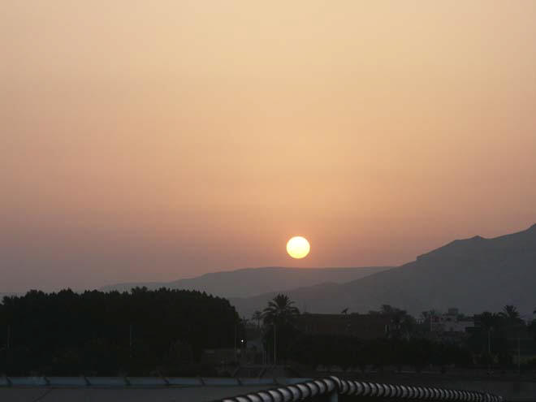
Unable to wait , later that same night Carter returned to the tomb. He made the hole bigger and they squeezed through one by one and dropped onto the floor. They found themselves in a small room.
Over 3000 years had passed since anyone had last entered. They saw a fingerprint left on the painted surface of an oil lamp. The smell of perfume still filled the air.

Slide 15
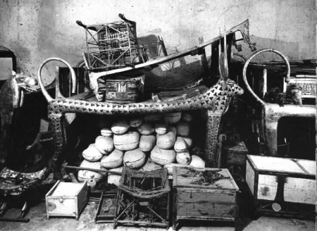
They found many magnificent statues and other items that blinked and glittered in the torchlight. They found a golden throne with figures of Tutankhamun and his wife on it.
But Carter was worried. If this was Tutankhamun’s tomb, then where was his body?
On the wall to the right were 2 life size statues of King Tutankhamun.

Slide 16
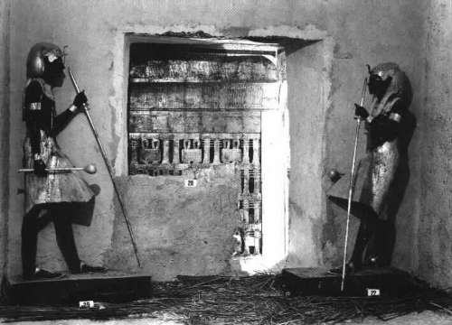
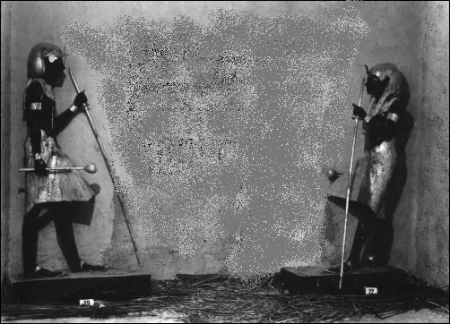
The statues stood opposite each other as if on guard.
Carter realised they marked a sealed up entrance to another room.

Slide 17
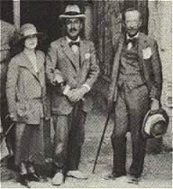
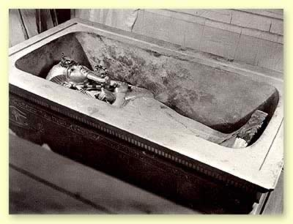
In his book, Howard Carter says he waited for over two months for the official opening of this tomb.
How do you think he felt?
Howard Carter returned at night and made a small hole near the floor in this wall. They squeezed through to see the tomb itself.
Having looked around, he blocked up the hole in the wall and covered the spot with a basket. The following morning he came back with the inspector, pretending never to have seen the treasures that follow.

Slide 18

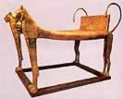
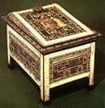




Slide 19
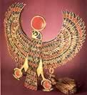

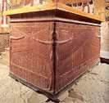
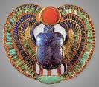

Slide 20

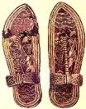

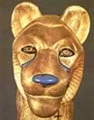

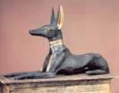

Slide 21

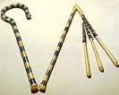
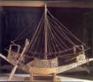

https://www.youtube.com/watch?v=V3U1IcB3ecU
https://www.bbc.co.uk/bitesize/topics/zg87xnb/articles/zvmkhbk/

Slide 22
Trouble!
Trouble began when newspaper reporters from all over the world began to arrive. Carter said they were getting in his way and holding up the work.
He decided to sell the exclusive rights to The Times newspaper.

Slide 23
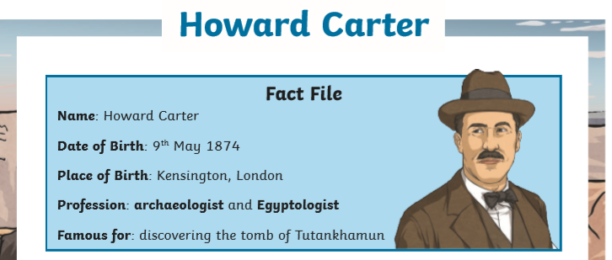
Some facts about Howard Carter....

Slide 24
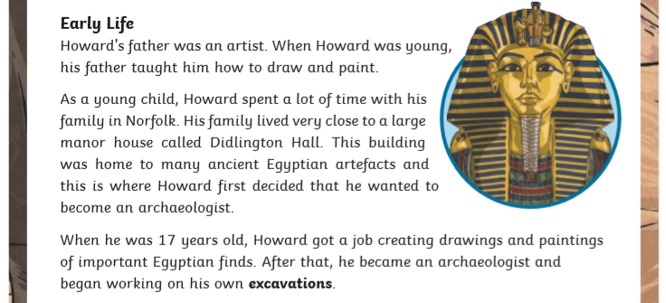

Slide 25
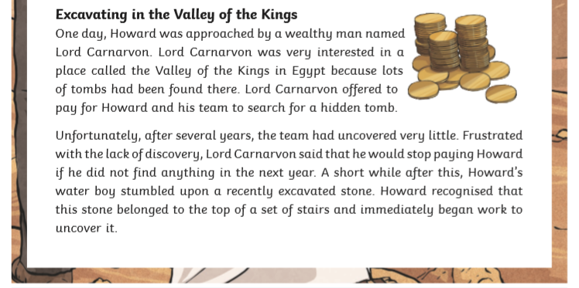

Slide 26
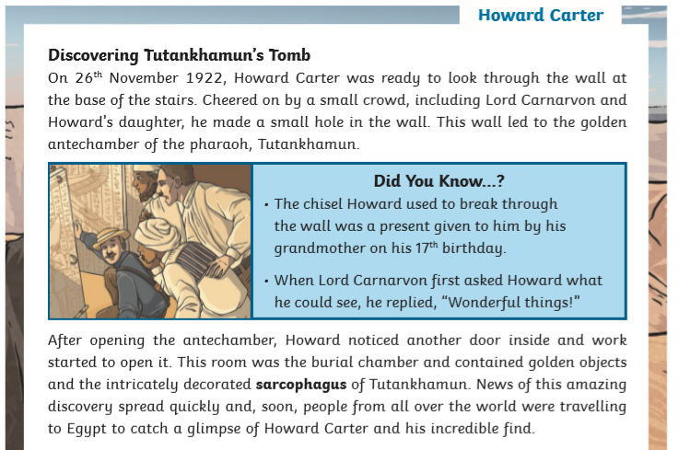

Slide 27
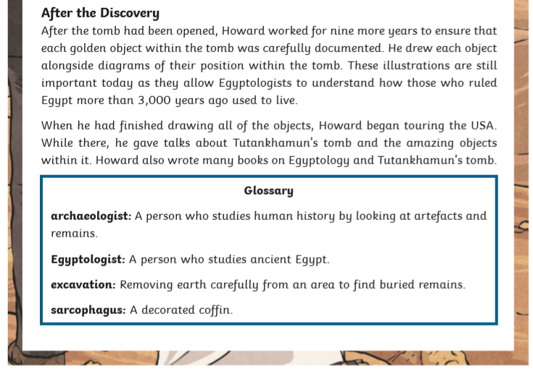

Slide 28
Hot Seating
In 3's one of you needs to be Howard Carter, one of you will be a newsreporter and the third taking notes.
You will need to produce questions as a group, then the inteviewer will ask them to 'Howard Carter'. It is important that the note taker listens carefully and write down the key information word for
word. https://www.bbc.co.uk/teach/class-clips-video/history-ks2-how-to-interview-people/zrhgwty
Once you have conducted the interview, you need to write it up in your books.

Slide 29
Wednesday 29th September 2021
LO: To build an overview of world history
C: Howard Carter
Interviewer: How did you feel when you were digging in Egypt?
Howard Carter: It was really hard work. There were times when I felt like
giving up due to the long, sweltering days but I knew I had to
keep going.

