Slide 1
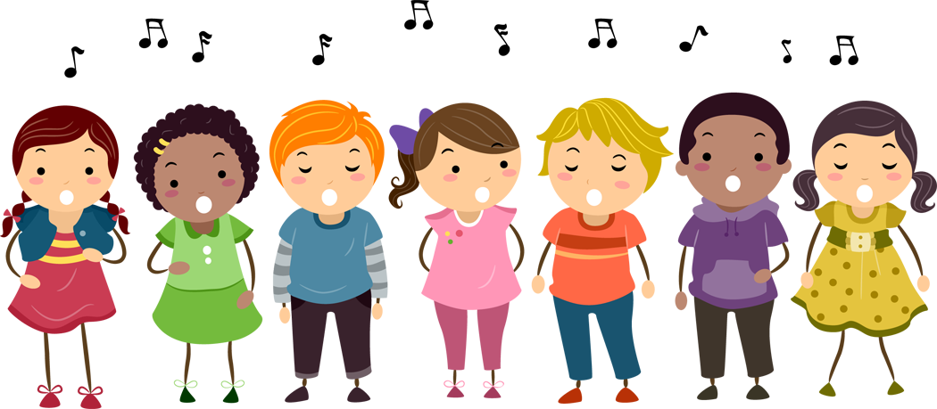
Good Afternoon Key Stage 2!
Our music term of the day is “dynamics”!
Dynamics are all about the volume of the music.
Can you hear any points where the music swells and gets louder? Or dwindles and gets quieter?

Slide 2

Let’s start with a warm up game!
Wake-Up Shake-Up
https://www.youtube.com/watch?v=mXVXPTyfA4c

Slide 3

Let’s practice Lord of the Harvest!
Come and Praise CD2 Track 112
https://www.youtube.com/watch?v=Njkm9jEW7cc

Slide 4
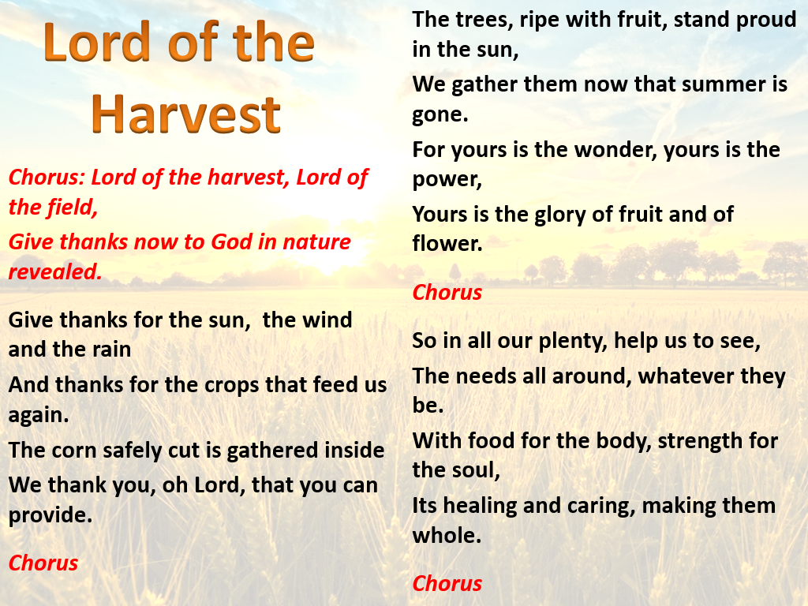
Come and Praise CD2 Track 112

Slide 5

Let’s learn I planted a seed!
Come and Praise CD2 Track 113
https://www.youtube.com/watch?v=ckwpn-fOZ4U
(Backing track)

Slide 6
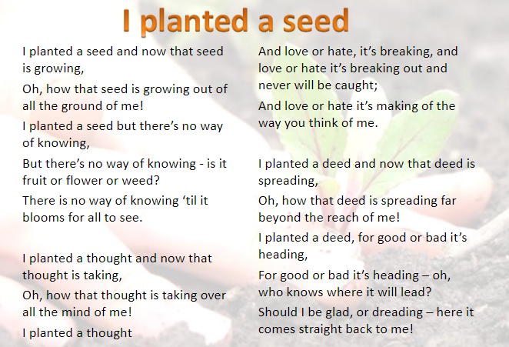
Come and Praise CD2 Track 112

Slide 7

Let’s finish with one you know!
https://www.youtube.com/watch?v=PukdaXUzgOU

Slide 8


