Slide 1
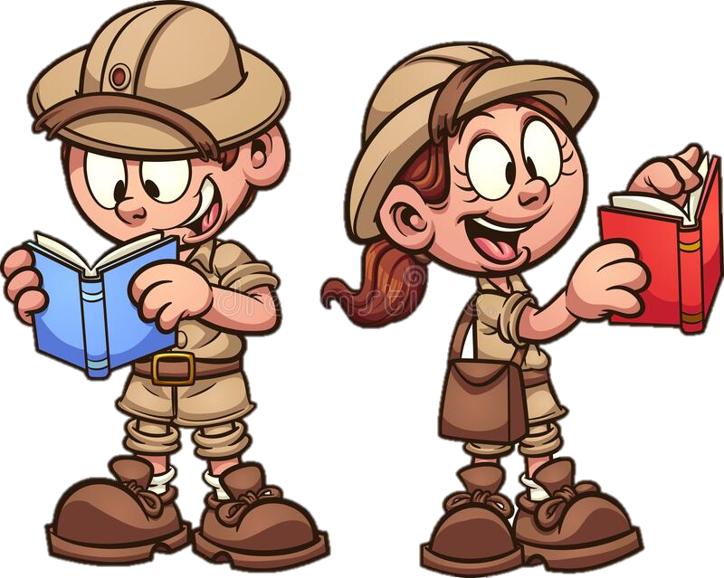
Monday 27th September 2021
LO: To write a resolution.
C: Finding Something Tale

Slide 2

Can you edit Friday’s work with red pen?

Slide 3
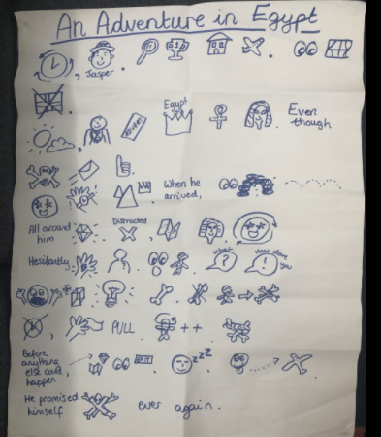
First, let’s recap the resolution of our Jasper Story!

Slide 4

First you need to have your bright idea...
Suddenly,

Slide 5
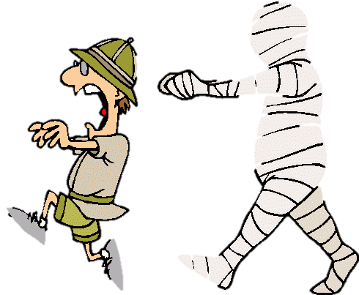
Next perform your action...
How are you feeling?
Can use any adverbials?

Slide 6
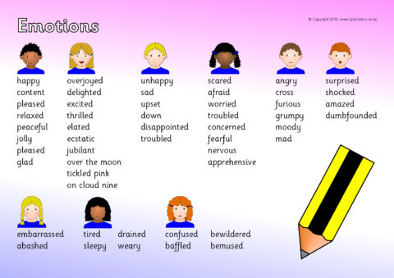
What a success!
How are you feeling?

Slide 7
Plenary: Can you highlight the adverbials you have used?
Add some more in red pen if you have forgotten them ☺

