Slide 2
Wednesday 6th October 2021
L.O: To celebrate the contributions of Black Britons to society, art and culture.
C: Success and contribution (Black History Month)

Slide 3

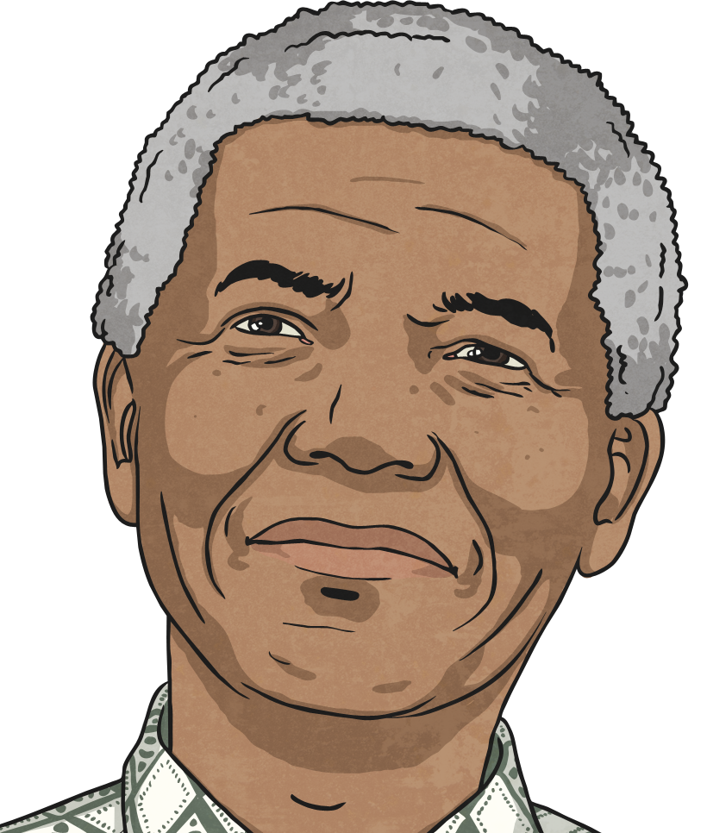
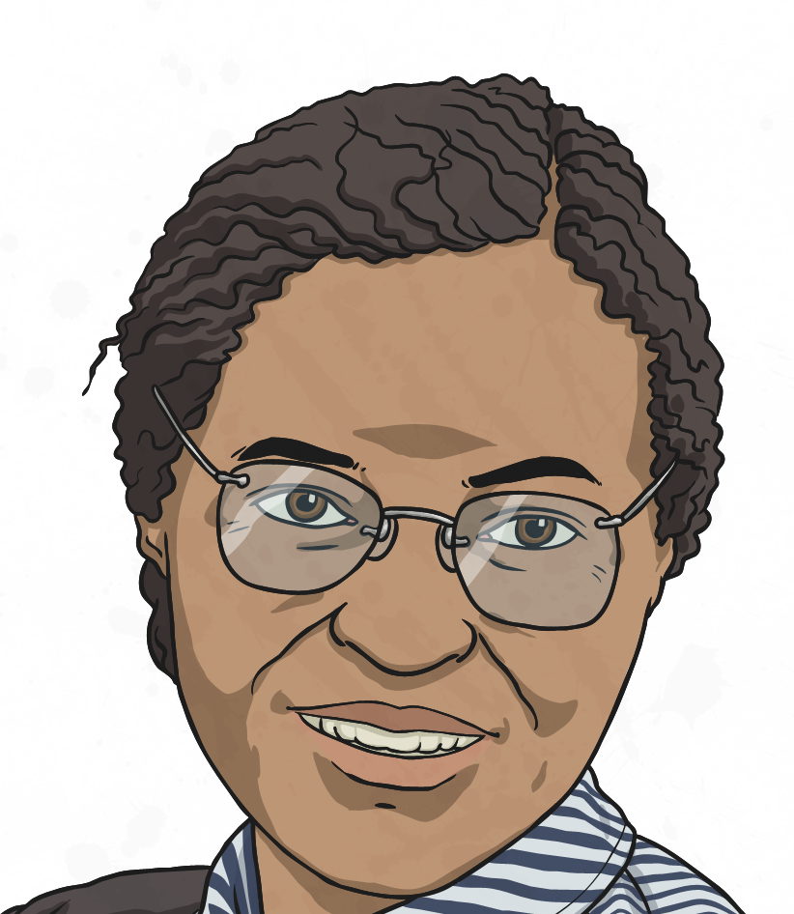
What is Black History Month?
Black History Month is a time set aside each year to celebrate the achievements of Black men and women in the past and today.

Slide 4

Why Do We Have Black History Month?
Why do you think we have Black History month?
Black people have not always been treated equally simply because of the colour of their skin.
Do you know of any examples or stories of when Black people have been treated unfairly in the past?
One example is that in America, Black and White people had to sit in different seats on a bus or public places, like the cinema.
Another example is from the late 16th century, when Black men, women and children were enslaved and brought to England to work.

Slide 5
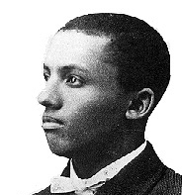
Why Do We Have Black History Month?
Lots of people knew that this was wrong and wanted things to change.
In 1926, in the United States of America, a man called Carter G. Woodson introduced a “Negro History Week,” which is now considered a historical, outdated term.
In the UK, a movement began in the 1980s as part of a local community activism to challenge racism.
In 1987, this turned into what we know today as Black
History Month.
How do you think this made Black people feel?
Carter G. Woodson

Slide 6
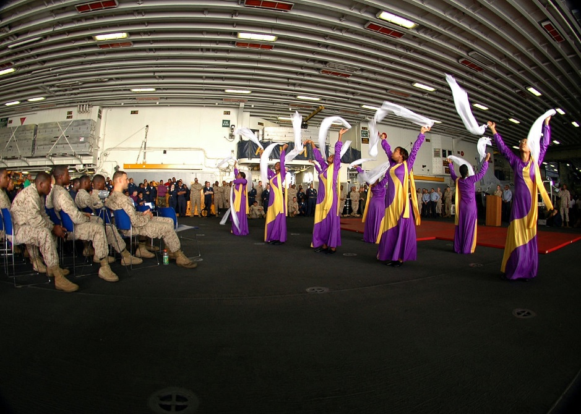
When is Black History Month?
Black History Month takes place annually in October in the UK and in February in America.
There is a different theme each year.
The theme for 2021 is ‘Proud to Be’ and different events are planned to take place throughout the month.

Slide 7
Famous Black Men and Women
Now we are going to watch a few videos about some famous black men and women.

Slide 8
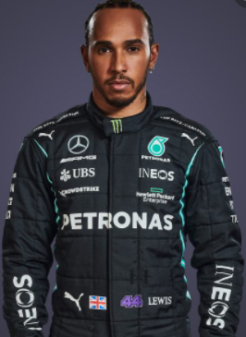
Lewis Hamilton
https://www.youtube.com/watch?v=zt1UpRPNVZE

Slide 9
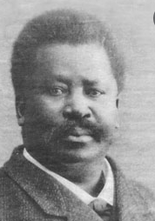
Pablo Fanque
https://www.bbc.co.uk/teach/class-clips-video/ks2-pablo-fanque-the-greatest-victorian-showman/zhcf6v4

Slide 10
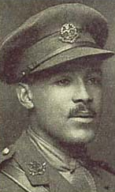
Walter Tall
https://www.bbc.co.uk/bitesize/topics/zqhyb9q/articles/zbgxbdm

Slide 11
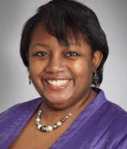
Malorie Blackman
https://www.theguardian.com/books/video/2013/jun/04/childrens-laureate-malorie-blackman-video-interview

Slide 12
What sort of adversities (problems and hurdles) do you think these people may have faced?

Slide 13
What positive words or phrases can we use to describe our famous figures?

Slide 14
Your task is to choose a famous figure, and write 5 positive words or phrases around the point of your star.
You can then draw a picture of your figure in the middle.

