Slide 1

Wednesday 6th October 2021
L.O: To use sentences appropriately.
C: Nouns and pronouns to avoid repetition and for cohesion.

Slide 2
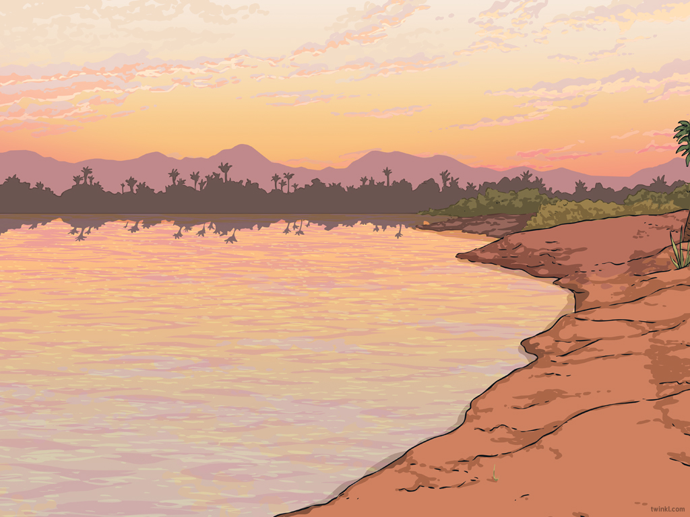

Starter
Let’s watch this video! I would like you to note down any key facts on your whiteboard or in the back of your book.
https://www.youtube.com/watch?v=V3U1IcB3ecU

Slide 3
Thinking time...
Now you have collected some facts, let’s have a look at a recount I have written...

Slide 4
The rich man paid me to look for the pharaoh’s tomb. I found it. There was some sparkly things inside. We thought the discovery was good.

Slide 5
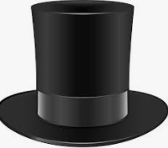
Black Hat Time!
I want you to wear your black hat and think negative thoughts about my recount. How could I improve it?

Slide 6
The rich man paid me to look for the pharaoh’s tomb. I found it. There was some sparkly things inside. We thought the discovery was good.

Slide 7
I tried to improve it:
The rich man paid me to go to Egypt and look for the pharaoh’s tomb. When I was digging I found the tomb. We checked for traps. There was some sparkly treasure inside. We also found a hidden room with the mummy in. We thought the discovery was great.

Slide 8
Black Hat Time!
I want you to wear your black hat and think negative thoughts about my recount. How could I improve it again?

Slide 9
Let’s improve it together:
We need to try to use our 5 w’s.
The rich man paid me to go to Egypt and look for the pharaoh’s tomb. When I was digging I found the tomb. We checked for traps. There was some sparkly treasure inside. We also found a hidden room with the mummy in. We thought the discovery was great.

Slide 10
Now it is your turn!
Today we are going to write our own descriptive sentences which we can save to use in our recounts.
Remember to try avoid being repetitive.

Slide 11
Introduction
Who did the activity?
Where did it all take place?
What did they do?
When did this happen?
Why was the activity carried out?

Slide 12
Main body
Write in chronological order.
Use sequential words.
Write in paragraphs.
Use detailed and technical vocabulary.
Write about what happened during the activity.

Slide 13

Sequential Words
Here are a few examples:
Finally
Later
Meanwhile
Next
Firstly
Then
Eventually
What others can you think of?

Slide 14
Concluding Paragraph
What would you recommend to others?
How would you describe the general atmosphere of the event?
Write about the highlights of the event.
What have you learnt?

Slide 15
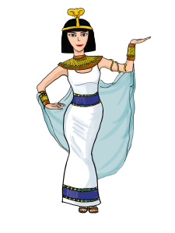
Our Task
We are going to read and analyse a model recount I have written!
Let’s see what features we can find!

Slide 16

Plenary
Choose your three favourite words/phrases/punctuation from my model which you may want to magpie for your own writing.

