Slide 1


Monday 4th October 2021
L.O: To write with purpose.
C: Diary (Cold Task).

Slide 2
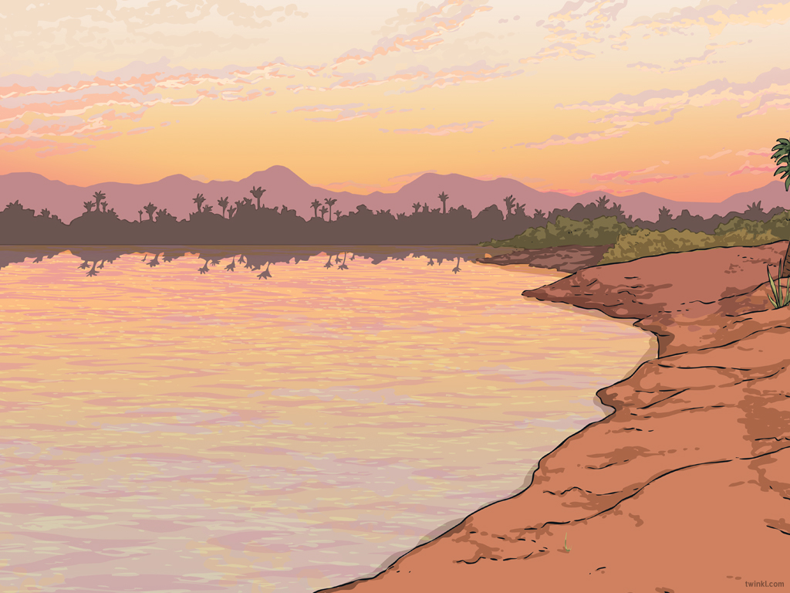

Can you tell your partner about your weekend? What did you get up to?

Slide 3

Now it is your turn to tell me!
I would like you to write a diary about your weekend.

