Slide 1

Thursday 7th October 2021
L.O: To understand texts.
C: Let’s do the Pharaoh!
(Inference and Prediction)

Slide 2
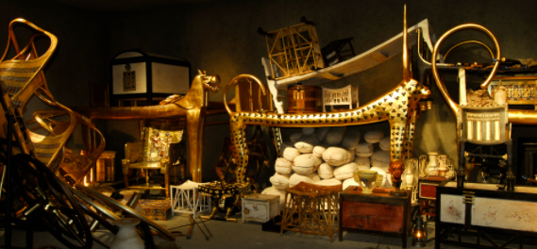

Starter: Where do you think Sennapod has hidden his treasure or his map?
Where would you hide it if you were him?

Slide 3
Let’s read up page 106-111

Slide 4
Let’s read up page 106-111
What do you think their plan is? How do you think they are planning to steal the treasure or find the map?

Slide 5
Firstly, I would like you to role play as Grimstone and Jelly.
Discuss your eeeevvvviilll plan...

Slide 6
Your Task
Can you write a set of instructions for your master plan?
Remember to keep your instructions clear and concise.
Paddlers: You are going to create a group write with the TA.

