Slide 1

Thursday 7th October 2021
L.O: To organise writing appropriately.
C: To plan a recount.

Slide 2
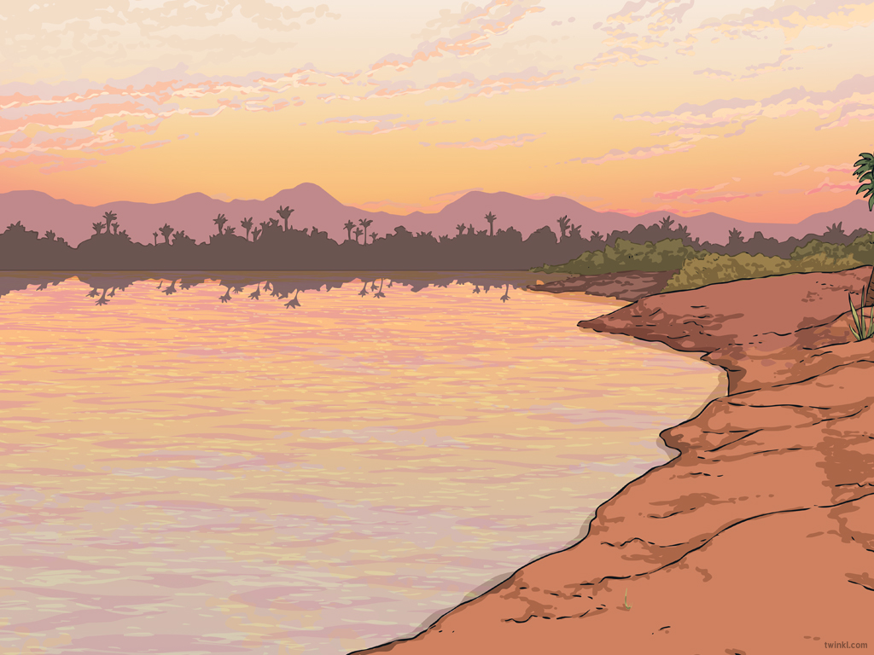

Starter
We are going to read a start of a recount. I want you to stand up each time you hear a verb that does not sound quite right.

Slide 3
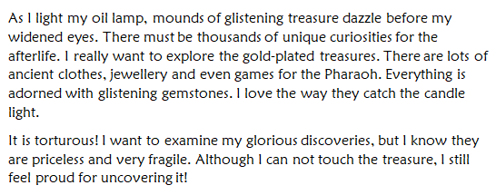

Slide 4
We are going to complete a plan today!
We are going to order our photos and add some bullet points with the pictures.

Slide 5
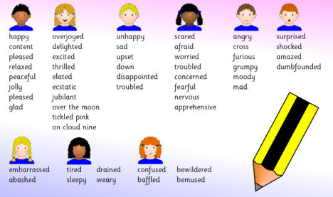
Next, we are going to add some emotion words to our plan!

