Slide 1

Friday 8th October 2021
L.O: To write with purpose.
C: Introduction- Class Write.

Slide 2
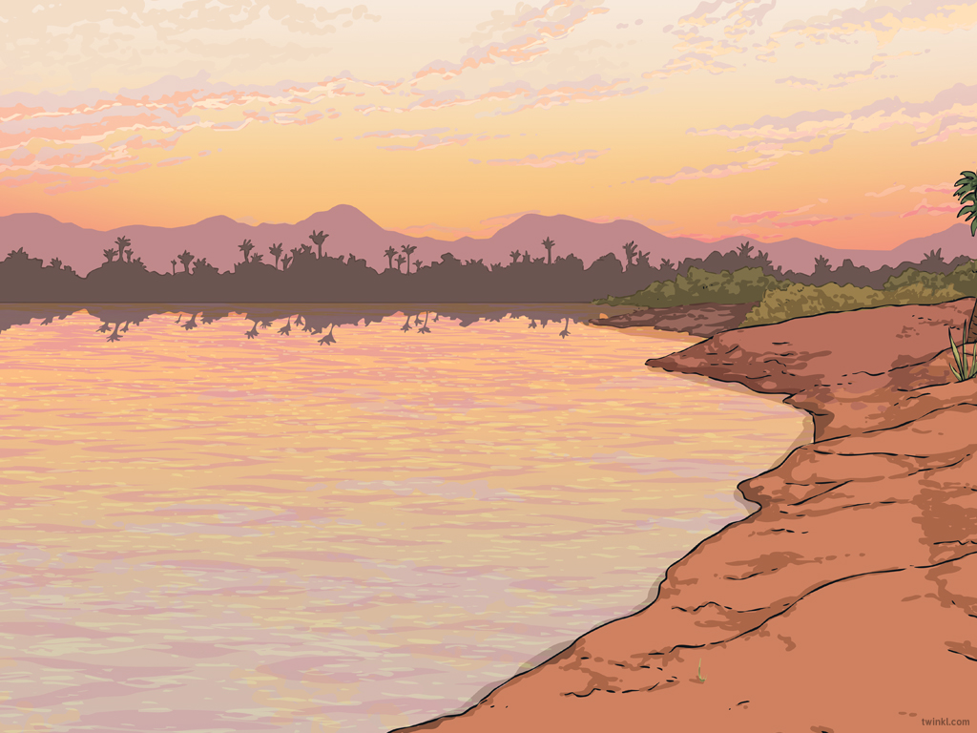

Let’s Recap!
Today we are going to write an introduction!
Let’s recap the structure of an introduction in an informal recount.

Slide 3
Introduction
Who did the activity?
Where did it all take place?
What did they do?
When did this happen?
Why was the activity carried out?

Slide 4
We are going to use this structure to write a class introduction together!

