Slide 1

Tuesday 5th October 2021
LO: To work scientifically.
C: Shadows

Slide 2
Paddling: I can carry out an investigation.
Snorkelling: I can also predict the result of an investigation.
Diving: I can even describe the steps and result of an investigation.

Slide 3

What do we know about shadows?
Guiding Questions:
How are shadows created?
What do opaque, translucent and transparent mean?

Slide 4
Today, we are…
Looking at how the distance between a light source and an object that’s blocking it affect the size/length of a shadow.
We will be conducting a fair investigation, where we only change one variable (part). We will be changing the distance between the object and the light source.

Slide 5
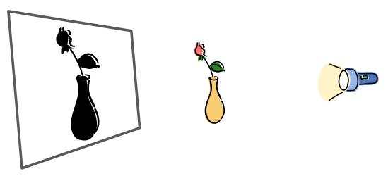
Demonstration

Slide 6
What do you predict will happen?
I predict the shape of the shadow will get longer/shorter/won’t change because…

Slide 7
What equipment will you need?
Light source
Paper
Pencil
Opaque object.

Slide 8
Remember: Move the object in a straight line and don’t move the torch! Only draw the outline and write the distance inside the shadow!
Complete sheet in book for your object. You could try a couple different objects if you want to!

Slide 9
What did you notice?
Write your findings at the bottom of your sheet.

