Slide 1


Slide 3




Complete the calculations.
5 $+$ 3 $=$
1)
2)
3)
4)
65 $+$ 3 $=$
$=$ 75 $+$ 3
$+$ 3 $=$ 98

Slide 4
Complete the calculations.
5 $+$ 3 $=$
1)
2)
3)
4)
8
65 $+$ 3 $=$
68
$=$ 75 $+$ 3
78
$+$ 3 $=$ 98
95

Slide 6




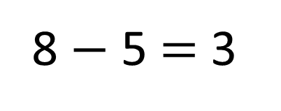
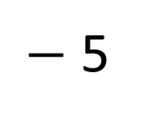
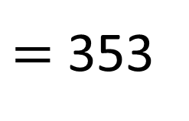
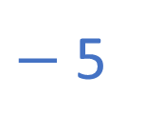
How many sweets in the shop?
358
$−$ 5
$=$ 353
8 $−$ 5 $=$ 3
$−$5
350
351
352
353
354
355
356
357
358
359
360

Slide 7
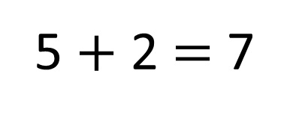
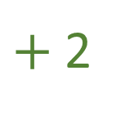
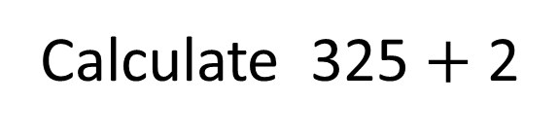
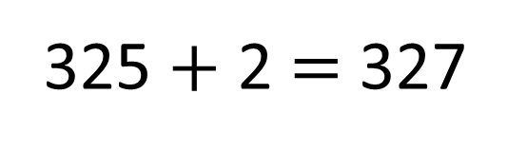
Calculate 325 $+$ 2
5 $+$ 2 $=$ 7
325 $+$ 2 $=$ 327
$+$2
320
321
322
323
324
325
326
327
328
329
330

Slide 8
Have a go at questions
1 - 4 on the worksheet

Slide 9


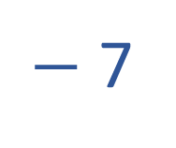
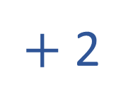
Have a think
$+$ 2
362
364
$−$ 7
897
890
$+$ 5
423
428

Slide 10




2
3
6
2
v
$$+$$
$$=$$
238
v
$$+$$

Slide 11

Have a think
4
2
0
0
6
1
1
3
3
v
$$+$$
2
v
$$=$$
463
v
$$+$$

Slide 12
Have a go at the rest of the questions on the worksheet

