Slide 1
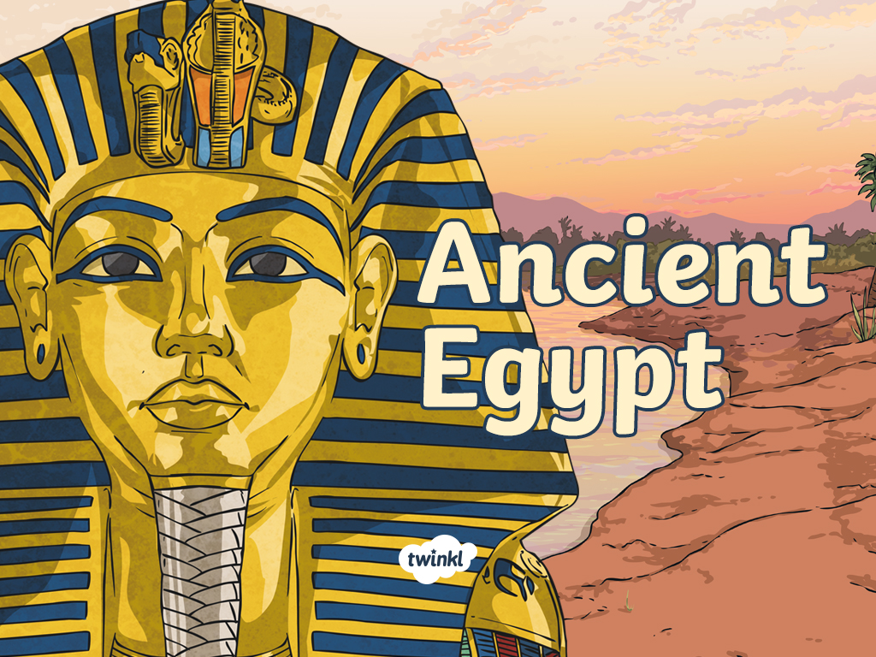
Tuesday 5th October 2021
L.O: To analyse writing.
C: Howard Carter Informal Recount

Slide 2
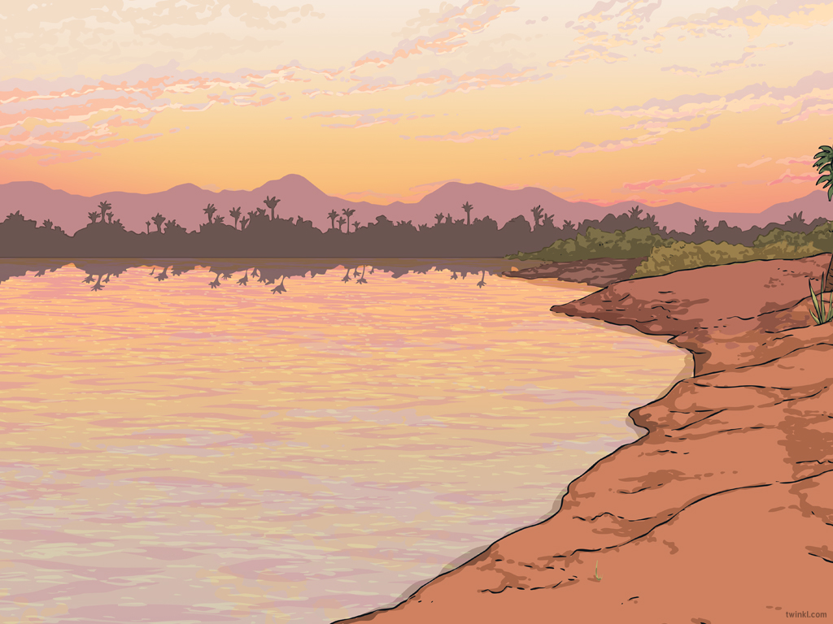

Key Words Spelling Game!
P_r_m_d
_h_r_o_
_u_a_k_a_u_
T_m_
H_w_r_ C_r_e_
L_r_ C_r_a_v_n
Can you work out the missing letters?

Slide 3

Key Words Spelling Game!
Pyramid
Pharaoh
Tutankhamun
Tomb
Howard Carter
Lord Carnarvon
Let’s mark with RED PEN!

Slide 4

Over the next few weeks:

Slide 5
What is a recount?
A recount retells an experience or an event that happened in the past. The purpose of a recount can be to inform, entertain or to reflect and evaluate.
A recount can focus on a specific section of an event or retell the entire story. A recount should always be told in the order that things happened.

Slide 6
Let’s look at the structure of a recount.

Slide 7
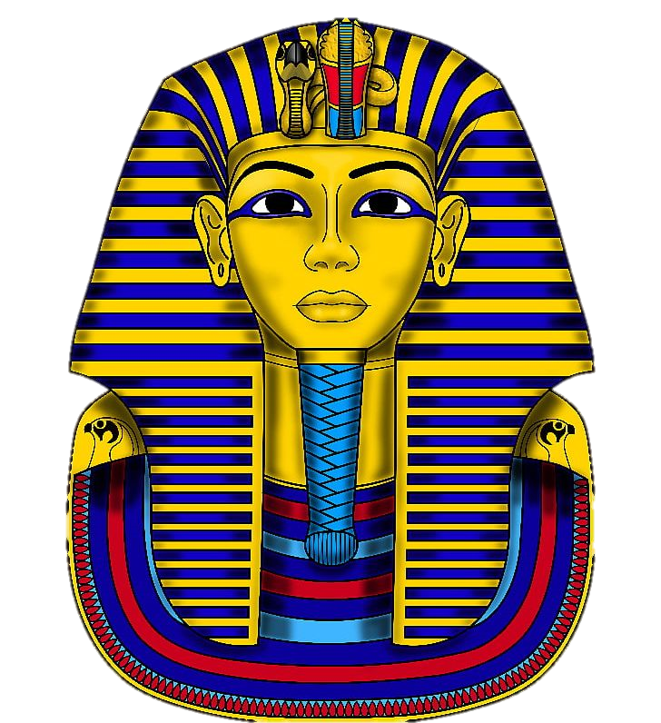
Introduction
Who did the activity?
Where did it all take place?
What did they do?
When did this happen?
Why was the activity carried out?

Slide 8
Main body
Write in chronological order.
Use sequential words.
Write in paragraphs.
Use detailed and technical vocabulary.
Write about what happened during the activity.

Slide 9

Sequential Words
Here are a few examples:
Finally
Later
Meanwhile
Next
Firstly
Then
Eventually
What others can you think of?

Slide 10
Concluding Paragraph
What would you recommend to others?
How would you describe the general atmosphere of the event?
Write about the highlights of the event.
What have you learnt?

Slide 11
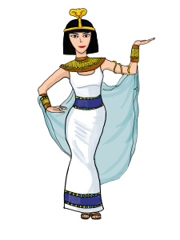
Our Task
We are going to read and analyse a model recount I have written!
Let’s see what features we can find!

Slide 12

Plenary
Choose your three favourite words/phrases/punctuation from my model which you may want to magpie for your own writing.

