Slide 1
Monday 2nd November 2020
LO: To understand what Christians believe the Trinity is
C: What is the Trinity
Once you have written the date, LO and context, please read through your knowledge organiser and stick it in.

Slide 2
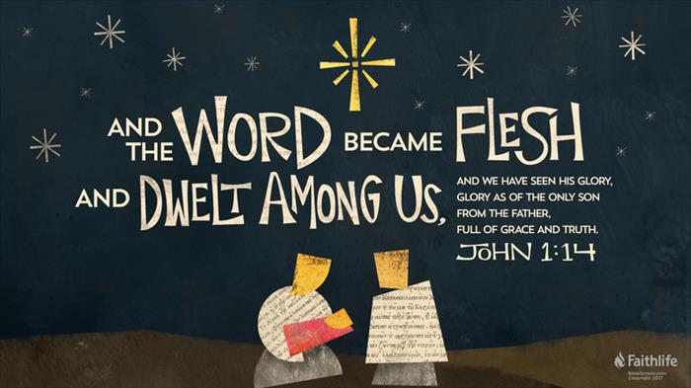
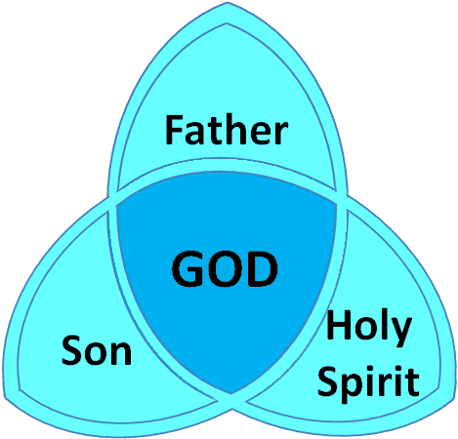
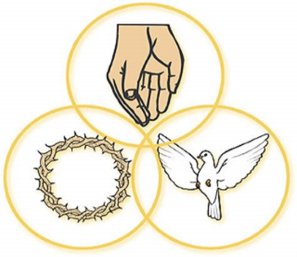
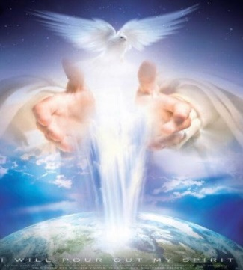
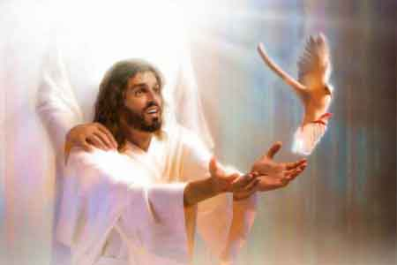
Christianity:
What is the Trinity?
Topic Overview
Christians believe that God is Trinity: God as three in one - Father, Son and Holy Spirit.
Christians worship God as a Trinity.
Christians believe the God the Father is the creator: he sent his Son (Jesus) who saved his people; the Son send the Holy Spirit to his disciples.
Christians find that understanding God is challenging: people spend their whole lives learning more and more about God.
Jesus, the Son of God, is seen by Christians as revealing what God the Father is like.
Christians believe the Holy Spirit is God’s power at work in the world and in their lives today, supporting them to follow Jesus.
Key Vocabulary | Definition
Trinity | The Christian belief that there is One God, who is Father, Son, and Holy Spirit.
Incarnation | The Christian belief that God took human form by becoming Jesus.
Gospel | ‘Good news.’ In Christianity, "good news" refers to the story of Jesus Christ's birth, death, and resurrection.
Carol | A religious song or hymn, usually associated with Christmas.
Links with other religions
Many religions believe in one God. Belief in the Trinity is unique to Christianity.
Allah (Islam): Muslims believe in one God (Allah). They believe Allah has no shape or form and that he has no children or parents.
God (Judaism). Jews do not believe in the Trinity. They believe that God alone should be worshipped.
Waheguru (Sikhism). Sikhs believe that there is only one God. They believe God is without form or gender.
Brahman (Hinduism): Hindus believe in one God called Brahman. Brahman takes on many forms that some Hindus worship as gods or goddesses. Hindus also believe in the ‘trimurti’ – three Gods who are responsible for the creation, upkeep and destruction of the world: Brahma, Vishnu and Shiva.
God (Buddhism). Most Buddhists do not believe in God.

Slide 3
What do I already know about the Trinity?

Slide 4

Let’s Watch
https://classroom.thenational.academy/lessons/what-is-the-holy-trinity-cthk6c

Slide 5
How do people depict the Trinity?

Slide 6
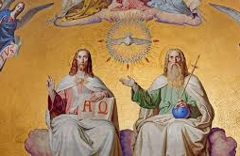

Slide 7
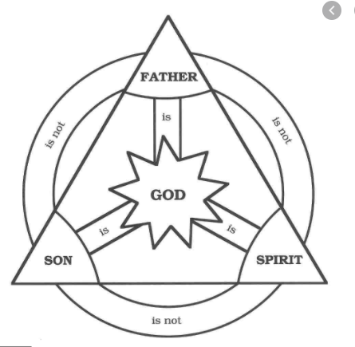

Slide 8
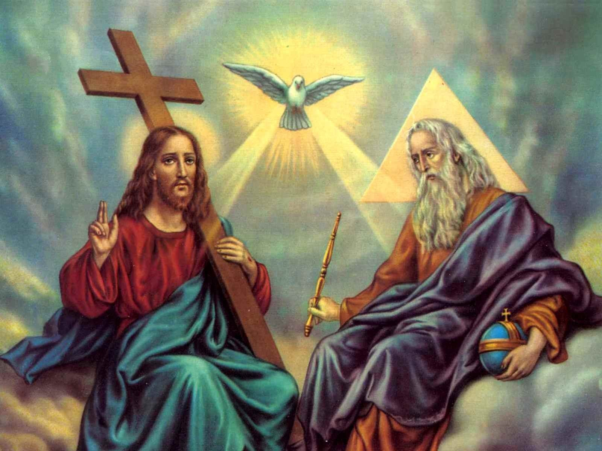

Slide 9
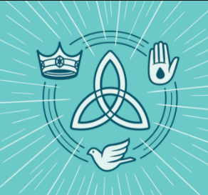

Slide 10
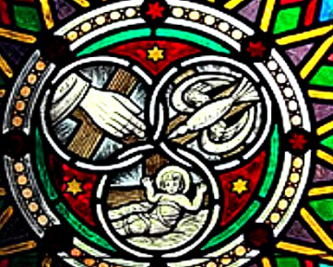

Slide 11
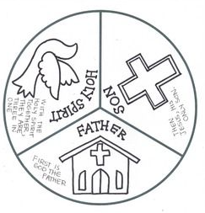

Slide 12
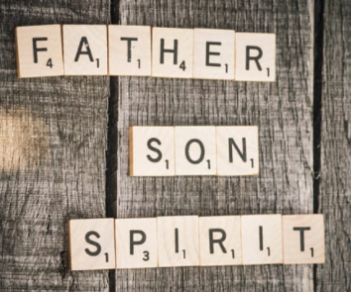

Slide 13
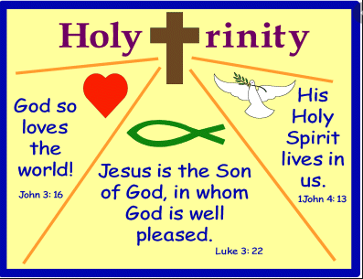

Slide 14
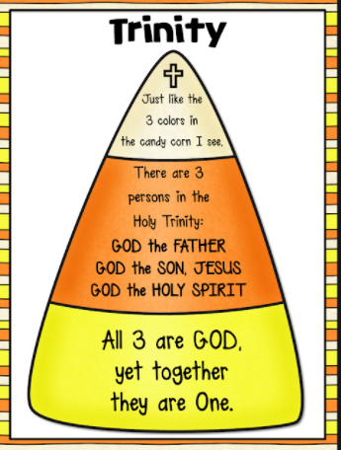

Slide 15
How could you represent Trinity to help others understand what it is?

