Slide 1

Wednesday 5th January 2022
L.O: To research the main features of a type of writing.
C: Cinquain Poems

Slide 2

A cinquain is a special kind of poem. Over the next two weeks, we are going to investigate the features and create our own!

Slide 3

First, I would like you to read these examples, or listen to me read them, and see what you notice about them.
Can you spot any features?

Slide 4
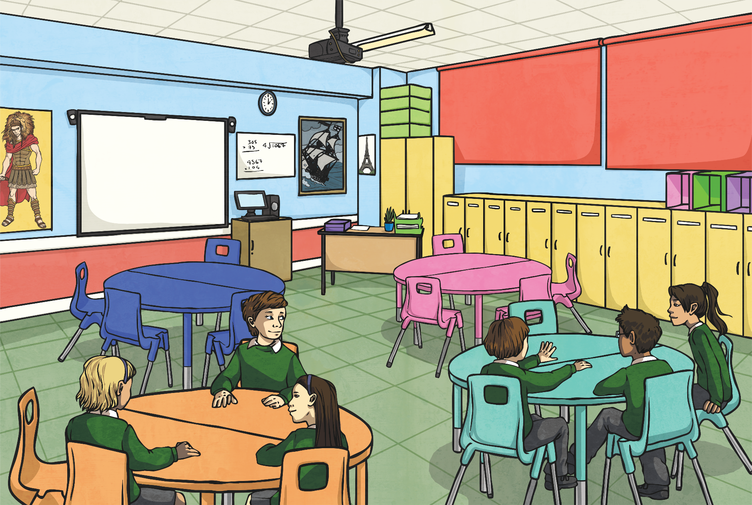
Cinquain Examples
What is each poem about?
Birthday
Happy, fun-filled
Playing, eating, dancing
Come and celebrate it with me
Party!
Summer
Hot and sunny
lazing, slurping ice-creams
Passport, suitcase, boring airport
No school!
My pet
Fluffy, wriggly
Licking faces, chewing
Never stops chasing his own tail!
Puppy

Slide 5
Cinquain Examples
What similarities do you notice?
Birthday
Happy, fun-filled
Playing, eating, dancing
Come and celebrate it with me
Party!
Summer
Hot and sunny
lazing, slurping ice-creams
Passport, suitcase, boring airport
No school!
My pet
Fluffy, wriggly
Licking faces, chewing
Never stops chasing his own tail!
Puppy

Slide 6
What features are we looking for?
I know that cinquains have five lines;
I can count the syllables in each line (2, 4, 6, 8, 2);
I know that cinquains should form approximately a diamond shape;
I understand that cinquains don’t have to rhyme.

Slide 7

Cinquain Features
What did you notice?
Summer
Hot and sunny
Lazing, slurping ice creams
Passport, suitcase, boring airport
No school!
The lines form the shape (approximately) of a diamond, so these poems are sometimes called diamond or diamante poems.

Slide 8
Cinquain Features
What did you notice?
There are always five lines.
Each line of the poem develops the subject of the first word.
Summer
Hot and sunny
Lazing, slurping ice creams
Passport, suitcase, boring airport
No school!

Slide 9

Cinquain Features
What did you notice?
Each line follows a theme:
2 (Sum-mer)
4 (Hot and sun-ny)
6 (La-zing, Slur-ping, ice creams)
8 (Pass-port, suit-case, bor-ing air-port)
2 (No School!)
Summer
Hot and sunny
Lazing, slurping ice creams
Passport, suitcase, boring airport
No school!

Slide 10
Cinquain Features
What did you notice?
Each line follows a theme:
Subject
Description
Action
Feeling
Conclusion
Summer
Hot and sunny
Lazing, slurping ice creams
Passport, suitcase, boring airport
No school!

Slide 11
Cinquain Features
What did you notice?
Summer
Hot and sunny
Lazing, slurping ice creams
Passport, suitcase, boring airport
No school!
Lines are always written centred on the page

Slide 12
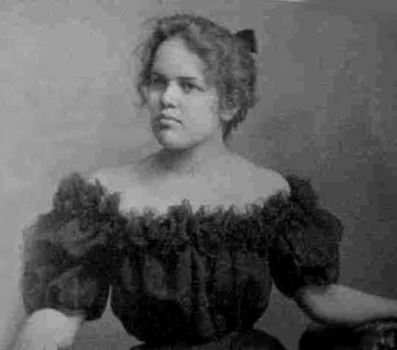
Did you know…?
The cinquain form was invented by the American poet Adelaide Crapsey, in about 1911.
The name comes from the French word ‘cinq’ meaning five.
Photo courtesy of anonymous (@wikipedia.com) - granted under creative commons licence – attribution

