Slide 1
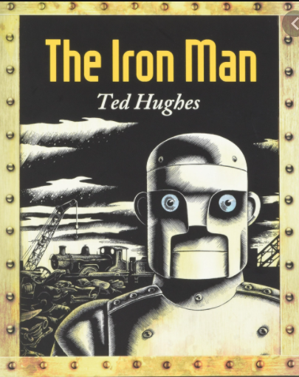
Thursday 6th January 2022
L.O: To understand texts
C: The Iron Man- Prediction

Slide 2
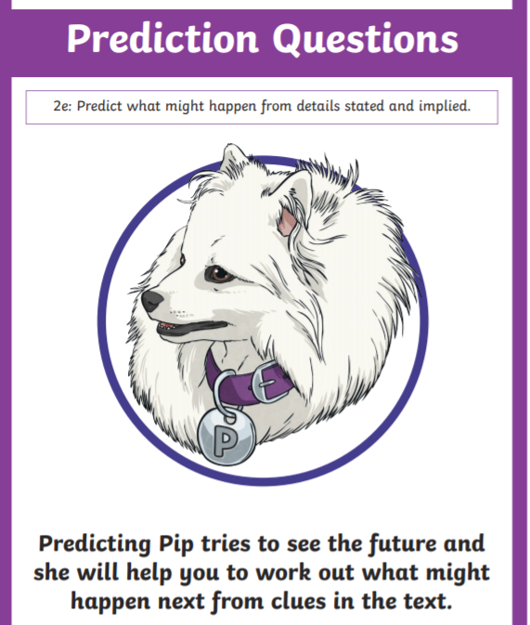
Today we are going to be using Predicting Pip!
We are going to predict what our new book might be about!

Slide 3

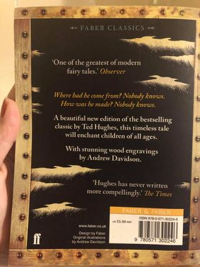
What are your initial (first) thoughts about this book?

Slide 4
Let’s think about our five w’s!

Slide 5
Who: What can we tell from the picture and the title?

Slide 6
When: What does the train in the background tell us about when the book was set?

Slide 7
What: What may happen? What is your prediction?

Slide 8
Where: Where might the story be set? What clues can you see on the front cover?

Slide 9
Why: Can we work this out yet? Does the blurb gives us any clues?

Slide 10
We are going to annotate the covers with our ideas….
Paddlers: Annotate the covers using the five w’s. Snorkelers: Annotate the covers using the five w’s supported by reasons. E.g. this story may be set a long time ago because I can see an old steam train. Divers: Annotate the covers using the five w’s supported by reasons. RED PEN QUESTION: What emotion do you think the Iron Man is feeling? Why?

