Slide 1


Slide 2
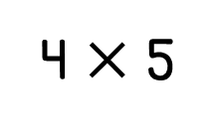
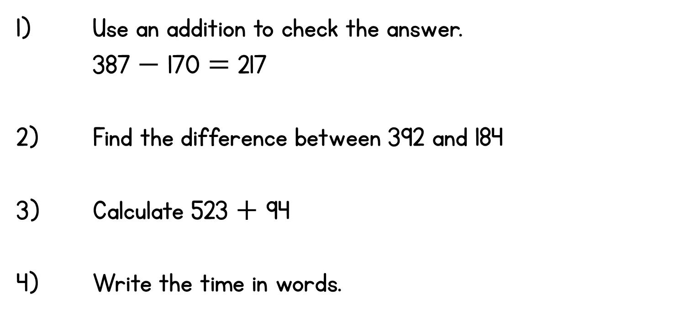
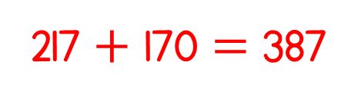
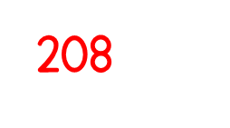

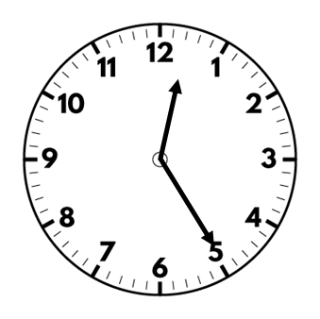

Year 3 | Week 9 | Day 1

Slide 4


Continue the sequence
2, 4, 6, 8, ____, ____, ____, ____
Continue the sequence
5, 10, 15, 20, ____, ____, ____, ____
What is the total score in each row?
a)
b)

Slide 5
Continue the sequence
2, 4, 6, 8, ____, ____, ____, ____
Continue the sequence
5, 10, 15, 20, ____, ____, ____, ____
What is the total score in each row?
a)
b)
10 12 14 16
25 30 35 40
15
12

Slide 6





What do you see?
Have a think
3
4
There are ____ equal groups of ____
$+ + =$
4
4
4
12
$× =$
3
4
12

Slide 7

What do you see?
Have a think
2
6
There are ____ equal groups of ____
$+ =$
6
6
12
$× =$
2
6
12

Slide 8


Have a think
2
2
2
2
8
$+ + + =$
$× =$
4
2
8

Slide 9
1) How many counters?
2) How many counters?
3) Which representations show 6?

Slide 10
1) How many counters?
2) How many counters?
3) Which representations show 6?
5
10

Slide 11
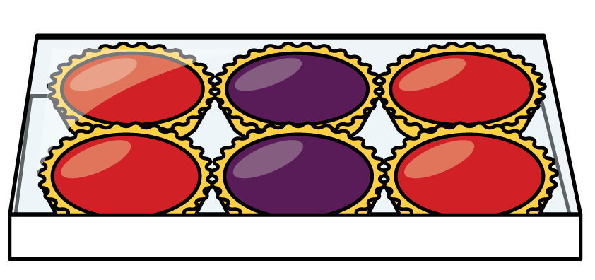
How many tarts?
3
3
2 2 2

Slide 12
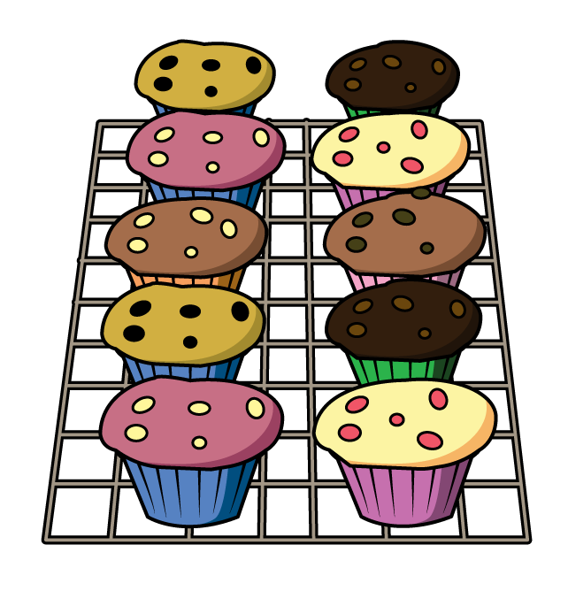
How many cakes?
2
2
2
2
2
5 5

Slide 13

What is an array?
6 columns
2 rows
6 $+$ 6 $=$ 12
2 $×$ 6 $=$12
2 $+$ 2 $+$ 2 $+$ 2 $+$ 2 $+$ 2 $=$ 12
6 $×$ 2 $=$12

Slide 14

Have a think
4 $+$ 4 $=$ 8
2 $×$ 4 $=$8
2 $+$ 2 $+$ 2 $+$ 2 $=$ 8
4 $×$ 2 $=$ 8

Slide 15

Have a think
You can’t make an array because 9 is an odd number
3 $+$ 3 $+$ 3 $=$ 9
3 $×$ 3 $=\text{9}$

Slide 16
Have a go at questions
1 - 4 on the worksheet

Slide 17

Draw an array to represent 5 $×$ 3
Have a think

Slide 18
How many different arrays can you build with 16 counters?
1 $×$ 16 16$×$ 1
4$×$ 4
2 $×$ 8 8 $×$ 2
Have a think

Slide 19
16$×$ 1
halve
double
8 $×$ 2
halve
double
4$×$ 4

Slide 20




What do you see?
Have a think
I see 6 $×$ 2
I see 2 $×$ 6
I see one 12 and twelve 1s
I see 3 $×$ 4
and 4 $×$ 3

